Slide 1
Chapter Six
Bond Markets
©2019 McGraw-Hill Education. All rights reserved. Authorized only for instructor use in the classroom. No reproduction or further distribution permitted without the prior written consent of McGraw-Hill Education.

Slide 2
Bond Markets
Capital markets are markets for equity and debt instruments with original issue maturities of more than one year.
Bonds are long-term debt obligations issued by corporations and government units.
Bond markets are markets in which bonds are issued and traded.
  Treasury notes (T-notes) and bonds (T-bonds).
  Municipal bonds.
  Corporate bonds.

Slide 3
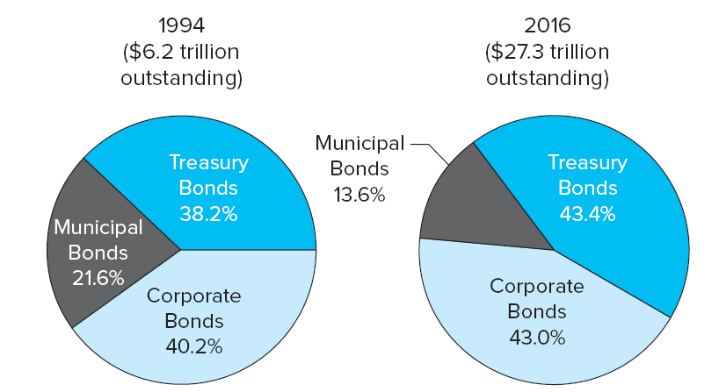
Bond Market Instruments Outstanding, 1994 - 2016
Figure 6–1 Bond Market Instruments Outstanding, 1994–2016
Sources: Federal Reserve Board website, “Flow of Funds Accounts,” various issues. www.federalreserve.gov
Access the long description slide.

Slide 4
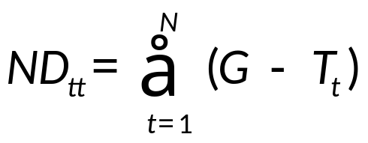
Treasury Notes and Bonds 1
Treasury notes and bonds (T-notes and T-bonds) are issued by the U.S. Treasury to finance the national debt and other government expenditures.
The annual federal deficit is equal to annual expenditures (G) less taxes (T) received.
The national debt (ND) is the sum of historical annual federal deficits:

Slide 5
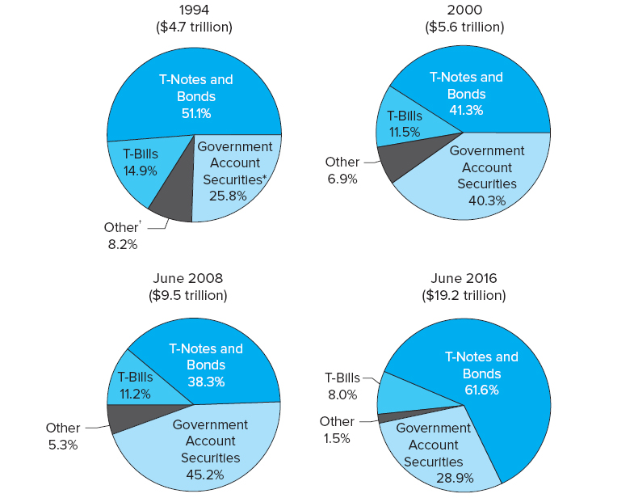
Composition of the U.S. National Debt
Figure 6–2 Composition of the U.S. National Debt
*Includes securities held by government trust funds, revolving funds, and special funds such as Social Security and government pension funds.
†Includes U.S. savings securities, dollar-denominated foreign government securities issued by the U.S. Treasury directly to foreign governments, and other.
Sources: U.S. Treasury Department, Treasury Bulletin, various issues. www.ustreas.gov
Access the long description slide.

Slide 6
Treasury Notes and Bonds 2
Default risk free: backed by the full faith and credit of the U.S. government.
Low returns: low interest rates (yields to maturity) reflect low default risk.
Interest rate risk: because of their long maturity, T-notes and T-bonds experience wider price fluctuations than money market securities when interest rates change.
Liquidity risk: older issued T-bonds and T-notes trade less frequently than newly issued T-bonds and T-notes.
Notes:
Newly issued Treasuries are called ‘on the run’ and older Treasuries are called ‘off the run.’

Slide 7
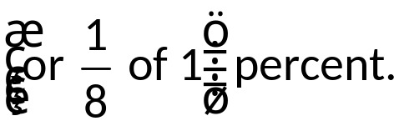
Treasury Notes and Bonds 3
T-notes have original maturities from over 1 to 10 years.
T-bonds have original maturities from over 10 years.
Issued in minimum denominations (multiples) of $100.
May be either fixed principal or inflation-indexed.
  Principal value used to determine the coupon on inflation-indexed bonds is adjusted to reflect inflation (measured by the CPI).
    In other words, the semiannual coupon payments and the final principal payment of inflation-indexed bonds are based on the inflation-adjusted principal value of the security.
Trade in very active secondary markets.
Prices are quoted as percentages of face value, while coupon rates are set at intervals of 0.125

Slide 8
Sample Treasury Bond Quote 1
$1,000 par Treasury Bond
Maturity | Coupon | Bid | Asked | Chg | Asked Yld
11/15/2045 | 3.000 | 107.6563 | 107.6865 | 0.0938 | 2.624
Maturity mo/yr: Month and year, the bond matures November 15, 2045, but it may be callable before that time.
Coupon: Coupon rate of 3% or $30.00 per year but paid semiannually ($1,000 face).
Bid: The closing price per $100 of par the dealer will pay to buy the bond; the seller would receive this price from selling to the dealer. In this case, 107.6563% of $1,000 or $1,076.56.

Slide 9
Sample Treasury Bond Quote 2
Maturity | Coupon | Bid | Asked | Chg | Asked Yld
11/15/2045 | 3.000 | 107.6563 | 107.6865 | 0.0938 | 2.624
Asked: The closing price per $100 of par the dealer requires to sell the bond; the buyer would pay this price to the dealer. In this case, 107.6865% of $1,000 or $1,076.87.
Chg: The change from the prior closing Asked price. In this case, the Asked price increased 0.0938 from the prior quoted closing ask price.
Asked Yld = Promised compound yield rate if purchased at the Asked price. In this case, the yield is 2.624% .
Notes:
Note that the yield is the yield to call if the price is above par and the yield to maturity if below par. The yield calculation uses semiannual compounding.

Slide 10
Treasury STRIPS
Separate Trading of Registered Interest and Principal Securities (STRIPS), a.k.a. “Treasury zero bonds” or “Treasury zero-coupon bonds”.
  Treasury security in which the periodic interest payment is separated from the final principal payment, effectively creating two sets of securities – one set for each semiannual interest payment and one for the final principal payment.
Created by the U.S. Treasury in response to the separate trading of Treasury security principal and interest that had been developed by securities firms.
STRIPS may be used to immunize against interest rate risk.

Slide 11
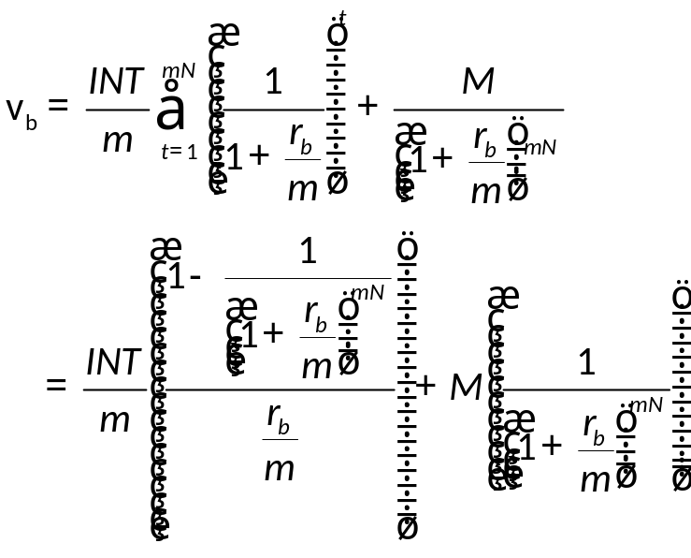
Treasury Note and Bond Yields
Prices quoted in the financial press (i.e., “clean prices”) are calculated as:
    V_{b} = the present value of the bond
    M = the par (i.e., face) value of the bond
    INT = annual interest payment = par value * coupon rate
    N = the number of years until the bond matures
    m = the number of times per year interest is paid
    r_{b} = interest rate used to discount cash flows on the bond

Slide 12
Accrued Interest 1
Accrued interest must be paid by the buyer of a bond to the seller of a bond if the bond is purchased between interest payment dates.
  It is the portion of the coupon payment accrued between the last coupon payment and the settlement day .
The price of the T-bond or T-note with accrued interest is called the full price or the dirty price, while the price without accounting for accrued interest is the clean price.

Slide 13
Accrued Interest 2
Accrued interest on T-notes and T-bonds is calculated as:
The full (or dirty) price of a T-note or T-bond is the sum of the clean price (Vb) and the accrued interest.

Slide 14
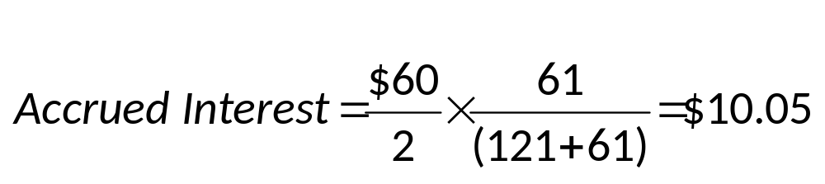
Accrued Interest Example
You buy a 6% coupon $1,000 par T-bond 59 days after the last coupon payment. Settlement occurs in two days. You become the owner 61 days after the last coupon payment (59+2), and there are 121 days remaining until the next coupon payment. The bond’s clean price quote is 120.59375. What is the full or dirty price (sometimes called the invoice price)?
The clean price is 120.59375% of $1,000 or $1,205.9375.
Thus, the dirty price is $1,205.9375 + $10.05 = $1,215.9875.
Notes:
Note: Treasuries use actual days, but munis and corporates use 30 day months and a 360 day year.

Slide 15
T-Note and Bond Markets 1
The primary market of T-notes and T-bonds is similar to that of T-bills; the U.S. Treasury sells T-notes and T-bonds through competitive and noncompetitive Treasury auctions.
  2-, 3-, 5-, and 7-year notes are auctioned monthly.
  10-year notes and 30-year bonds are auctioned quarterly (Feb, May, Aug, and Nov).
Most secondary trading occurs directly through brokers and dealers.

Slide 16

T-Note and Bond Markets 2
Competitive and non-competitive bidders.
Competitive bidders submit bid yields, highest bid accepted is call the ‘stop out yield’.
  All noncompetitive bidders and competitive bidders who bid less than the stop out receive their full allotment. Bidders at the stop out yield may receive a prorata share of their allotment.
  T-Note or Bond coupon rate is rounded down from stop yield to the nearest

Slide 17
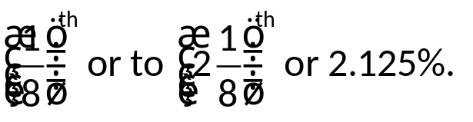
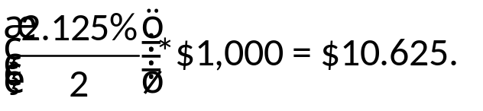
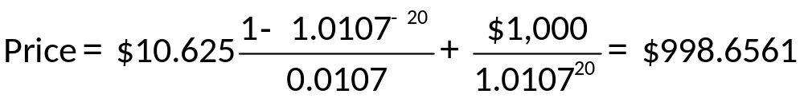
T-Note and Bond Markets Concluded
The stop out yield on a 10 year Treasury is 2.14%. What price would every successful bidder pay for a $1,000 par bond?
The annual coupon will be rounded down to the nearest
The semiannual coupon is
Thus:
All investors would pay a quoted price of 99.86561 per $100 of par.

Slide 18
Municipal Bonds 1
Municipal bonds are securities issued by state and local governments and are repaid using tax receipts or revenues generated from a project.
  to fund imbalances between expenditures and receipts.
  to finance long-term capital outlays.
Attractive to household investors because interest is exempt from federal and most local income taxes.
General obligation (G O) bonds are backed by the full faith and credit of the issuer.
Revenue bonds are sold to finance specific revenue-generating projects and are backed by the cash flows from that project.
Notes:
The majority of munis are Revenue Bonds.

Slide 19
Municipal Bonds 2
Compare municipal bond returns with fully taxable corporate bonds by finding the after tax return for corporate bonds:
i _{a} = i_{b}(1 – t)
  i _{a} = after-tax rate of return on a taxable corporate bond
  i_{b} = before-tax rate of return on a taxable bond
  t = marginal total income tax rate of the bond holder
Alternately, convert municipal interest rates to tax equivalent rates of return: i_{b} = i_{a}/(1 − t).

Slide 20
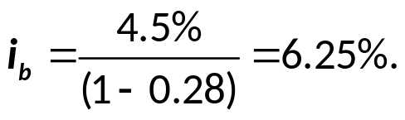
Municipal Bond Rates & Taxes
For a 28% tax bracket, what is the equivalent after tax rate of a 6% corporate yield?
i_{a} = 6%(1 − 0.28) = 4.32%.
For a 28% tax bracket, what corporate taxable yield is equivalent to a 4.5% municipal bond rate?

Slide 21
Municipal Bonds Concluded
Primary markets.
  Firm commitment underwriting: a public offering of municipals made through an investment bank, where the investment bank guarantees a price for the newly issued bonds by buying the entire issue and then reselling it to the public.
  Best efforts offering: a public offering in which the investment bank does not guarantee a firm price and acts more as a placing or distribution agent (for a fee).
  Private placement: bonds are sold on a semi-private basis to qualified investors (generally F I s).
Secondary markets: Municipals trade infrequently due mainly to a lack of information on bond issuers.

Slide 22
Corporate Bond Characteristics 1
Corporate bonds are long-term obligations issued by corporations.
  Minimum denomination on publicly traded corporate bonds is $1,000.
A bond indenture is the legal contract that specifies the rights and obligations of the bond issuer and the bond holders.
Bearer versus registered bonds.
Term versus serial bonds.
Mortgage bonds are secured debt issues.

Slide 23
Corporate Bond Characteristics 2
Debentures and subordinated debentures.
Convertible bonds versus nonconvertible bonds.
      r_{cvb =} r_{ncvb} − o p_{cvb}
    r_{cvb} = yield on a convertible bond
    r_{ncvb} = yield on a nonconvertible bond
    o p_{cvb} = value of the conversion option to the bond holder
Stock warrants give bond holders the opportunity to purchase common stock at a prespecified price.

Slide 24
Corporate Bond Characteristics Concluded
Callable bonds versus noncallable bonds.
      r_{ncb =} r_{cb} − o p_{cb}
  r_{ncb} = yield on a noncallable bond
  r_{cb} = yield on a callable bond
  o p_{cb} = value of the issuer’s option to call the debt early
A sinking fund provision is a requirement that the issuer retire a certain amount of the bond issue early over a number of years, especially as the bond approaches maturity.
Notes:
A call provision is an unattractive feature to bond holders, since the bond holder may be forced to return the bond to the issuer before he/she is ready to end the investment (and the investor can only reinvest the funds at a lower interest rate). For that reason, callable bonds have higher yields than comparable noncallable bonds.

Slide 25
The Trading Process for Corporate Bonds
Primary sales are identical to that of municipals (i.e., either occur through a public sale or a private placement).
Secondary markets.
  The exchange market (e.g., N Y S E Bonds).
  The over-the-counter (O T C) market.
Bond ratings
  The three major bond rating agencies are Moody’s, Standard & Poor’s (S&P), and Fitch Ratings.
  Bonds are rated by perceived default risk.
  Bonds may be either investment or speculative (i.e., junk) grade.
Notes:
The instructor may wish to mention that one of the unintended consequences of the so called Volcker Rule in the Dodd-Frank bill has been to make it more expensive for banks to hold bond inventories. As a result they have reduced their market making activity and reduced liquidity in the bond markets.

Slide 26
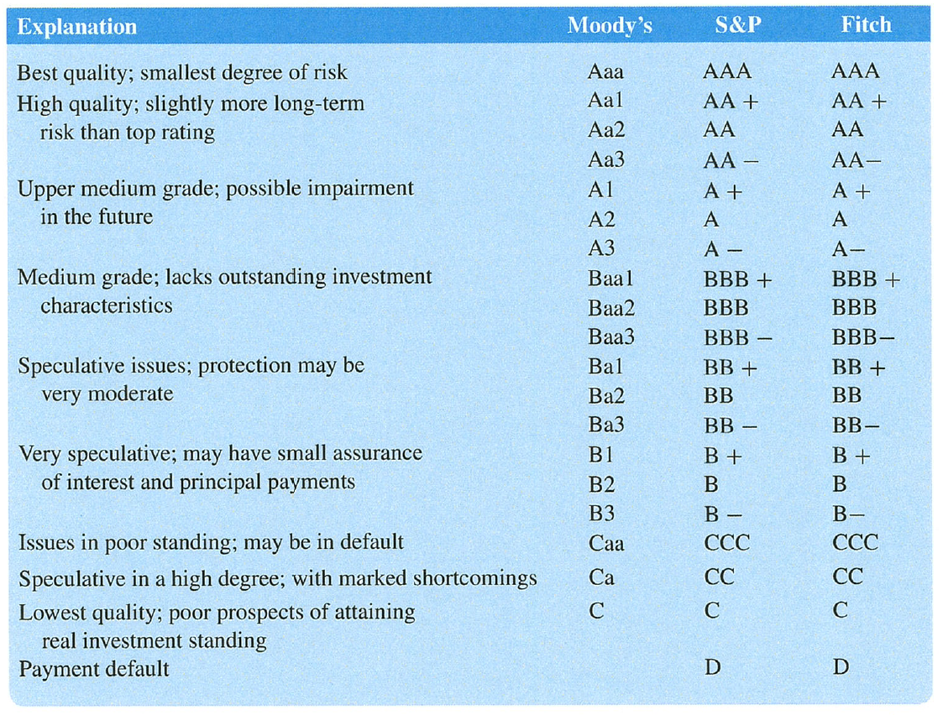
Bond Credit Ratings

Slide 27
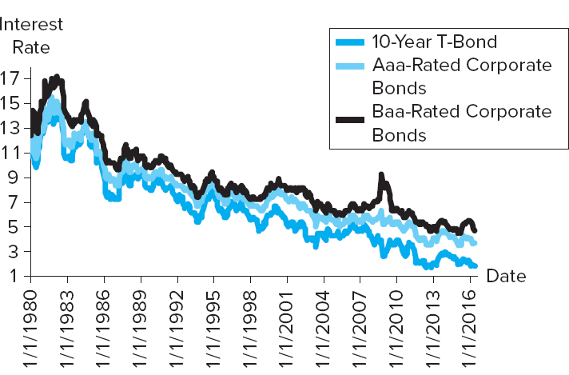
Rates on Treasury Bonds
Figure 6–9 Rates on Treasury Bonds, Aaa-Rated Bonds, and Baa-Rated Bonds
Source: Federal Reserve Board website, “Research and Data.” www.federalreserve.gov
Access the long description slide.

Slide 28
Corporate Bond Quote Example
Issuer Name | Symbol | Coupon | Maturity | Moody’s/S&P/ Fitch | High | Low | Last | Change | Yield %
Philip Morris Intl | PM3975964 | 2.625 % | 03/06/2023 | A2/A/A | 95.335 | 93.521 | 93.772 | 0.858 | 3.388
Issuer name, ticker symbol and coupon.
Maturity month and year.
Bond rating by the three major ratings agencies.
High, Low, and Last prices in decimal form as a percent of par.
  Daily high price was $953.35.
Change is the change from the prior day’s last price.
Yield % is the promised yield to maturity using the last price.

Slide 29
Bond Market Indexes
Managed by major investment banks.
  E.g., Barclays, Merrill Lynch.
Reflect both the monthly capital gain and loss on bonds plus any interest (coupon) income earned.
Changes in values of bond indexes can be used by bond traders to evaluate changes in the investment attractiveness of bonds of different types and maturities.

Slide 30
Bond Market Participants
The major issuers of debt market securities are federal, state and local governments, as well as corporations.
The major purchasers of capital market securities are households, businesses, government units, and foreign investors.
  Financial firms (e.g., banks, insurance companies, and mutual funds) are the major suppliers of funds for municipal and corporate bonds.
  Foreign investors and financial firms are the major suppliers of funds for Treasury securities (including T-bills, T-notes, and T-bonds).

Slide 31
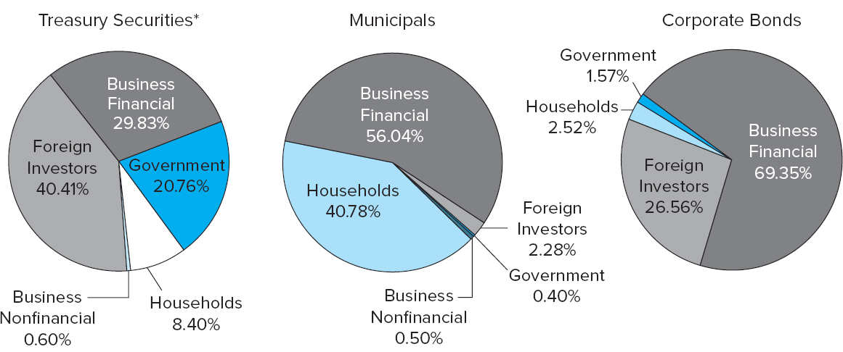
Bond Market Securities Held by Various Groups of Market Participants
Figure 6–10 Bond Market Securities Held by Various Groups of Market Participants, 2016
*Includes Treasury bills, notes, and bonds.
Source: Federal Reserve Board website, “Financial Accounts of the United States.” www.federalreserve.gov
Access the long description slide.

Slide 32
International Aspects of Bond Markets 1
Motivations for international bond investing.
  Potentially higher returns.
  Better diversification.
Additional complexities in international bond investing.
  Higher risk; political risks higher and potential for capital flight in lesser developed markets.
    Greek crisis in Europe is an example.
  Lower recourse in the event of non-repayment.
  Foreign exchange rate movements can significantly impact returns.
Notes:
A lender to a sovereign nation has very little recourse in the event of non-repayment except the threat of reputational loss and reduced access to future capital.

Slide 33
International Aspects of Bond Markets 2
International bond markets involve unregistered bonds that are internationally syndicated, offered simultaneously to investors in several countries, and issued outside of the jurisdiction of any single country.
Eurobonds are long-term bonds issued outside the country of the currency in which they are denominated.
  E.g., dollar-denominated bonds issued in Europe or Asia.
Foreign bonds are long-term bonds issued outside of the issuer’s home country and usually denominated in the currency of the country in which they are issued.
  E.g., Japanese company issues a dollar-denominated public bond rather than a yen-denominated bond in the U.S.
Sovereign bonds are government-issued debt.

Slide 34
International Debt Securities Issued, 1994 - 2015
TABLE 6–12 International Debt Securities Issued, 1994–2015 (in billions of U.S. dollars)
blank | 1994 | 1997 | 2000 | 2007 | 2009 | 2010 | 2012 | 2015
Total net issues | $253.6 | $519.9 | $1,138.2 | $3,002.5 | $2,329.2 | $1,506.7 | $704.9 | $887.8
Money market instruments | 3.3 | 19.6 | 122 | 198.7 | –237.5 | 12.1 | 20.3 | 48.8
Bonds and notes | 250.3 | 500.3 | 1,016.2 | 2,803.8 | 2,566.7 | 1,494.60 | 684.7 | 839
Developed countries | 205.5 | 389.1 | 1,065.6 | 2,784.5 | 2,072.50 | 1,187.1 | –37.8 | 494.8
Offshore centers | 7.2 | 14.9 | 16.1 | 24.5 | 21.5 | 13.8 | 62.9 | 23.4
Other countries | 32.5 | 115.9 | 56.5 | 193.5 | 235.1 | 305.8 | 679.8 | 369.6
International institutions | 8.5 | 35.1 | 22.4 | 38.1 | 1,330.50 | 93.2 | 287.4 | 95.2
Financial institutions | 136.1 | 346.5 | 622.3 | 2,592.60 | 322.7 | 583.5 | 85.7 | 500
Public sector | 103.1 | 68 | 221.5 | 88.2 | 101.9 | 260.3 | 38.8 | -21.4
Corporate issuers | 14.4 | 70.3 | 272 | 283.6 | 574.1 | 569.7 | 293 | 314
Sources: Bank for International Settlements, Quarterly Review, various issues. www.bis.org

Slide 35
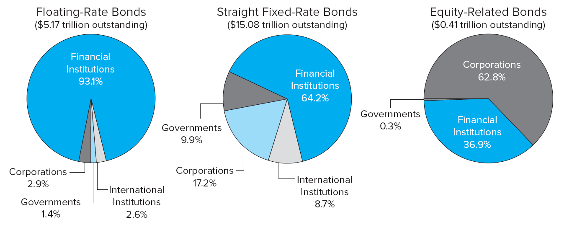
Distributions of International Bonds Outstanding by Type of Issuer, March 2016
Figure 6–12 Distribution of International Bonds Outstanding by Type of Issuer, March 2016
Source: Bank for International Settlements, Quarterly Review, June 2016. www.bis.org
Access the long description slide.

Slide 36
Bond Market Instruments Outstanding, 1994 – 2016 Long Description
The first pie chart shows that in 1994 there was $6.2 trillion outstanding, of which 38.2% was treasury bonds, 21.6% was municipal bonds, and 40.2% were corporate bonds. The second pie chart shows that in 2016 there was $27.3 trillion outstanding, of which 43.4% was treasury bonds, 43.0% were corporate bonds, and 13.6% were municipal bonds.
Return to slide containing original image.

Slide 37
Composition of the U.S. National Debt Long Description
In 1994 the U.S. national debt was $4.7 trillion, of which 51.5% was T-Notes and Bonds, 25.8% was government account securities, 14.9% was T-Bills, and 8.2% was other. In 2000, the U.S. national debt was $5.6 trillion, of which 42.3% was T-Notes and Bonds, 40.3% was government account securities, 11.5% was T-bills, and 6.9% was other. In June 2008 the U.S. national debt was $9.5 trillion, of which 38.3% was T-Notes and bonds, 45.2% was government account securities, 11.2% was T-bills, and 5.3% was other. In June 2016 the U.S. national debt was $19.2 trillion, of which 61.6% was T-Notes and bonds, 28.9% was government account securities, 8% was T-bills, and 1.5% was other.
Return to slide containing original image.

Slide 38
Bond Market Securities Held by Various Groups of Market Participants Long Description
Treasury securities are held 29.83% by business financial, 20.76% government, 8.40 Households, 40.41% foreign investors, and 0.60% business nonfinancial. Municipals are held 56.04% by business financial, 40.78% by households, 2.28% by foreign investors, 0.4% by government, and 0.5% by business nonfinancial. Corporate bonds are held 69.35% by business financial, 26.56% by foreign investors, 2.52% by households, and 1.57% by government.
Return to slide containing original image.

Slide 39
Rates on Treasury Bonds Long Description
The Baa-Rated corporate bond rates are the highest, followed by the Aaa-Rated Corporate bond rates, followed by the 10-year T-bond rates throughout this time period.
Return to slide containing original image.

Slide 40
Distributions of International Bonds Outstanding by Type of Issuer, March 2016 Long Description
For floating-rate bonds ($5.17 trillion outstanding), 93.1% were issued by financial institutions, 2.9% were issued by corporations, 1.4% were issued by governments, and 2.6% were issued by international institutions. For straight Fixed-rate bonds ($15.08 trillion outstanding), 64.2% were issued by financial institutions, 9.9% were issued by governments, 17.2% were issued by corporations, and 8.7% were issued by international institutions. For equity-related bonds ($0.41 trillion outstanding) 62.8% were issued by corporations, 36.9% were issued by financial institutions, and 0.3% were issued by governments.
Return to slide containing original image.

