Slide 1
Chapter Nine
Foreign Exchange Markets
©2019 McGraw-Hill Education. All rights reserved. Authorized only for instructor use in the classroom. No reproduction or further distribution permitted without the prior written consent of McGraw-Hill Education.

Slide 2
Overview of Foreign Exchange Markets 1
Today’s U.S.-based companies compete and operate globally.
Events and movements in foreign financial markets can affect the profitability and performance of U.S. firms.
  Firms with only U.S. operations still face foreign competition.
  For example, a U.S. resort competes with European resorts even though the U.S. firm has no foreign operations.
    If the dollar strengthens against the euro, the cost to come to the U.S. resort increases for Europeans and can reduce the number of foreign visitors at the U.S. resort.

Slide 3
Overview of Foreign Exchange Markets 2
Foreign trade is possible because of the ease with which foreign currencies can be exchanged,
  U.S. imported $3.7 trillion worth of goods in 2015.
  U.S. exported $3.3 trillion worth of goods in 2015.
If a country imports more than they export, the supply of that country’s currency in the foreign exchange markets will exceed demand for the country’s currency and the value of the currency will tend to fall, all else equal.

Slide 4
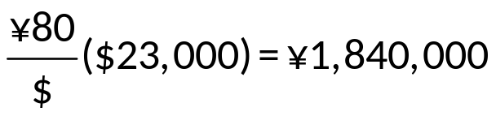
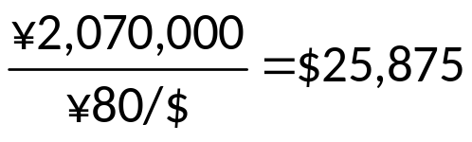
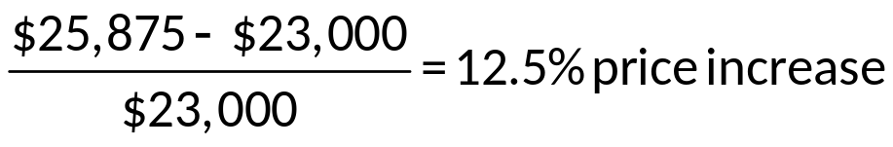
Foreign Exchange Markets Example
A weakening dollar can generate inflation in the U.S.
  Toyota sells Camrys in the U.S. for $23,000 when the exchange rate is 90¥ per dollar. Toyota receives ¥2,070,000 in revenue per car sold.
  If the dollar weakens and is worth only 80¥ per dollar, how many yen will Toyota receive per car sold?
What price would Toyota have to charge to receive the same amount of yen as before?

Slide 5
Overview of Foreign Exchange Markets Concluded
Internationally active firms often seek to hedge their foreign currency exposure
  By using derivatives such as swaps and futures.
  By borrowing money in the same currency in which they are earning revenues.
  By locating production facilities (and incurring local currency costs) where they are earning revenues.

Slide 6
Foreign Exchange 1
Foreign exchange markets are markets in which one currency is exchanged for another, either today (in the spot market) or at a set time in the future (in the forward market).
Foreign exchange markets facilitate:
  Foreign trade.
  Raising capital in foreign markets.
  The transfer of risk between market participants.
  Speculation in currency values.
A foreign exchange rate is the price at which one currency can be exchanged for another currency.

Slide 7
Foreign Exchange Market Trading
Table 9–2 Foreign Exchange Market Trading (in billions of U.S. dollars)
Blank | 1989 | 1992 | 1995 | 1998 | 2000 | 2004 | 2007 | 2010 | 2013 | 2016
Total trading | $590 | $820 | $1,190 | $1,490 | $1,200 | $1,880 | $3,210 | $3,971 | $5,345 | $5,088
Spot transactions | 317 | 394 | 494 | 568 | 387 | 621 | 1,005 | 1,488 | 2,046 | 1,654
Forward and other transactions | 273 | 426 | 696 | 922 | 813 | 1,259 | 2,205 | 2,483 | 3,299 | 3,434
Sources: Bank for International Settlements, Annual Report, various dates. www.bis.org

Slide 8
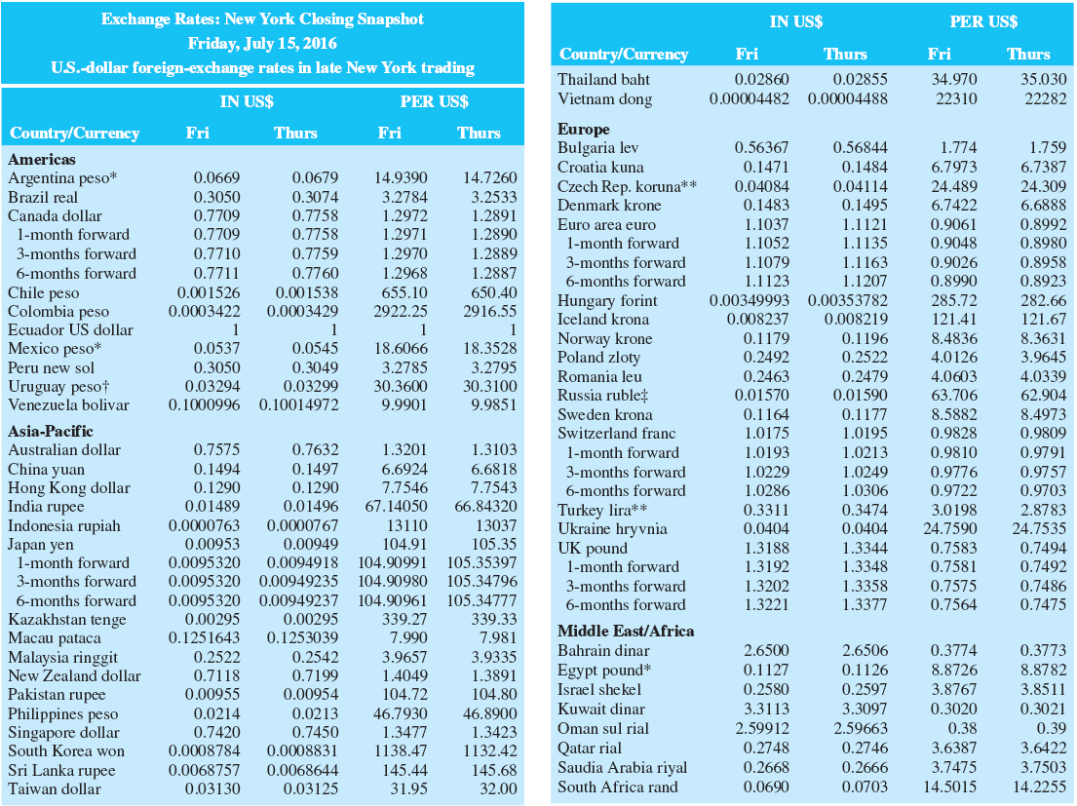
Foreign Currency Exchange Rates
Table 9–1 Foreign Currency Exchange Rates
*Floating rate. †Financial. ‡Russian Central Bank rate.
**Commercial rate. ††Special Drawing Rights (SDR); from the International Monetary Fund; based on exchange rates for U.S., British and Japanese currencies.
Note: Based on trading among banks of $1 million and more, as quoted at 4 P.M. ET by Thomson Reuters.
Source: The Wall Street Journal Online, July 18, 2016. www.wsj.com.

Slide 9
Top Currency Traders
Table 9–3 Top Currency Traders by Percentage of Overall Volume
Rank | Name | Market Share
1 | Citigroup | 12.91%
2 | J.P. Morgan Chase | 8.77
3 | UBS | 8.76
4 | Deutsche Bank | 7.86
5 | Bank of America Merrill Lynch | 6.40
6 | Barclays Capital | 5.67
7 | Goldman Sachs | 4.65
8 | HSBC | 4.56
9 | XTX Markets | 3.87
10 | Morgan Stanley | 3.19

Slide 10
Foreign Exchange 2
Foreign exchange risk is the risk that cash flows will vary as the actual amount of U.S. dollars received on a foreign investment changes due to a change in foreign exchange rates.
Currency depreciation occurs when a country’s currency falls in value relative to other currencies.
  Domestic goods become cheaper for foreign buyers.
  Foreign goods become more expensive for foreign sellers.
Currency appreciation occurs when a country’s currency rises in value relative to other currencies.

Slide 11
Foreign Exchange Concluded
Foreign exchange markets operated under the gold standard through most of the 1800s.
  U.K. was the dominant international trading country until WWII forced it to deplete its gold reserves to purchase arms and munitions from the U.S.
19 44: Bretton Woods Agreement fixed exchange rates within 1% bands.
19 71: Smithsonian Agreement increased bands to 2 ¼%.
19 73: Smithsonian Agreement II introduced “managed” free float.

Slide 12
FX Market
Foreign exchange markets are the largest of all financial markets with turnover exceeding $4.8 trillion per day in 2015.
London continues to be the largest center for trading in foreign exchange.
  Over 37% of worldwide trading.
New York is the second-largest market.
  Over 19% of all trading.
Singapore is the third-largest.
  Handles about 1/7th the volume of London.

Slide 13
FX Rates
Foreign exchange rates may be listed two ways:
  U.S. dollars received per unit of foreign currency (in US$).
  Foreign currency received for each U.S. dollar (per US$).
Foreign exchange can involve both spot and forward transactions:
  Spot foreign exchange transactions involve the immediate exchange of currencies at current exchange rates.
  Forward foreign exchange transactions involve the exchange of currencies at a specified exchange rate at a specific date in the future.

Slide 14
Exchanges
Organized derivatives markets have existed since 19 72.
  International Money Market (IMM) (a subsidiary of the Chicago Mercantile Exchange Group (CMEG)) is based in Chicago.
  Derivative trading in foreign currency futures and options.
In 19 82, the Philadelphia Stock Exchange (PHLX) became the first exchange to offer around-the-clock trading of currency options.

Slide 15
The European Currency (€)
The European Community (EC) was formed in 19 67 by consolidating three smaller communities
  European Coal and Steel Community.
  European Economic Market.
  European Atomic Energy Community.
The Maastricht Treaty of 19 93 set the stage for the eventual creation of the Euro
The Euro (€), the currency of the European Union (EU), began trading on January 1, 19 99 when twelve European countries fixed their currencies’ exchange ratios
Euro notes and coins began circulating on January 1, 2002

Slide 16
The Euro (€)
The U.S. dollar depreciated against the euro in the mid-2000s, but generally strengthened during the European sovereign debt crisis.
  Interest rate differentials play a large role in euro/$ exchange rate movements, except during European sovereign debt crisis.
The Central Bank of Russia has replaced some of its U.S. dollar reserves with euros, as has the Chinese Central Bank.
In 2016, 43.8% of foreign exchange transactions were denominated in dollars, compared to 15.6% denominated in euros.

Slide 17
The Yuan
In the early 2000s, the international community pressured China to allow its currency (the yuan) to float freely instead of pegging it to the U.S. dollar:
  Chinese exports were relatively cheap, which hurt domestic manufacturing in other countries, especially the U.S.
    The yuan was mostly pegged to either the euro or the dollar from 2009 to 2005, and during the crisis from 2008 to 2010.
    2009 – Hong Kong was allowed to begin trading the yuan offshore.
    January 2011 – Chinese based companies were allowed to use the yuan off the mainland and America was allowed to begin yuan trading.
    October 2011 – foreign companies can settle direct investment accounts on the mainland in yuan.
    February 2013 - the CME Group initiated trading in yuan (or renminbi) futures.
    November 2015 – the IMF designated the Chinese yuan an IMF-accepted reserve currency, along with the US dollar, Japanese Yen, British Pound Sterling, and euro in the Special Drawing Right (SDR) basket.

Slide 18
The Dollar during the Financial Crisis
From September 2008 to March 2009, the dollar increased in value against the major currencies as investors sought out safety in U.S. Treasury investments.
From March 2009 to November 2009, the dollar began to fall as investors again sought out higher yields as fears of economic collapse subsided.
Varied since (based on the amount of fears of investors), but generally trending upward with continuing problems in Europe, even with U.S. credit rating downgrade.

Slide 19
Foreign Exchange Risk 1
The risk involved with a spot foreign exchange transaction is that the value of the foreign currency may change relative to the U.S. dollar.
Foreign exchange risk can come from holding foreign assets and/or liabilities.
Suppose a firm makes an investment in a foreign country:
  Convert domestic currency to foreign currency at spot rates.
  Invest in foreign country security.
  Repatriate foreign investment and investment earnings at prevailing spot rates in the future.

Slide 20
Foreign Exchange Risk 2
Firms can hedge their foreign exchange exposure either on or off the balance sheet.
On-balance-sheet hedging involves matching foreign assets and liabilities.
  As foreign exchange rates move, any decreases in foreign asset values are offset by decreases in foreign liability values (and vice versa).
Off-balance-sheet hedging involves the use of forward contracts or other derivative securities.
  Forward contracts are entered into (at t = 0) that specify exchange rates to be used in the future (That is., no matter what the prevailing spot exchange rates are at t = 1).

Slide 21
Foreign Exchange Exposure 1
A financial institution’s overall net foreign exchange exposure in any given currency is measured as,
Net exposure_{i} = (FX assets_{i} − FX liabilities_{i}) + (FX bought_{i} − FX sold_{i})
= Net foreign assets_{i} + Net FX bought_{i}
= Net position_{i}
where
i = ith country’s currency
A net long (short) position is a position of holding more (fewer) assets than liabilities in a given currency.

Slide 22
Foreign Exchange Exposure 2
Table 9–4 Liabilities to and Claims on Foreigners Reported by Banks in the United States, Payable in Foreign Currencies (millions of dollars, end of period)
Item | 1993 | 1996 | 1999 | 2002 | 2004 | 2007 | 2010 | 2013 | 2016†
Banks’ liabilities | $78,259 | $103,383 | $88,537 | $80,543 | $ 68,189 | $279,559 | $167,408 | $316,811 | $232,186
Banks’ claims (assets) | 62,017 | 66,018 | 67,365 | 71,724 | 129,544 | 170,113 | 341,739 | 491,083 | 451,400
Claims of banks’ domestic customers* | 12,854 | 10,978 | 20,826 | 35,923 | 32,056 | 74,693 | 82,123 | 75,608 | 74,398
Note: Data on claims exclude foreign currencies held by U.S. monetary authorities.
*Assets owned by customers of the reporting bank located in the United States that represents claims on foreigners held by reporting banks for the accounts of the domestic customers.
†As of March.
Sources: Treasury Bulletin, various issues. www.ustreas.gov

Slide 23
Trading Activities
A financial institution’s position in foreign exchange markets generally reflects four trading activities:
  Purchase and sale of foreign currencies for customers’ international trade transactions.
  Purchase and sale of foreign currencies for customers’ investments.
  Purchase and sale of foreign currencies for hedging purposes.
  Purchase and sale of foreign currencies for speculation (That is., profiting through forecasting foreign exchange rates).

Slide 24
Purchasing Power Parity (PPP) 1
Purchasing power parity (PPP) is the theory explaining the change in foreign currency exchange rates as inflation rates in the countries change
i _{U S} = IP _{U S} + RFR _{U S}
i _{U S} − i _{S} = IP _{U S} − IP _{S}
i_{U S} = Interest rate in the United States
i_{S} = Interest rate in Switzerland (or another foreign country)
I P_{U S} = Inflation rate in the United States
I P_{S} = Inflation rate in Switzerland (or another foreign country)
RFR_{U S} = Real risk-free rate in the United States
RFR_{S} = Real risk-free rate in Switzerland (or another foreign country)

Slide 25
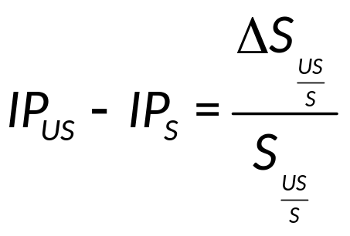
Purchasing Power Parity (PPP) 2
Assuming real rates of interest (or rates of time preference) are equal across countries:
RFR _{U S} = RFR _{S}
Then, the following is true: i _{U S} − i _{S} = IP _{U S} − IP _{S}
The PPP theorem says the change in the exchange rate between two countries” currencies is proportional to the difference in the inflation rates in the two countries:

Slide 26
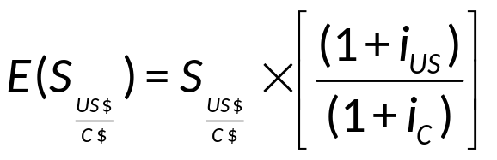
International Fisher Effect (IFE)
The IFE states that the expected spot rate is the current spot rate multiplied by the ratio of the foreign nominal interest rate to the domestic nominal interest rate
Implication
  The country with the higher (lower) nominal interest rate will tend to see its currency depreciate (appreciate)
Notes:
This is simply the uncovered version of the interest rate parity theorem. To exploit deviations from this equation is a risky arbitrage so it may not hold as well as the standard interest rate parity which uses the forward rate.

Slide 27
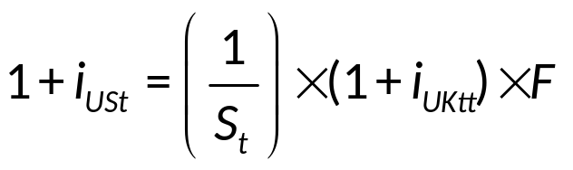
Interest Rate Parity
The interest rate parity theorem (IRPT) is the theory that the domestic interest rate should be equal to the foreign interest rate minus the expected appreciation of the domestic currency
For example, using the British pound and the dollar:
  i_{USt} = the interest rate on a U.S. investment maturing at time t
  i_{UKt} = the interest rate on a U.K. investment maturing at time t
  S_{t} = $/£ spot exchange rate at time t
  F_{t} = $/£ forward exchange rate at time t

Slide 28
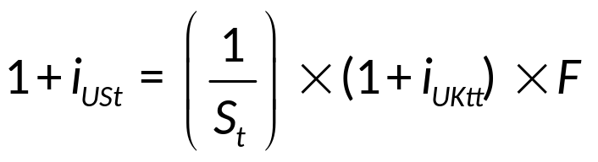
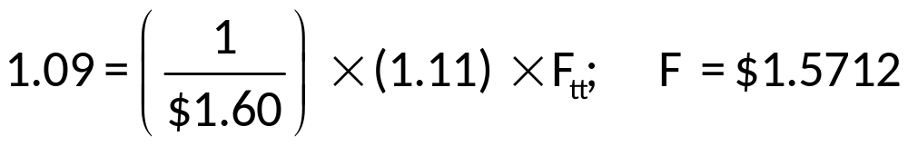
Interest Rate Parity Example 1
Suppose U.S. interest rates are 9%, British interest rates are 11%, and the current spot rate is £1 = $1.60. According to interest rate parity, what is the equilibrium forward rate?
  i_{USt} = the interest rate on a U.S. investment maturing at time t
  i_{UKt} = the interest rate on a U.K. investment maturing at time t
  S_{t} = $/£ spot exchange rate at time t
  F_{t} = $/£ forward exchange rate at time t

Slide 29
Interest Rate Parity Example 2
Suppose U.S. interest rates are 9%, British interest rates are 11%, and the current spot rate is £1 = $1.60. How could one take advantage of this if the forward rate is actually $1.55?
Investors would borrow pounds at 11% in the U.K., owing £1.11 pounds at year-end per pound borrowed.
Sell the pounds spot for $1.60/£ and invest in the U.S. giving $1.60 × 1.09 = $1.744.
Buy the £1.11 pounds owed at the forward rate of $1.55 a pound for a dollar cost of £1.11 × ($1.55/£) = $1.7205.
The net gain is $1.744 − $1.7205 = $0.0235 per pound borrowed.
Notes:
This works because the difference in interest rates is 2% and the percent change in the currency value is a 3.125% drop in value of the pound. So we borrow at the higher rate and invest in the lower, losing 2% but we more than make it up by borrowing in a currency that is weakening by 3.125%.
Stress that this is riskless arbitrage that does not involve your own money so it is a money machine. Note we have ignored risk and tax differences in the investments and transaction costs.
Banks set the forward rates based on interest rate differentials.

Slide 30
Balance of Payments Accounts
Balance of payments accounts summarize all transactions between citizens of two countries
  Current accounts summarize foreign trade in goods and services, net investment income, and gifts, grants, or aid given to other countries.
  Capital accounts summarize capital flows into and out of a country.
  Financial accounts record transfers of financial capital and nonfinancial capital.
    Accounts are further divided into sub-accounts: U.S.-owned assets abroad are divided into official reserve assets, government assets, and private assets.

