Slide 1
Chapter Ten
Derivative Securities Markets
©2019 McGraw-Hill Education. All rights reserved. Authorized only for instructor use in the classroom. No reproduction or further distribution permitted without the prior written consent of McGraw-Hill Education.

Slide 2
Derivatives
A derivative is a financial security whose payoff is linked to another, previously issued security.
  Derivatives involve the buying and selling, or transference, of risk.
In many derivatives, two parties agree to exchange a standard quantity of an asset at a predetermined price at a specific date in the future.
In theory, derivative trading should not adversely affect the economic system because it allows individuals who want to bear risk to take more risk, while allowing individuals who want to avoid risk to transfer that risk elsewhere.
Notes:
In 2003, Alan Greenspan (former Fed Reserve Board Chairman) credited the derivative securities markets with helping the banking system maintain its strength through the economic recession in the early 2000s.

Slide 3
Derivatives’ Uses
Derivatives are leveraged instruments where participants put up a small amount of money and obtain the gain or loss on a much larger position.
Derivatives are used for speculation and for hedging.
  Speculation:
    Buying or selling a derivative contract in order to earn a leveraged rate of return.
  Hedging:
    Entering into a derivatives contract to reduce the risk associated with positions or commitments in their line of business.

Slide 4
Derivatives Markets
The first wave of modern derivatives were foreign currency futures.
  In response to the introduction of floating exchange rates between currencies of different countries (result of the Smithsonian Agreements of 19 71 and 19 73).
The second wave of modern derivatives were interest rate derivative securities.
  In response to increases in the volatility of interest rates in the late 19 70s and after, as the Federal Reserve started to target nonborrowed reserves rather than interest rates.
The third wave of modern derivatives occurred in the 19 90s and 2000s with credit derivatives.
  Example: credit forwards, credit risk options, and credit swaps.

Slide 5
Forwards and Futures 1
A spot contract is an agreement to transact involving the immediate exchange of assets and funds.
A forward contract is an agreement to transact involving the future exchange of a set amount of assets at a set price.
Forward contracts:
  Can be based on a specified interest rate (Example: LIBOR) rather than a specified asset.
  Involve underlying assets that are nonstandardized, because the terms to each contract are negotiated individually between the buyer and seller.

Slide 6
Forwards and Futures 2
A futures contract is an agreement to transact involving the future exchange of a set amount of assets for a price that is settled daily.
Futures contracts begin underline differ end underline from forwards in that futures:
  are characterized by significantly less default risk.
  employ margin requirements and daily marking to market.
    margin requirement is a performance bond posted by a buyer and a seller of a futures contract.

Slide 7
Futures Markets 1
Futures contract trading occurs in trading “pits” using an open-outcry auction among exchange members.
  Floor brokers place trades for the public.
  Professional traders trade for their own accounts.
  Position traders take a position in the futures market based on their expectations about the future direction of the prices of the underlying assets, and trade for their own account.
  Day traders take a position within a day and liquidate it before day’s end.
  Scalpers take positions for very short periods of time, sometimes only minutes, in an attempt to profit from active trading.

Slide 8
Futures Markets 2
Price volatility and trading interest determines which contracts are offered.
Profit pressures for derivatives exchanges to merge.
  CME Group contains CME Globex, CBOT, NYMEX, and COMEX.
Electronic trading is becoming more popular for derivative trading.
  Example: Eurex, the world’s largest derivatives exchange, launched a fully electronic exchange in the U.S. in 2004.

Slide 9
Futures Contract Terms
Underlying unit.
Deliverable grades.
Tick size.
Price quote.
Contract months.
Last trading day.
Last delivery day.
Delivery method.
Settlement.
Position limits.
Trading hours.
Ticker symbol.
Exchange rule.

Slide 10
Futures Contracts 1
A long position is the purchase of a futures contract.
A short position is the sale of a futures contract.
A clearinghouse is the unit that oversees trading on the exchange and guarantees all trades made by the exchange traders.
Open interest is the total number of the futures or option contracts outstanding at the beginning of the day.

Slide 11
Futures Contracts 2
An initial margin is a deposit required on futures trades to ensure that the terms of the contracts will be met.
  Amount of the margin varies according to the type of contract traded and the quantity of futures contracts traded.
  Minimum margin levels are set by each exchange.
The maintenance margin is the margin a futures trader must maintain once a futures position is taken.
  If losses occur such that margin account funds fall below the maintenance margin, the customer is required to deposit additional funds in the margin account to keep the position open.

Slide 12
Characteristics of Actively Traded Futures Contracts 1
Table 10–2 Characteristics of Actively Traded Futures Contracts
Type of Futures | Contract Size | Exchange* | Open Interest
Interest Rates | Blank | Blank | Blank
Treasury bonds | $100,000 | CBOT | 565,872
Treasury notes | $100,000 | CBOT | 2,803,617
Treasury notes—5 year | $100,000 | CBOT | 2,774,435
Treasury notes—2 year | $200,000 | CBOT | 1,096,652
Federal funds—30 days | $5,000,000 | CBOT | 798,818
Eurodollars | $1,000,000 | CME | 10,774,413
Currency
Japanese yen | ¥12,500,000 | CME | 159,811
Canadian dollar | C$100,000 | CME | 115,675
British pound | £62,500 | CME | 244,578

Slide 13
Characteristics of Actively Traded Futures Contracts 2
Type of Futures | Contract Size | Exchange* | Open Interest
Swiss franc | Sfr 125,000 | CME | 45,224
Australian dollar | A$ 100,000 | CME | 100,183
Euro FX | Euro 125,000 | CME | 367,157
Index
Mini DJIA | $5 times average | CBOT | 142,984
S&P 500 index | $250 times index | CME | 92,766
Mini S&P index | $50 times index | CME | 2,014,809
Mini Nasdaq 100 | $20 times index | CME | 287,132
Mini Russell 1000 | $100 times index | ICE-US | 940
Mini FTSE 100 index | £10 times index | ENXT | 51
*CBOT = Chicago Board of Trade; CME = Chicago Mercantile Exchange; ICE-U.S. = Intercontinental Exchange Futures U.S.; ENXT = Euronext.liffe.
Source: CME Group website, August 3, 2016. www.cmegroup.com

Slide 14
Marking to Market and Margin Requirements Example
An investor has a $1 million long position in T-bond futures. The investor’s broker requires a maintenance margin of 4%, or $40,000 ($1m × 0.04), which is the amount currently in the investor’s account.
Suppose the value of the futures contracts drops by $50,000 to $950,000. The investor will now be required to hold $38,000 ($950,000 × 0.04) in his account (or, he has a $2,000 surplus).
Further, because futures contracts are marked to market, the investor’s broker will make a margin call to the investor requiring him to immediately send a check for $50,000 − $2,000, or $48,000, leaving him with an account balance of $38,000 at his broker for the $950,000 T-bond futures position.

Slide 15
Options 1
An option is a contract that gives the holder the right, but not the obligation, to buy or sell an underlying asset at a prespecified price for a specified time period.
A call option is an option that gives the purchaser the right, but not the obligation, to buy the underlying security from the writer of the option at a prespecified price on or before a prespecified date.
A put option is an option that gives the purchaser the right, but not the obligation, to sell the underlying security to the writer of the option at a prespecified price on or before a prespecified date.

Slide 16
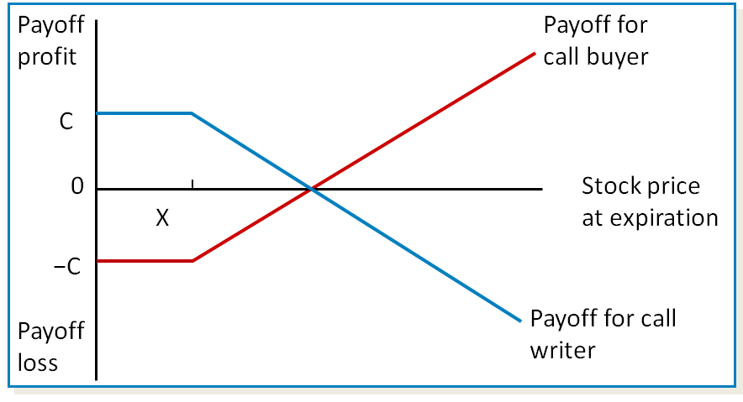
Profit Diagrams for Call Options
Access the long description slide.

Slide 17
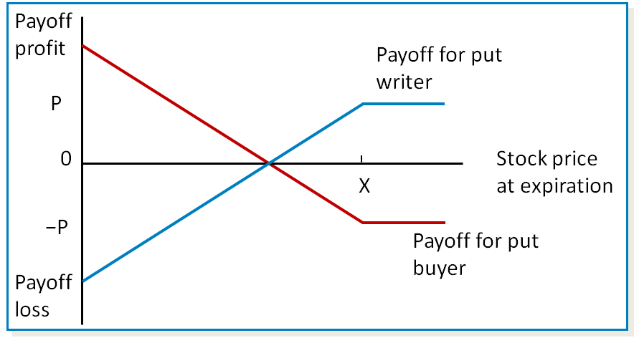
Profit Diagrams for Put Options
Access the long description slide.

Slide 18
Options 2
The Black-Scholes option pricing model (the model most commonly used to price and value options) is a function of:
  the spot price of the underlying asset.
  the exercise price on the option.
  the option’s exercise date.
  the price volatility of the underlying asset.
  the risk-free rate of interest.
The intrinsic value of an option is the difference between an option’s exercise price and the underlying asset price.
  the intrinsic value of a call option = max{S − X, 0}.
  the intrinsic value of a put option = max{X − S, 0}.

Slide 19
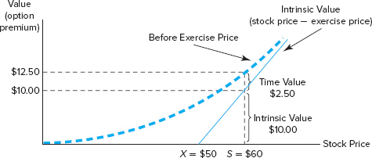
Option Intrinsic Value and Time Value
Figure 10–9 The Intrinsic Value versus the Before-Exercise Value of a Call Option
Access the long description slide.

Slide 20
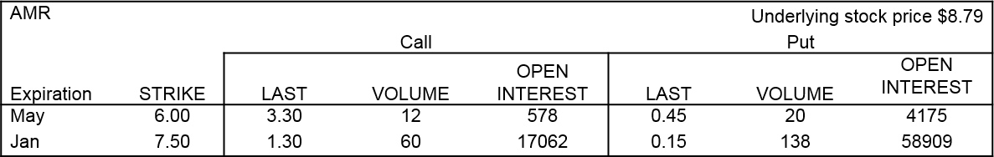
Option Price Quote Example
The May call is in the money (positive intrinsic value) and the call premium is $3.30 × 100 = $330 (contracts are for 100 shares).
The intrinsic value of the call (S-X) is ($8.79 − $6.00) × 100 = $279.
The time value of the call is $330 − $279 = $51.
The May put is out of the money and the put’s intrinsic value (X-S) is 0.
The put still has time value, however, equal to $0.45 × 100 = $45.
Access the long description slide.
Notes:
An investor would not exercise the May call because that would be throwing away the $51 time value.
Notice that the closer to the money option has much higher open interest.

Slide 21
Option Markets
The Chicago Board of Options Exchange (CBOE) opened in 19 73 as the first exchange devoted solely to the trading of stock options.
Options on futures contracts began trading in 19 82.
An American option can be exercised at any time before (and on) the expiration date.
A European option can be exercised only on the expiration date.
The trading process for options is similar to that for futures contracts.

Slide 22
Characteristics of Actively Traded Options 1
Table 10–5 Characteristics of Actively Traded Options
Type of Option | Exchange* | Contract Traded
Stock options | CBOE | Stock options
Blank | AM | Stock options
Blank | NASDAQ OMX PHLX | Stock options
Blank | NASDAQ OMX BX | Stock options
Blank | NY | Stock options
Stock index options | CBOE | Dow Jones Industrial Average
Blank | CBOE | Nasdaq 100
Blank | CBOE | Russell 2000
Blank | CBOE | S&P 100 Index
Blank | CBOE | S&P 500 Index
Blank | AM | S&P Midcap
Blank | NASDAQ OMX PHLX | Gold/Silver

Slide 23
Characteristics of Actively Traded Options 2
Type of Option | Exchange* | Contract Traded
Financial futures options: Interest rate | CBOT | T-bonds
Blank | CBOT | T-notes
Blank | CBOT | T-notes—5 year
Blank | CME | Eurodollar
Currency | CME | Japanese yen
Blank | CME | Canadian dollar
Blank | CME | British pound
Blank | CME | Swiss franc
Blank | CME | Euro FX
Stock index | CBOT | DJIA
Blank | CME | S&P 500 Index
*CBOE = Chicago Board Options Exchange; AM = American Exchange; NASDAQ OMX PHLX = Philadelphia Stock Exchange; NASDAQ OMX BX = Boston Stock Exchange; NY = NYSE Archipelago Exchange; CBOT = Chicago Board of Trade; CME = Chicago Mercantile Exchange.

Slide 24
Options Concluded
The underlying asset on a stock option is the stock of a publicly traded company.
The underlying asset on a stock index option is the value of a major stock market index (Example: DJIA or S&P 500).
The underlying asset on a futures option is a futures contract.
Credit spread call options.
  The value of a credit spread call option increases as the default (risk) premium or yield spread on a specified benchmark bond of the borrower increases above some exercise spread.
  A digital default option pays a stated amount in the event of a loan default.

Slide 25
Swaps 1
A swap is an agreement between two parties to exchange a series of cash flows for a specific period of time at a specified interval.
A plain vanilla interest rate swap is an exchange of fixed-interest payments for floating-interest payments by two counterparties.
  The swap buyer makes the fixed-rate payments in an interest rate swap transaction.
  The swap seller makes the floating-rate payments in an interest rate swap transaction.
  No principal is exchanged.

Slide 26
Swaps 2
A currency swap is a swap used to hedge against exchange rate risk from mismatched currencies on assets and liabilities.
  Usually associated with borrowing money.
  The exchanges can be at a fixed or a variable rate of interest as negotiated in the contract, but the exchanges occur at a known currency exchange rate.
  Used to hedge exchange rate risk from mismatched currencies of assets and liabilities.

Slide 27
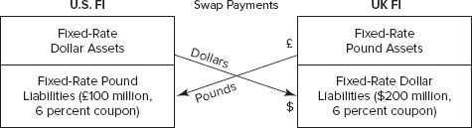
Fixed-Fixed Pound/Dollar Currency Swap
Access the long description slide.

Slide 28
Swaps Concluded
Credit default swaps (CDS) allow financial institutions to hedge credit risk.
  Total return swaps involve swapping an obligation to pay interest at a specified fixed or floating rate for payments representing the total return on a loan (interest and principal value changes) of a specified amount.
    Can be used to hedge credit exposure, but contain an element of interest rate risk as well as credit risk.
  In a pure credit swap, the financial institution lender will send (each swap period) a fixed fee or payment (like an insurance premium) to the counterparty, but if the FI lender’s loan or loans do not default, it receives nothing back from the counterparty.
    A pure credit swap is similar to buying credit insurance and/or a multiperiod credit option.

Slide 29
Swap Markets
Swaps are not standardized contracts.
Swap dealers (usually financial institutions) keep markets liquid by matching counterparties or by taking positions themselves.
Unlike futures and options markets, swap markets were historically governed by very little regulation.
The International Swaps and Derivatives Association (I S D A) is an association among 56 countries that sets codes of standards for swap documentation.

Slide 30
Caps, Floors, and Collars
Financial institutions use options on interest rates to hedge interest rate risk.
  A cap is a call option on interest rates, often with multiple exercise dates.
  A floor is a put option on interest rates, often with multiple exercise dates.
  A collar is a position taken simultaneously in a cap and a floor (usually buying a cap and selling a floor).

Slide 31
International Aspects of Derivative Securities Markets
Table 10–12 Derivative Financial Instruments Traded on Organized Exchanges (in billions of dollars)
Contract | 1999 | 2001 | 2004 | June 2008 | December 2008 | December 2010 | December 2013 | March 2016
Futures | Blank | Blank | Blank | Blank | Blank | Blank | Blank | Blank
All markets | $ 8,294.20 | $ 9,633.5 | $ 17,661.8 | $ 28,631.7 | $ 19,478.0 | $ 22,312.0 | $ 26,012.7 | $ 25,443
Interest rate | 7,913.90 | 9,234.0 | 17,024.8 | 26,892.1 | 18,732.3 | 21,013.4 | 24,577.4 | 25,213
Currency | 36.7 | 65.6 | 84.1 | 176.0 | 95.2 | 170.2 | 230.3 | 230
Equity index | 343.2 | 334.0 | 552.9 | 1,563.5 | 650.5 | 1,128.4 | 1,205.0 | n.a.
North America | 3,553.20 | 5,906.4 | 9,777.9 | 14,975.6 | 10,137.0 | 11,863.5 | 13,686.0 | 15,784
Europe | 2,379.20 | 2,444.5 | 5,533.8 | 9,430.5 | 6,506.3 | 6,345.3 | 8,860.2 | 7,083
Asia and Pacific | 2,149.80 | 1,202.0 | 2,200.7 | 3,581.7 | 2,466.5 | 3,168.6 | 2,432.3 | 1,762
Other markets | 211.9 | 80.4 | 149.4 | 643.9 | 368.1 | 934.7 | 1,033.8 | 814
Options | Blank | Blank | Blank | Blank | Blank | Blank | Blank | Blank
All markets | $ 5,258.70 | $14,083.7 | $ 31,330.3 | $ 55,655. | $ 38,237.3 | $ 45,634.6 | $ 33,796.2 | $ 47,564
Interest rate | 3,755.50 | 12,492.6 | 28,335.00 | 46,898.2 | 33,978.8 | 40,930.0 | 31,019.9 | 47,410
Currency | 22.4 | 27.4 | 37.2 | 190.8 | 129.3 | 144.2 | 113.9 | 153
Equity index | 1,480.80 | 1,563.7 | 2,958.1 | 8,566.1 | 4,129.1 | 4,560.4 | 2,662.4 | n.a.
North America | 3,377.10 | 10,292.2 | 18,119.7 | 27,838.7 | 19,533.4 | 24,353.4 | 11,557.1 | 35,621
Europe | 1,603.20 | 3,698.0 | 12,975.4 | 26,720.3 | 18,115.7 | 19,247.2 | 20,640.3 | 11,636
Asia and Pacific | 240.7 | 62.8 | 169.6 | 463.2 | 219.4 | 383.3 | 657.6 | 13
Other markets | 37.7 | 30.8 | 65.6 | 632.9 | 368.7 | 1,650.7 | 941.3 | 294
Sources: Bank for International Settlements, Quarterly Review, various dates. www.bis.org

Slide 32
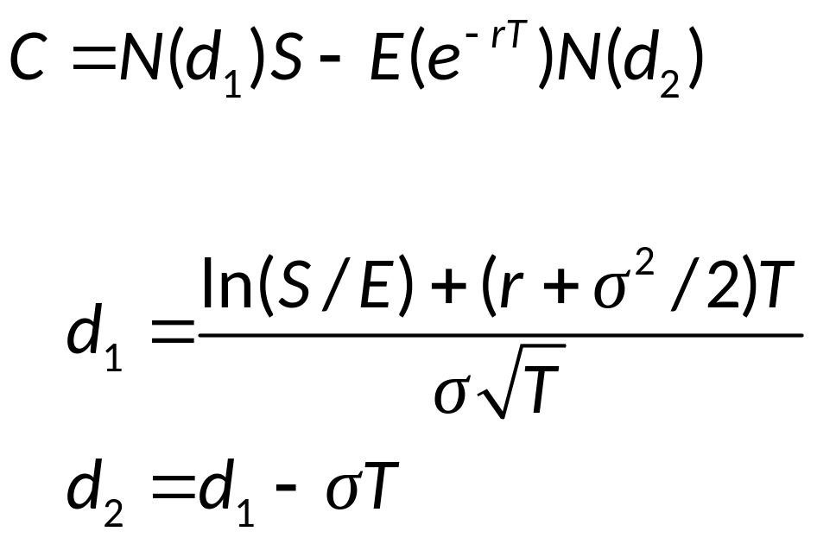
Black-Scholes Option Pricing Model

Slide 33
Profit Diagrams for Call Options Long Description
The horizontal axis is unitless and displays the stock price at expiration. The vertical axis is unitless and displays the profit payout or loss. The payoff for the call writer is positive and horizontal until a price of X, then decreases. The payoff for the call buyer is negative and horizontal until a price of X, then increases.
Return to slide containing original image.

Slide 34
Profit Diagrams for Put Options Long Description
The horizontal axis is unitless and displays the stock price at expiration. The vertical axis is unitless and displays the profit payout or loss. The payoff for the call writer is positive and decreases until a price of X, then remains horizontal and negative The payoff for the call buyer is negative and increases until a price of X, then remains horizontal and positive.
Return to slide containing original image.

Slide 35
Option Price Quote Example Long Description
The underlying stock price is $8.79. The expiration of May has a strike of 6.00. The expiration of January has a strike price of 7.50. The call information provides the last, volume, and open interest figures. The put information provides the same information.
Return to slide containing original image.

Slide 36
Option Intrinsic Value and Time Value Long Description
The horizontal axis displays the stock price and the vertical axis displays the value (option premium). A blue dashed line that increases in a concave up manner shows the before exercise price and a solid blue line with a positive slope passes through the point ($50, 0) and remains vertically lower than the exercise price. The intrinsic value is the difference between the stock price and the exercise price. The graph displays that at a stock price of $60 the intrinsic value is $10, the additional time value is $2.50, bringing the value to $12.50.
Return to slide containing original image.

Slide 37
Fixed-Fixed Pound/Dollar Currency Swap Long Description
The U.S. financial institution swaps a fixed-rate dollar asset of $200 million, 6% coupon for a fixed rate pound liability, 100 million pounds, 6% coupon.
Return to slide containing original image.

