Slide 1
Chapter Eleven
Commercial Banks: Industry Overview
©2019 McGraw-Hill Education. All rights reserved. Authorized only for instructor use in the classroom. No reproduction or further distribution permitted without the prior written consent of McGraw-Hill Education.

Slide 2
Commercial Banks 1
Commercial banks are the largest group of financial institutions in terms of total assets.
Major assets are loans.
Major liabilities are federally insured deposits—thus, they are considered depository institutions.
Perform services essential to U.S. financial markets.
  Play a key role in the transmission of monetary policy.
  Provide payment services.
  Provide maturity intermediation services.
Banks are regulated to protect against disruptions to the services they perform and to protect government insured deposits.

Slide 3
Commercial Bank Assets 1
Loans generate the most revenue for banks.
  Loans and investment securities continue to be the primary assets of the banking industry.
  Though business loans were the major asset on bank balance sheets between 19 65 and 19 87, they have dropped in importance since 19 87.
Investment securities generate revenue and provide banks with liquidity.
Cash assets are held to meet reserve requirements and to provide liquidity.
Other assets include premises and equipment, other real estate owned, etc.

Slide 4
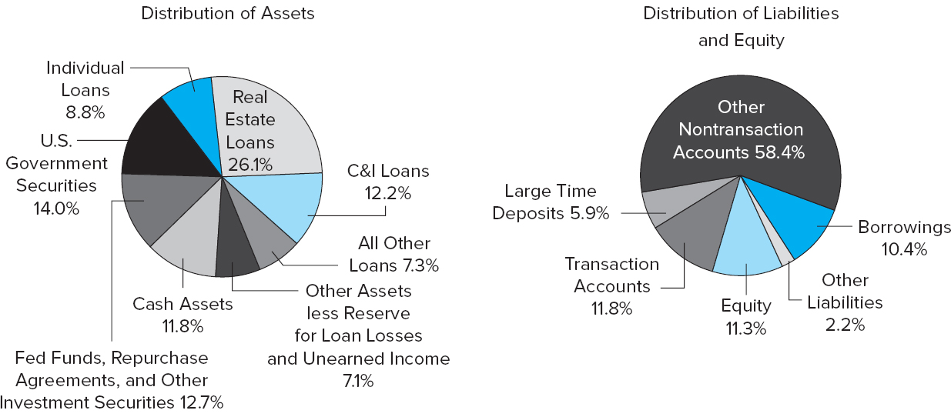
Commercial Bank Assets, Liabilities, and Equity, 2016
Figure 11-3 Distribution of Commercial Bank Assets, Liabilities, and Equity, 2016
Source: Federal Deposit Insurance Corporation, Quarterly Banking Profile, First Quarter 2016. www.fdic.gov
Access the long description slide.

Slide 5
Commercial Bank Assets 2
Commercial banks face unique risks because of their asset structure.
  Credit (default) risk is the risk that loans are not repaid.
  Liquidity risk is the risk that depositors will demand more cash than banks can immediately provide.
  Interest rate risk is the risk that interest rate changes erode profitability or net worth.
  Credit, liquidity, and interest rate risk all contribute to a commercial bank’s level of insolvency risk.

Slide 6
Commercial Bank Liabilities
Transaction accounts are the sum of noninterest-bearing demand deposits and interest-bearing checking accounts.
  Transaction accounts are about 15.5% of total deposits.
  Interest-bearing checking accounts are called negotiable order of withdrawal (NOW) accounts.
Household (retail) savings and time deposits have been declining in recent years because of competition from money market mutual funds (M M M F s).
  Passbook savings accounts.
  Retail time deposits.
Large time deposits.
  Negotiable C Ds are fixed-maturity interest-bearing deposits with face values of $100,000 or more that can be resold in the secondary market.

Slide 7
Commercial Bank Liabilities and Equity
Nondeposit liabilities.
  Fed funds purchased.
  Repurchase agreements.
  Notes and bonds.
Minimum levels of equity capital are required by regulators to act as a buffer against losses.
  Common and preferred stock.
  Surplus or additional paid-in capital.
  Retained earnings.

Slide 8
Off-Balance-Sheet Activities
Commercial banks engage in many fee-related activities that are conducted off the balance sheet.
  Guarantees such as letters of credit.
    Future commitments to lend.
  Derivative transactions.
    Example: futures, forwards, options, and swaps.
Off-balance-sheet (O B S) assets.
  When an event occurs, this item moves onto the asset side of the balance sheet or income is realized on the income statement.
Off-balance-sheet (O B S) liabilities.
  When an event occurs, this item moves onto the liability side of the balance sheet or an expense is realized on the income statement.

Slide 9
Commercial Banks 2
Number of banks have been decreasing over time.
  U.S. had 14,483 banks in 19 84.
  U.S. had 5,289 banks in 2016.
The Reigle-Neal Act of 19 94
  Made it easier for banks to open branches across state lines.
Financial Services Modernization Act of 19 99.
  Gave commercial banks the full authority to enter the investment banking (and insurance) business.
Industrial loan corporations (I L C s) are considered “non-bank” banks.
  Example: Walmart and Target both attempted to utilize I L C s, and Target’s application was approved.

Slide 10
Shadow Banking 1
Shadow banking.
  Activities of nonfinancial service firms that perform banking services.
How does it work?
  Savers place their funds with M M M F s and similar funds, which invest those funds in the liabilities of shadow banks. Borrowers get loans and leases from shadow banks rather than from traditional banks.
Shadow banks face significantly less regulation than traditional banks.

Slide 11
Shadow Banking 2
Retail banking is consumer-oriented.
  Residential and consumer loans are funded by accepting small deposits.
  Community banks specialize in retail banking.
Wholesale banking is commercial-oriented.
  Commercial and industrial loans are often funded with purchased funds.
  Regional or superregional banks engage in a complete array of wholesale banking activities.
  Money center banks rely heavily on nondeposit or borrowed sources of funds, often borrowed in the federal funds market.

Slide 12
Top Ten U.S. Banks by Asset Size, 2016
Table 11-3 Top 10 U.S. Banks Listed by Total Asset Size 2016 (in billions of dollars)
Bank | Banking Assets | Holding Company Assets
1. J.P. Morgan Chase | $2,015.8 | $2,466.1
2. Wells Fargo | 1,694.20 | 1,889.20
3. Bank of America | 1,676.70 | 2,189.80
4. Citigroup | 1,342.60 | 1,818.80
5. U.S. Bancorp | 423.2 | 438.5
6. Capital One | 370.7 | 339.2
7. P N C Financial | 350.6 | 361.5
8. Bank of New York Mellon | 301.9 | 372.4
9. TD Bank | 273.4 | 276.3
10. H S B C North America | 198.9 | 295.5
Source: Federal Reserve Board website, National Information Center. August 2016. www.federalreserve.gov

Slide 13
Treasury Notes and Bonds
Size has traditionally affected the types of activities and financial performance of commercial banks.
  Small banks typically focus on the retail side.
  Large banks usually engage in both retail and wholesale banking, often focusing on the wholesale side of the business.
Interest rate spread is the difference between lending and deposit rates.
Net interest margin is interest income minus interest expense divided by earning assets.
Return on assets is net income divided by assets.
Return on equity is net income divided equity.

Slide 14
Bank Size and Activities
Common differences between large and small banks.
  Larger banks generally lend to larger corporations, meaning their interest rate spreads and net interest margins have usually been narrower than those of smaller regional banks.
  Large banks tend to pay higher salaries and invest more in buildings and premises than small banks.
  Small banks usually hold fewer OBS assets and liabilities.
  Large banks tend to diversify their operations more and generate more noninterest income than small banks.
  Large banks tend to use more purchased funds and have fewer core deposits.
  Large banks tend to hold less equity than do small banks.

Slide 15
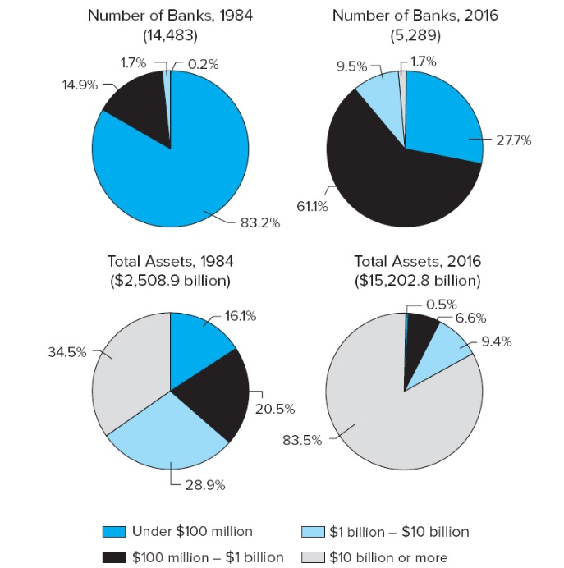
U.S. Bank Asset Concentration, 19 84 versus 2016
Figure 11-6 U.S. Bank Asset Concentration, 19 84 versus 2016
Sources: General Accounting Office, Interstate Banking, G A O/G G D, 95–35, December 19 94, p. 101; and F D I C Quarterly Banking Profile, First Quarter 2016. www.fdic.gov
Access the long description slide.

Slide 16
Industry Performance 1
U.S. commercial banks flourished during the economic expansion (and falling interest rates) of the 19 90s.
  Commercial bank earnings were a record $71.6 billion in 19 99.
The economic downturn of the early 2000s caused performance to deteriorate only slightly.
  Average R O A was 1.19% in 2000, down from 1.31% in 19 99.
By 2003, R O A and R O E had reached all-time highs.
In the fourth quarter of 2006, mortgage delinquencies (particularly subprime mortgages) surged.
Losses from falling values of subprime mortgages caused fourth quarter 2007 net income to hit a 16-year low.

Slide 17
Industry Performance 2
Performance deteriorated in the late 2000s during the strongest recession in the U.S. since the Great Depression.
  Less than half of all institutions reported increased earnings in 2007, the first time in 23 years that a majority of institutions had not posted full-year earnings increases.
R O A and R O E over time.
  In 2008, annual R O A was a poor 0.13%, and it fell again in 2009 to 0.09% before rising to 0.65% in 2010.
  Similarly, R O E was 1.33% in 2008, 0.85% in 2009, and 9.26% in 2015.

Slide 18
Industry Performance Concluded
Number of insured institutions on the F D I C’s “Problem List” declined from 203 to 183 during 2015, and there were only 8 bank failures.
Performance has deteriorated slightly in 2016 as R O A and R O E fell to 0.95% and 8.43%, respectively.
  Higher expenses for loan losses and lower noninterest income from trading and asset servicing.

Slide 19
Selected Indicators for U.S. Commercial Banks, 19 89 through 2016
Table 11-4 Selected Indicators for U.S. Commercial Banks, 19 89 through 2016
blank | 19 89 | 19 99 | 2001 | 2003 | 2006 | 2007 | 2008 | 2009 | 2010 | 2012 | 2013 | 2015 | 2016
Number of institutions | 12,709 | 8,580 | 8,079 | 7,769 | 7,450 | 7,283 | 7,086 | 6,839 | 6,530 | 6,096 | 5,876 | 5,338 | 5,289
Return on assets (%) | 0.49 | 1.31 | 1.15 | 1.40 | 1.33 | 0.93 | 0.13 | 0.09 | 0.65 | 1.00 | 1.07 | 1.04 | 0.95
Return on equity (%) | 7.71 | 15.31 | 13.09 | 15.34 | 13.02 | 9.12 | 1.33 | 0.85 | 5.86 | 8.92 | 9.60 | 9.26 | 8.43
Net interest margin (%) | 4.02 | 4.07 | 3.91 | 3.83 | 3.39 | 3.35 | 3.21 | 3.50 | 3.81 | 3.42 | 3.25 | 3.04 | 3.06
Noncurrent loans to total assets (%) | 2.30 | 0.63 | 0.92 | 0.77 | 0.51 | 0.87 | 1.84 | 3.36 | 3.12 | 2.18 | 1.62 | 0.94 | 0.94
Net charge-offs to loans (%) | 1.16 | 0.61 | 0.95 | 0.89 | 0.41 | 0.62 | 1.32 | 2.57 | 2.67 | 1.11 | 0.69 | 0.43 | 0.44
Asset growth rate (%) | 5.38 | 5.37 | 4.91 | 7.42 | 11.63 | 10.75 | 10.15 | −3.76 | 2.05 | 5.87 | 2.13 | 2.89 | 3.3
Net operating income growth (%) | −38.70 | 20.42 | −1.89 | 14.92 | 11.19 | -21.21 | −80.48 | −22.55 | 1,088.10 | 26.30 | 13.69 | 8.06 | −2.79
Number of failed/ assisted institutions | 206 | 7 | 3 | 3 | 0 | 2 | 20 | 120 | 139 | 41 | 23 | 8 | 1
*Through March.
Sources: F D I C, Quarterly Banking Profile, various dates. www.fdic.gov

Slide 20
Regulators
The Federal Deposit Insurance Corporation (F D I C) insures the deposits of commercial banks.
The U.S. has a dual banking system—banks can be either nationally or state-chartered.
  The Office of the Comptroller of the Currency (O C C) charters, closes, and examines national banks.
  State authorities charter and regulate state-chartered banks.
The Federal Reserve System (F R S) serves as the central bank of the U.S. and has regulatory power over nationally chartered banks, their holding companies and state banks that opt into the Federal Reserve System.
  A holding company is a parent company that owns a controlling interest in a subsidiary bank or other FI.

Slide 21
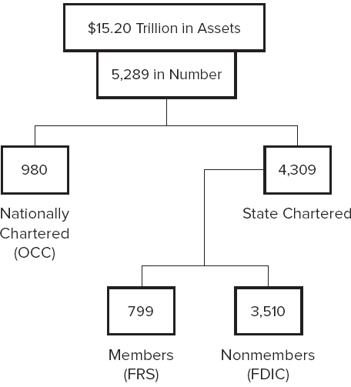
Bank Regulators
Figure 11-8 Bank Regulators
Source: F D I C, Statistics on Banking, First Quarter 2016. www.fdic.gov
Access the long description slide.

Slide 22
20 Largest Banks in the World by Total Assets
Table 11-5 The 20 Largest (in Total Assets) Banks in the World (in billions of dollars)
Bank | Country | Total Assets
1. Industrial Commercial Bank of China | China | $3,422
2. China Construction Bank Corp. | China | 2,827
3. Agricultural Bank of China | China | 2,741
4. Mitsibushi UJF Financial Group | Japan | 2,649
5. Bank of China | China | 2,591
6. HSBC Holdings | United Kingdom | 2,410
7. J.P. Morgan Chase | United States | 2,352
8. BNP Paribas | France | 2,168
9. Bank of America | United States | 2,147
10. Crédit Agricole | France | 1,847
11. Wells Fargo | United States | 1,788
12. Deutsche Bank | Germany | 1,771
13. Citigroup | United States | 1,731
14. Mizuho Financial Group | Japan | 1,718
15. Barclays Bank | United Kingdom | 1,672
16. Sumitomo Mitsui Financial | Japan | 1,657
17. Banco Santander | Spain | 1,457
18. Société Generale | France | 1,450
19. Groupe B P C E | France | 1,268
20. Royal Bank of Scotland | United Kingdom | 1,217
Source: Authors’ research.

Slide 23
Global Issues
Advantages of international expansion.
  Risk diversification.
  Economies of scale.
  Innovations.
  Funds source.
  Customer relationships.
  Regulatory avoidance.
Disadvantages of international expansion.
  Information/monitoring costs.
  Nationalization/expropriation.
  Fixed costs.

Slide 24
Global Banking Performance 1
The financial crisis of 2008-2009 spread worldwide and banks saw losses that were magnified by illiquid markets.
  The largest banks in the Netherlands, Switzerland, and the U.K. had net losses in 2008.
  Banks in Ireland, Spain, and the U.S. were especially hard hit because they had large investments in mortgages and mortgage-backed securities.
Many European banks averted outright bankruptcy thanks to direct support from their central banks and national governments.

Slide 25
Global Banking Performance 2
Greece suffered a severe debt crisis in the spring of 2010.
  Problems from the Greek banking system then spread to other European nations, such as Portugal, Spain and Italy.
  The situation stabilized after 2012, but a major debt payment was due from Greece to creditors on June 30, 2015.
    Deal was reached that required Greece to surrender to all of its creditors’ demands: tax increases, pension reform, and the creation of a fund (under European supervision) with state-owned assets earmarked to be privatized or liquidated.
European banking system was rocked again in June 2016 with “Brexit”.

Slide 26
Commercial Bank Assets, Liabilities, and Equity, 2016 Long Description
The distribution of assets were 26.1% real estate loans, 14% U.S. government securities, 12.7% fed funds, repurchase agreements, and other investment securities, 12.2% C&I loans, 8.8% individual loans, 7.3% all other loans, and 7.1% other assets less reserve for loan losses and unearned income.
The distribution of liabilities and equity consist of 58.4% other nontransaction accounts, 11.8% transaction accounts, 11.3% equity, 10.4% borrowings, 5.9% large time deposits, and 2.2% other liabilities.
Return to slide containing original image.

Slide 27
U.S. Bank Asset Concentration, 19 84 versus 2016 Long Description
In 1984 there were 14,483 banks, of which 83.2% were under 100 million, 14.9% were 100 million to 1 billion, 1.7a% were 1 billion to 10 billion, and 0.2% were 10 billion or more. In 1984, total assets were $2.5089 trillion, of which 16.1% was under 100 million, 20.5% was 100 million to 1 billion, 28.9% was 1 billion to 10 billion, and 34.5% was 10 billion or more. In 2016 there were 5,289 banks, of which 27.7% were under 100 million, 61.6% were 100 million to 1 billion, 9.5% were 1 billion to 10 billion, and 1.7% were 10 billion or more. In 2016 total assets were 15.2028 trillion, of which 0.5% was under 100 million, 6.6% was 100 million to 1 billion, 9.4% was 1 billion to 10 billion, and 83.5% was 10 billion or more.
Return to slide containing original image.
Access the long description slide.

Slide 28
Bank Regulators Long Description
There is $15.2 trillion in assets among 5,289 bank regulators. 980 of those are nationally chartered and 4,309 are state chartered. Of those that are state chartered, 799 are members (FRS) and 3,510 are nonmembers (FDIC).
Return to slide containing original image.

