Slide 1
Chapter Twelve
Commercial Banks’ Financial Statements and Analysis
©2019 McGraw-Hill Education. All rights reserved. Authorized only for instructor use in the classroom. No reproduction or further distribution permitted without the prior written consent of McGraw-Hill Education.

Slide 2
CAMELS Ratings 1
Regulators use CAMELS ratings to evaluate the safety and soundness of banks.
CAMELS ratings rely heavily on financial statement data.
Components.
  Capital adequacy.
  Asset quality.
  Management quality.
  Earnings quality.
  Liquidity.
  Sensitivity to market risk.

Slide 3
CAMELS Ratings Components 1
Capital adequacy.
  Evaluated in relation to the volume of risk assets; the volume of marginal and inferior quality assets; the bank’s growth experience, plan, and prospects; and the strength of management.
Asset quality.
  Evaluated by the level, distribution, and severity of adversely classified assets; the level and distribution of nonaccrual and reduced-rate assets; the adequacy of the allowance for loan losses; and management’s demonstrated ability to administer and collect problem credits.
Management quality.
  Evaluated against virtually all factors necessary to operate the bank within accepted banking practices and in a safe/sound manner.

Slide 4
CAMELS Ratings Components 2
Earnings.
  Evaluated with respect to their ability to cover losses and provide adequate capital protection; trends; peer group comparisons; the quality and composition of net income; and the degree of reliance on interest-sensitive funds.
Liquidity.
  Evaluated in relation to the volatility of deposits; the frequency and level of borrowings; the use of brokered deposits; technical competence; availability of assets readily convertible into cash; and access to money markets or other sources of funds.
Sensitivity to market risk.
  Reflects the degree to which changes in interest rates, foreign exchange rates, commodity prices, or equity prices can adversely affect an FI’s earnings or economic capital.

Slide 5
CAMELS Ratings 2
CAMELS ratings range from 1 to 5.
  Composite “1”—banks are basically sound in every respect.
  Composite “2”—banks are fundamentally sound, but may have modest weaknesses correctable in the normal course of business.
  Composite “3”—banks exhibit financial, operational, or compliance weaknesses ranging from moderately severe to unsatisfactory.
  Composite “4”—banks have an immoderate volume of serious financial weaknesses or a combination of other conditions that are unsatisfactory.
  Composite “5”—banks have an extremely high immediate or near-term probability of failure.

Slide 6
Financial Statements
The Federal Financial Institutions Examination Council (F F I E C) prescribes uniform principles, standards, and report forms for depository institutions.
  Balance sheets are reported on report of condition forms.
  Income statements are reported on report of income forms.
  Commercial banks report contingent assets and liabilities on off-balance-sheet reports.
Retail banks focus business activities on consumer banking relationships
Wholesale banks focus business activities on commercial banking relationships.
  Most wholesale banks also engage in retail banking.

Slide 7
Commercial Bank Assets 1
#1 - Cash and due from depository institutions.
  Consists of vault cash, deposits at the Federal Reserve, deposits at other financial institutions, and cash items in the process of collection.
  None of these generates much income for the bank.
#2 - Investment securities.
  Consists of federal funds sold, repurchase agreements (RPs or repos), U.S. Treasury and agency securities, securities issued by states and political subdivisions (municipals), mortgage-backed securities, and other debt and equity securities.
  Highly liquid, low default risk, and can usually be traded in secondary markets.

Slide 8
Commercial Bank Assets 2
#3 - Loans and leases.
  Categorized as commercial and industrial (C&I) loans, loans secured by real estate, individual or consumer loans, and other loans .
  Major asset items on the bank’s balance sheet and generate the largest flow of revenue income.
  Least liquid asset items and a major source of credit and liquidity risk for most banks.
#4 - Other assets.
  Consists of items such as trading assets, premises and fixed assets, other real estate owned, intangible assets, and other.
  Generally a small part of the bank’s overall assets.

Slide 9
Commercial Bank Liabilities
#1 – Deposits.
  Demand deposits.
  Negotiable order of withdrawal (N O W) accounts.
  Money market deposit accounts (M M D A s).
  Other savings deposits.
  Retail certificates of deposits (C Ds).
  Wholesale certificates of deposits (C Ds).
    Negotiable instruments traded in secondary markets.
    Brokered deposits.

Slide 10
Commercial Bank Liabilities and Equity
#2 - Borrowed funds.
  Federal funds.
  Repurchase agreements (R Ps or repos).
  Other borrowing.
    Banker’s acceptances (B As), commercial paper, medium-term notes, and discount window loans.
#3 - Other liabilities.
  Do not require interest to be paid.
    Accrued interest, deferred taxes, dividends payable, minority interests in consolidates subsidies, and other miscellaneous claims.
Equity.
  Preferred and common stock.
  Surplus and additional paid-in capital.
  Retained earnings.

Slide 11
Off-Balance-Sheet Items
Off-balance-sheet items are contingent assets and liabilities that may affect a commercial bank’s balance sheet and/or income statement.
Loan commitments.
  Contractual commitment by a bank or another FI (e.g., insurance company) to loan to a customer a certain maximum amount at given interest rate terms.
Letters of credit.
  Commercial letters of credit
  Standby letters of credit.
Loans sold.
  Loans originated by the bank and then sold to other investors that can be returned to the originating institution.
Derivative securities.
  Futures, forward, swap, and option positions taken by the FI for hedging or other purposes.

Slide 12
Other Fee-Generating Activities
Trust services.
  Trust departments of commercial banks hold and manage assets for individuals or corporations.
Processing services.
  Commercial banks have traditionally provided financial data processing services for their business customers, including managing a customer’s accounts receivable and accounts payable.
  Cash management services include the provision of lockbox services.
Correspondent banking.
  Provision of banking services to other banks that do not have the staff resources to perform the service themselves.

Slide 13
Income Statement
Income statement.
  Identifies the interest income and expenses, net interest income, provision for loan losses, noninterest income and expenses, income before taxes and extraordinary items, and net income from on- and off-balance sheet activities.
  Net interest income = Interest income − interest expense.
  Net noninterest income = Noninterest income − noninterest expense.
  Income before taxes and extraordinary items (E B T E I) = Net interest income – provision for loan losses + noninterest income − noninterest expense.
  Net income = E B T E I − income taxes +/− extraordinary items.

Slide 14
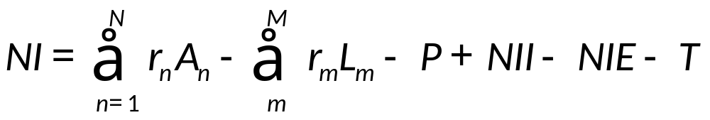
Relationship between Income Statement and Balance Sheet
  There is a direct relationship between the income statement and the balance sheet of commercial banks.
  N I = net income
  A_{n} = dollar value of the bank’s nth asset
  L_{m} = dollar value of the bank’s mth liability
  r_{n} = rate earned on the bank’s nth asset
  r_{m} = rate paid on the bank’s mth liability
  P = provision for loan losses
  N I I = noninterest income earned, including income from O B S activities
  N I E = noninterest expenses
  T = taxes and extraordinary items
  N = number of assets the bank holds
  M = number of liabilities the bank holds

Slide 15
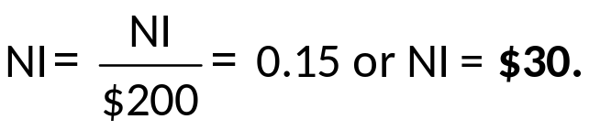
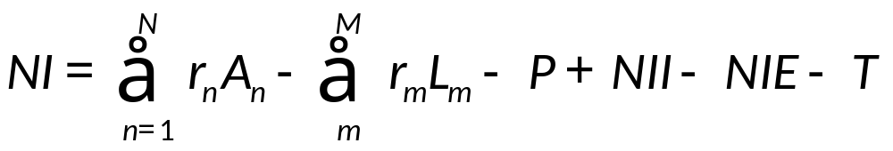
Income Statement Example
Suppose that a bank has equity of $200, interest expense of $90, provision for loan loss (P) = $20, net noninterest income of -$15, and a tax rate of 34%. What is the minimum total interest revenue required to give a R O E of 15%? ($ in millions).
Required
N I = [Interest revenue − Interest expense − P + (N I I − N I E)] × (1 − Tax rate).
  $30 = [Interest revenue − $90 − $20 + − $15] × (1 − 0.34).
  Required interest revenue = $170.45.

Slide 16
Financial Statement Analysis
Financial statement analysis is based on accounting ratios.
Time series analysis is the analysis of financial statements over a period of time.
Cross-sectional analysis is the analysis of financial statements comparing one firm with others.
  The Uniform Bank Performance Report (U B P R) maintained by the F F I E C allows banks to observe competitor financial statements.
Most financial statement analyses is a combination of time series analysis and cross-sectional analysis.

Slide 17
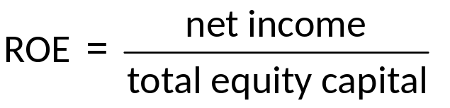
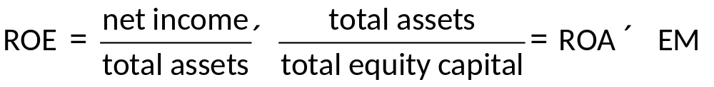
Return on Equity (R O E) Framework 1
  Return on Equity (R O E) analysis begins with R O E and then breaks it down into its components.
  R O E measures the amount of income after taxes earned for each dollar of equity capital contributed by the bank’s stockholders.
  R O E can be broken down into two component parts:

Slide 18
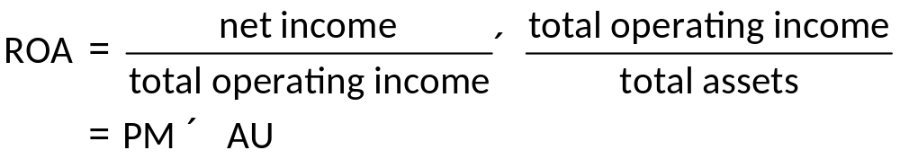
Return on Equity (R O E) Framework 2
Return on Assets (R O A) determines the net income produced per dollar of assets.
Equity Multiplier (E M) measures the dollar value of assets funded with each dollar of equity payments.
  The higher this ratio, the more leverage or debt the bank is using to fund its assets.
R O A can also be broken down into two components:

Slide 19
Return on Assets (R O A) Components
Profit Margin (P M) measures the ability to produce net income from operating expenses (or revenue).
  Interest expense ratio.
  Provision for loan loss ratio.
  Noninterest expense ratio.
  Tax ratio.
Asset Utilization (A U) measures the extent to which the bank’s assets generate revenue.
  Interest income ratio.
  Noninterest income ratio.

Slide 20

Other Ratios 1
The net interest margin (N I M) measures the net return on a bank’s earning assets.
The spread measures the difference between the average yield on earning assets and average cost of interest-bearing liabilities.

Slide 21
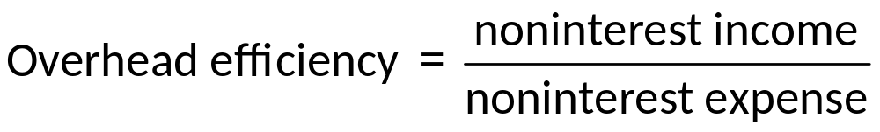
Other Ratios 2
Overhead efficiency measures the bank’s ability to generate noninterest income to cover noninterest expenses.
Many components of key ratios provide additional insight into the financial stability of banks.
  See Table 12-6 for a decomposition of profit margin.
  See Table 12-7 for a decomposition of asset utilization.

Slide 22
Application: Heartland Bank and Trust vs Bank of America 1
Heartland Bank and Trust.
  Profitable and efficient community bank.
  Invests mainly in agriculture, real estate loans, and low-cost funding methods.
Bank of America.
  Operates with a larger and more balanced portfolio of assets and liabilities across both wholesale and retail banking.

Slide 23
The Impact of Market Niche and Size
Retail and wholesale commercial banks operate in different market niches that should be noted when performing financial statement analysis.
Large banks have greater access to purchased funds and capital markets compared to small banks.
  Lends to large banks generally operating with lower amounts of equity capital than small banks.
  Large banks generally use more repurchased funds and fewer core deposits.
  Large banks tend to put more into salaries, premises, and other expenses than do small banks.
  Large banks tend to diversity their operations and services more than small banks, and they also generate more noninterest income.
Notes:
Note that, while large banks tend to hold less equity, they don’t necessarily return more on their assets.

Slide 24
Application: Heartland Bank and Trust vs Bank of America 2
Return on Assets (R O A).
  H B T is more profitable overall.
Profit Margin (P M).
  H B T is producing the higher income per dollar of total operating income.
Asset Utilization (A U).
  B O A is producing less operating income per dollar of assets.
B O A generates more noninterest income than H B T.
  Likely due to B O A’s relatively large amount of O B S activities.

