Slide 1
Chapter Thirteen
Regulation of Commercial Banks
©2019 McGraw-Hill Education. All rights reserved. Authorized only for instructor use in the classroom. No reproduction or further distribution permitted without the prior written consent of McGraw-Hill Education.

Slide 2
Commercial Banks
Commercial banks provide many unique services.
  Information services.
  Liquidity services.
  Price-risk reduction services.
Failure to provide these services or a breakdown in their efficient provision can be costly to both the ultimate providers (households) and users (firms) of funds.
Accordingly, commercial banks are regulated at the federal (and sometimes state) level.

Slide 3
Types of Regulation
Six types of regulations seek to enhance the net social benefits of commercial banks’ services to the economy.
  Safety and soundness regulation.
  Monetary policy regulation.
  Credit allocation regulation.
  Consumer protection regulation.
  Investor protection regulation.
  Entry and chartering regulation.

Slide 4
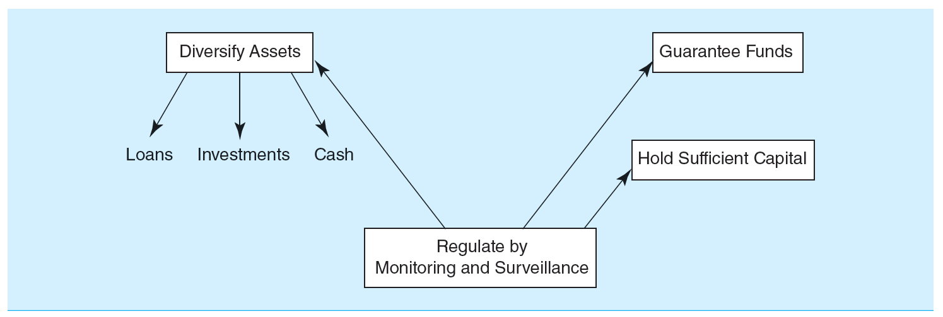
Safety and Soundness Regulation
Safety and soundness regulation.
  Exists to protect depositors and borrowers against the risk of C B failure.
    Example: Due to a lack of diversification in asset portfolios.
Access the long description slide.

Slide 5
5 Objectives of 2010 Wall Street Reform and Consumer Protection Act 1
#1 - Promote robust supervision and regulation of financial firms by establishing.
  A new Financial Services Oversight Council of financial regulators.
  A new authority for the Federal Reserve to supervise all firms that could pose a threat to financial stability, even those that do not own banks.
  Stronger capital and other prudential standards for all financial firms.
  A new National Bank Supervisor to supervise all federally chartered banks.
  The elimination of the federal thrift charter for thrifts not dedicated to mortgage lending and other loopholes.
  The registration of advisors of hedge funds and other private pools of capital with the Securities Exchange Commission (S E C).

Slide 6
5 Objectives of 2010 Wall Street Reform and Consumer Protection Act 2
#2 - Establish comprehensive supervision of financial markets by establishing.
  The regulation of securitization markets.
  Comprehensive regulation of all O T C derivatives.
  New authority for the Federal Reserve to oversee payment, clearing and settlement systems.
#3 - Protect consumers and investors from financial abuse by establishing.
  A new Consumer Financial Protection Agency.
  Stronger regulations to improve the transparency, fairness, and appropriateness of consumer and investor products and services.
  A level playing field and higher standards for providers of consumer financial products and services.

Slide 7
5 Objectives of 2010 Wall Street Reform and Consumer Protection Act Concluded
#4 - Provide the government with the tools it needs to manage financial crises by establishing.
  A new regime to resolve crises involving nonbank financial institutions whose failure could have serious systemic effects.
  Revisions to the Federal Reserve’s emergency lending authority to improve accountability.
#5 - Raise international regulatory standards and improve international cooperation by establishing international reforms to support efforts in the U.S., including strengthening the capital framework, improving oversight of global financial markets, coordinating the supervision of internationally active firms, and enhancing crisis management tools.

Slide 8
Monetary Policy and Credit Allocation Regulation
Monetary policy regulation.
  Regulators control and implement monetary policy by requiring minimum levels of cash reserves to be held against commercial bank deposits.
  CBs often view required reserves as similar to a tax and as a positive cost of undertaking financial intermediation.
Credit allocation regulation.
  Regulations support the C B’s lending to socially important sectors, such as housing and farming.
  May require a C B to hold a minimum amount of assets in one particular sector of the economy or to set maximum interest rates, prices, or fees to subsidize certain sectors.
    Example: Qualified thrift lender (Q T L) test.

Slide 9
Consumer Protection Regulation
Consumer protection regulation.
  Regulations are imposed to prevent the C B from discriminating unfairly in lending.
  Community Reinvestment Act (C R A) of 19 77.
    CRA ratings range from outstanding to substantial noncompliance, and examinations for compliance have become increasingly rigorous.
  Home Mortgage Disclosure Act (H M D A) of 19 75.
    Especially concerned about discrimination on the basis of age, race, sec, or income.
  Consumer Financial Protection Agency (C F P B).
    Created as part of the financial services overhaul bill passed in 2010 to protect consumers from unfair, deceptive and abusive practices
    Example of C F P B oversight occurred in September 2016 when Wells Fargo Bank was ordered o pay $185 million in fines and penalties to settle “the widespread illegal practice of secretly opening unauthorized deposit and credit card accounts”.

Slide 10
Investor Protection Regulation
Investor protection regulation.
  Considerable number of laws protect investors who use commercial banks directly to purchase securities and/or indirectly to access securities markets through investing in mutual or pension funds managed by C B s.
    Protect investors against abuses such as insider trading, lack of disclosure, outright malfeasance, and breach of fiduciary responsibilities.
  Securities Act of 19 33 and 19 34.
  Investment Company Act of 19 40.
  Wall Street Reform and Consumer Protection Act of 2010.

Slide 11
Entry and Chartering Regulation
Entry and chartering regulation.
  Entry into commercial banking is regulated.
  Activities once a C B has been established are also regulated.
Increasing/decreasing the cost of entry into a financial sector affects the profitability of firms already competing in that industry.
Barriers to entry and regulations pertaining to the scope of permitted activities affect a C B’s charter value and the size of its net regulatory burden.

Slide 12
Commercial Bank Regulators
U.S. commercial banks may be subject to the supervision and regulations of as many as four separate regulators.
  Federal Deposit Insurance Corporation (F D I C).
  Office of the Comptroller of the Currency (O C C).
  Federal Reserve (F R).
  State bank regulators.
Facets of regulatory structure.
  Regulation of the overall operations.
  Regulation of product and geographic operations.
  Provision and regulation of deposit insurance.
  Balance sheet regulations.

Slide 13
Product Segmentation 1
Commercial banking and investment banking.
  Commercial banking involves deposit taking and lending.
  Investment banking involves underwriting, issuing, and distributing securities.
The Glass-Steagall Act of 19 33 imposed a rigid separation between commercial and investment banks.
By 19 87, commercial banks were allowed to engage in limited investment banking activity through Section 20 affiliates.
The Financial Services Modernization Act (F S M A) of 19 99 repealed Glass-Steagall.

Slide 14
Product Segmentation 2
Banking and insurance.
  Bank Holding Company Act (B H C A) of 19 56 and the Garn-St. Germain Depository Institutions Act of 19 82 restricted insurance companies from owning or being affiliated with full-service banks.
  F S M A of 19 99 now allows bank holding companies to open insurance underwriting affiliates and also allows insurance companies to open banks.
Commercial banking and commerce.
  B H C A of 19 56 required B H C s to divest themselves of nonbank-related subsidiaries over a 10-year period and effectively restricted acquisitions of banks by commercial firms.
  F S M A of 19 99 changed restrictions on ownership limits imposed on financial services holding companies.

Slide 15
Product Segmentation Concluded
Nonbank financial service firms and banking.
  Relative to the barriers separating banking and either securities, insurance, or commercial sector activities, the barriers among nonbank financial service firms and banking are generally much weaker.
  Activities of nonfinancial service firms that perform banking service have been termed shadow banking.
  As of 2016, shadow banks continue to be unregulated by the federal government.
    However, the 2010 Wall Street Reform and Consumer Protection Act calls for regulators to be given broad authority to monitor and regulate nonbank financial firms that pose risks to the financial system.

Slide 16
Geographic Expansion 1
Geographic expansions can have a number of dimensions. In particular, they can be.
  Domestic.
  Within a state or region.
  International (participating in a foreign market).
Regulatory factors impacting geographic expansion.
  Restrictions on intrastate banking by commercial banks.
    By 19 94, only one state (Iowa) had not deregulated intrastate banking.
  Restrictions on interstate banking by commercial banks.
    McFadden Act, passed in 19 27 and amended in 19 33.
    Douglas Amendment to the Bank Holding Company Act, 19 56.
    By 19 94, all states but Hawaii had passed some form of interstate banking law or pact.

Slide 17
Geographic Expansion 2
Regulatory factors impacting geographic expansion.
  Riegle-Neal Interstate Banking and Branching Efficiency Act of 19 94.
    Allowed U.S. and foreign banks to branch interstate by consolidating out-of-state bank subsidiaries into a branch network and/or by acquiring banks of individual branches of banks through acquisitions or merger.
    Result of this is that full interstate banking is a reality in the U.S.
    Relaxation of the branching restrictions, along with recognition of the potential cost, revenue, and risk benefits from geographic expansions, are major reasons for the recent merger wave (and increased consolidation) in U.S. banking.

Slide 18
Deposit Guarantee Funds 1
The Federal Deposit Insurance Corporation (F D I C).
  The F D I C was created in 19 33 during the Depression to restore public confidence in the banking system.
  The initial insurance limit was $2,500; this amount was periodically increased to $100,000, where it remained until the financial crisis of 2007 to 2008, when it was increased to $250,000.
Other laws of the 19 30s limited competition among banks.
  Regulation Q specified maximum interest rates on deposits and prevented competition on deposit rates.

Slide 19
Deposit Guarantee Funds 2
System worked extremely well until 19 79; from October 19 79 to October 19 82, the Fed changed its monetary policy strategy by targeting bank reserves rather than interest rates in an attempt to lower the underlying rate of inflation.
  Led to a sudden and dramatic rise in interest rates, with T-bill rates rising as high as 16%,
Led to disintermediation—that is the withdrawal of deposits from depository institutions and their reinvestment elsewhere.

Slide 20
Deposit Guarantee Funds Concluded
Increasing competition and record high interest rates reduced industry profitability, particularly at thrifts.
Problems were exacerbated by a policy of regulatory forbearance—that is a policy of not closing economically insolvent depository institutions, but allowing their continued operation.

Slide 21
Demise of F S L I C
Federal Savings and Loan Insurance Corporation (F S L I C).
  Insured savings institutions from 19 34 to 19 89.
  Savings institutions failures in the 19 80s led to an insolvent F S L I C by 19 89.
The Financial Institutions Reform, Recovery, and Enforcement Act (F I R R E A) of 19 89.
  Dissolved the F S L I C and transferred management to the F D I C.
  Restructured savings association fund was renamed the Savings Association Insurance Fund (S A I F).
  Restructured bank insurance fund was renamed the Bank Insurance Fund (B I F).

Slide 22
Reform of Deposit Insurance
The F D I C introduced risk-based deposit insurance premiums in January of 19 93.
  In 19 96, the safest institutions insured by the B I F paid no deposit insurance premiums.
  In 19 97, the safest institutions insured by the S A I F paid no deposit insurance premiums.
  By the early 2000s, over 90% of depository institutions paid the statutory minimum premium, and the average assessment rate was less than 0.1 cent per $100 of deposits.
In March 2006, the B I F and the S A I F were merged into the Deposit Insurance Fund (D I F).
In January 2007, the F D I C began a more aggressive risk-based system.

Slide 23
Balance Sheet Regulation 1
Liquidity regulation.
  Banks must hold minimum levels of reserves against net transaction accounts.
  Ensures that banks can meet required payments on liability claims, such as deposit withdrawals.
  See Appendix 13B for more details.

Slide 24
Balance Sheet Regulation 2
Under Basel III, Dis must calculate and monitor four capital ratios.
  Common equity Tier I R B C ratio.
    Common equity Tier I capital / Credit risk-adjusted assets.
  Tier I R B C ratio.
    Tier I capital (common equity Tier I capital + additional Tier I capital) / credit risk-adjusted assets.
  Total R B C ratio.
    Total capital (Tier I + Tier II) / credit risk-adjusted assets.
  Tier I leverage ratio.
    Tier I capital / total exposure.

Slide 25
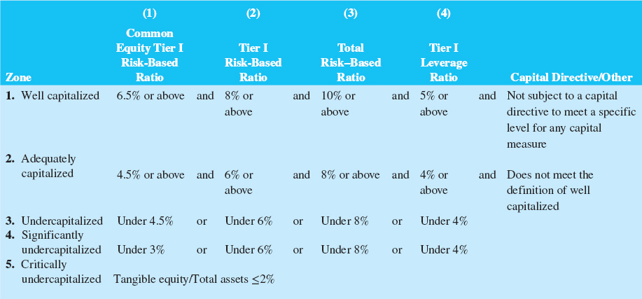
Specifications of Capital Categories for Prompt Corrective Action (PCA)
Table 13-3 Specifications of Capital Categories for Prompt Corrective Action.
Access the long description slide.
Notes:
Dur Annual = 4.3774 years.

Slide 26
Balance Sheet Regulation Concluded
Credit risk-adjusted assets.
  Credit risk-adjusted on-balance-sheet assets.
  Credit risk-adjusted off-balance-sheet assets.
Capital conservation buffer.
  Designed to ensure that Dis build up a capital surplus, or buffer, outside period of financial stress that can be drawn down as losses are incurred during period of financial stress.
Countercyclical capital buffer.
  May be declared by any country experiencing excess aggregate credit growth.
  Aims to protect the banking system and reduce systemic exposures to economic downturns.
Notes:
Dur Annual = 4.3774 years.

Slide 27
Foreign vs. Domestic Regulation 1
Regulation of U.S. banks in foreign countries.
  The Overseas Direct Investment Control Act of 19 64 restricted U.S. banks’ ability to lend to U.S. corporations to make foreign investment.
  The North American Free Trade Agreement (N A F T A) of 19 94 enabled U.S. banks to expand to Mexico and Canada.
  A 19 97 agreement between 100 countries (under the World Trade Organization (W T O)) began dismantling barriers inhibiting foreign direct investment into emerging countries.

Slide 28
Foreign vs. Domestic Regulation 2
The International Banking Act (I B A) of 19 78 declared foreign banks are to be regulated the same as national domestic banks.
  Foreign banks are subject to Federal Reserve examinations.
The Foreign Bank Supervision Enhancement Act (F B S E A) of 19 91 gave additional powers to the Federal Reserve.
  Fed must approve new subsidiary, branch, agency, or representative offices of foreign banks in the U.S.
  Fed has the authority to close foreign banks operating in the U.S.

Slide 29
Calculating Deposit Insurance Premium Assessments
F D I C Reform Act of 2005.
  Instituted a deposit insurance premium scheme, effective January 1, 2007 (and subsequently revised) that combined examination ratings and financial ratios.
    Risk Category I contains all well-capitalized institutions in Supervisory Group A (generally those with CAMELS ratings of 1 or 2).
    Risk Category II contains all institutions in Supervisory Groups A and B (generally those with CAMELS ratings of 1, 2, or 3) except those in Risk Category I and undercapitalized institutions.
    Risk Category III contains all undercapitalized institutions in Supervisory Groups A and B and institutions in Supervisory Group C.

Slide 30
Calculating Minimum Required Reserves at U.S. DIs
U.S. bank regulation concentrates on a bank’s management of its cash reserves, defined as vault cash and cash deposits held by the bank at the Federal Reserve.
The reserve computation period always begins on a Tuesday and ends on a Monday 14 days later.
Reserve maintenance period is the period over which deposits at the F R B must meet or exceed the required reserve target.
  Lagged reserve accounting versus contemporaneous reserve accounting systems.

Slide 31
Safety and Soundness Regulation Long Description
Diagram showing CB's diversify assets, guarantee funds, and hold sufficient capital and regular by monitoring and surveillance to protect against risk of failure.
Return to slide containing original image.

Slide 32
Specifications of Capital Categories for Prompt Corrective Action (PCA) Long Description
The 5 zones are: well capitalized, adequately capitalized, undercapitalized, significantly undercapitalized, and critically undercapitalized. The Table provides the percentages for common equity tier I risk based ratio, Tier I risk based ratio, Total risk based ratio, and Tier I leverage ratio and provides information about the capital directive for the first 2 zones.
Return to slide containing original image.

