Slide 1
Chapter Fourteen
Other Lending Institutions: Savings Institutions, Credit Unions, and Finance Companies
©2019 McGraw-Hill Education. All rights reserved. Authorized only for instructor use in the classroom. No reproduction or further distribution permitted without the prior written consent of McGraw-Hill Education.

Slide 2
Savings Institutions (S I s)
Comprise two groups of D I s: savings associations and savings banks.
  Savings associations were historically referred to as Savings and Loans (S&L s) associations.
Specialize in long-term residential mortgages, which are usually financed with short-term deposits of small savers.
Faced a major crisis during the 1982-1992 period, resulting in the failure of half of Sis.

Slide 3
The S&L Crisis of 19 82-19 92 1
Alarming number (1,248) of savings institution failures occurred in the 19 82-19 92 period, peaking at 316 in 19 89.
Rapid decline in asset growth of the industry.
The Federal Reserve radically changed its monetary policy during October 19 79 to October 19 82.
  Targeted reserves rather than interest rates.
  Led to sudden surge in interest rates.
  Many S I s faced negative net interest margins.
  S I s lost depositors because of Regulation Q.

Slide 4
The S&L Crisis of 19 82-19 92 2
Real estate and land prices collapsed in many areas of the U.S. in the mid-19 80s.
  Many mortgages defaulted as a result.
The Federal Savings and Loan Insurance Corporation (F S L I C) had a policy of regulatory forbearance.
  policy was to not close economically insolvent F I s, allowing them to continue to operate.

Slide 5
The S&L Crisis of 19 82-19 92 Concluded
The Financial Institutions Reform, Recovery, and Enforcement Act (F I R R E A) of 19 89.
  Abolished the F S L I C.
  Created a new Savings Association Insurance Fund (S A I F) that was put under the management of the Federal Deposit Insurance Corporation (F D I C).
  Replaced the Federal Home Loan Bank Board with the Office of Thrift Supervision (O T S).
  Created the Resolution Trust Corporation (R T C) to close and liquidate insolvent Sis.
  The Qualified Thrift Lender Test (Q T L) sets a floor on the mortgage-related assets that thrifts must hold (currently at 65%).
  Introduced Prompt Corrective Action (P C A), which mandates that regulators must close problem banks and thrifts faster.

Slide 6
Assets and Liabilities of S I s, 2016
Table 14-1 Assets and Liabilities of Savings Institutions, 2016
Blank | Billions of Dollars | Percentage
Cash and due from | $84.75 | 7.65%
U.S. Treasury and federal agency obligations | 40.77 | 3.68
Federal funds and repos | 1.21 | 0.11
Bonds, corporate stock, and other securities | 36.5 | 3.29
Mortgage loans | 461.55 | 41.64
MBS (includes CMOs, POs, IOs) | 232 | 20.93
Commercial loans | 64.16 | 5.79
Credit card loans | 82.29 | 7.43
Other consumer loans | 45.34 | 4.09
Other loans and financing leases | 20.61 | 1.86
Less: Allowance for loan losses and unearned income | 9.76 | 0.88
Other assets | 48.92 | 4.41
Total assets | $1,108.34 | 100.00%
Total deposits | $867.85 | 78.30%
Federal funds and repos | 8.95 | 0.81
Other borrowed money | 91.99 | 8.3
Other liabilities | 16.52 | 1.49
Total liabilities | 985.31 | 88.90%
Net worth | 123.03 | 11.1
Total liabilities and net worth | $1,108.34 | 100.00%
Number of institutions | 820
Source: F D I C, Statistics on Banking, Second Quarter 2016, www.fdic.gov

Slide 7
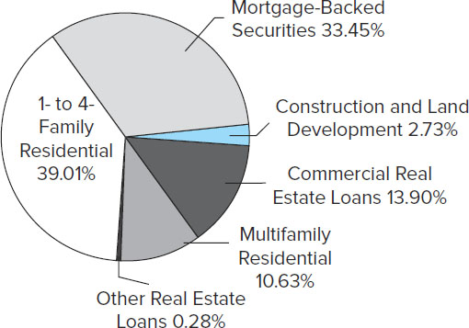
Real Estate Assets
Figure 14-2 Real Estate Assets as a Percentage of Total
Real Estate Assets at Savings Institutions
Source: Federal Deposit Insurance Corporation, Quarterly Banking Profile, Second Quarter 2016, www.fdic.gov
Access the long description slide.

Slide 8
S I Balance Sheets
Assets.
  Mortgages (41.64%) and mortgage-backed securities (20.93%) represent 62.57% of total assets.
    This compares to less than 40% for commercial banks.
  Commercial loans and consumer loans amounted to just 5.79% and 11.52% of SI assets, respectively.
    This compares to 12.16% and 8.84% for commercial banks, respectively.
Liabilities.
  Transaction accounts and small time and savings deposits are the predominant source of funds, with total deposits accounting for 78.30% of total liabilities and net worth.
Net worth is the book value of the equity holders’ capital contribution.

Slide 9
Regulators of S I s
Main regulators of savings institutions.
  #1 - Office of the Comptroller of the Currency.
    Established in 1989 under FIRREA.
    Chartered and examined all federal savings institutions, and supervised the holding companies of savings institutions.
    Wall Street Reform and Consumer Protection Act of 2010 mandated the consolidation of the Office of Thrift Supervision and the O C C, and now the O C C regulates both national banks and federal savings institutions.
  #2 - The F D I C.
    Also established in 1989 under FIRREA.
    Oversaw and managed the Savings Association Insurance Fund (S A I F).
    F D I C merged the S A I F and the Bank Insurance Fund (B I F) in 2007.
  #3 - Other regulators (i.e., state regulators).

Slide 10
Equity Valuation 1
Table 14-2 Selected Indicators for U.S. Savings Institutions, 19 89-2016
Blank | 19 89 | 19 99 | 2000 | 2003 | 2005 | 2006 | 2007 | 2008 | 2009 | 2010 | 2013 | 2016
Number of institutions | 3,086 | 1,642 | 1,590 | 1,411 | 1,307 | 1,279 | 1,251 | 1,219 | 1,173 | 1,128 | 936 | 820
Return on assets (%) | -0.39 | 1 | 0.92 | 1.28 | 1.15 | 0.99 | 0.13 | -0.72 | 0.14 | 0.65 | 1.08 | 1.31
Return on equity (%) | -8.06 | 11.73 | 11.14 | 13.66 | 10.4 | 8.68 | 1.08 | -7.75 | 1.31 | 5.76 | 9.07 | 11.83
Noncurrent assets plus other real estate owned to assets (%) | 2.78 | 0.58 | 0.56 | 0.62 | 0.57 | 0.63 | 1.46 | 2.4 | 3 | 3.04 | 1.74 | 1.12
Asset growth rate (%) | -11.14 | 5.6 | 6.41 | 8.47 | 8.64 | -3.7 | 4.97 | -17.53 | -17.5 | -0.84 | -0.68 | 3.23
Net operating income growth (%) | -58.95 | 16.7 | 3.55 | 23.03 | 8.03 | -9.84 | -81.68 | -456.82 | 120.44 | 273.16 | 2.5 | 16.62
Number of failed institutions | 331 | 1 | 1 | 0 | 0 | 0 | 1 | 5 | 20 | 18 | 1 | 0
Source: F D I C, Statistics on Banking, Second Quarter 2016, www.fdic.gov

Slide 11
Credit Unions (C U s) 1
Credit unions (C U s) are nonprofit depository institutions mutually organized and owned by their members (depositors).
First established in the early 1900s as self-help organizations.
  Members deposit savings and the funds are lent to other members.
C U s are prohibited from serving the general public—i.e., members are required to have a common bond of occupation, association, etc.
  E.g., university-affiliated C U s, police C U s, etc.
Because C U s are nonprofit organizations, their earnings are not taxed.
  May offer higher interest rates than commercial banks on deposits.
  May charge lower interest rates than commercial banks on loans.

Slide 12
Credit Unions (C U s) 2
Most numerous of all depository institutions.
  6,105 C U s in 2016.
  107.6 million members.
Less affected by the crisis of the 1980s that hit SIs and C B s .
  Traditionally make small (< $10,000) consumer loans.
  Loans are funded with member deposits.
  Small amounts of residential mortgages.
  Tend to hold large amounts of safe, liquid government securities as assets.
    E.g., 14.7% of assets in 2016.

Slide 13
Credit Unions (C U s) Concluded
National credit union system consists of three tiers.
  U.S. Central Credit Union is the top tier.
    Provides investment and liquidity services to Corporate C u s.
  12 corporate credit unions comprise the middle tier at the state or regional level.
    Cooperatively owned by their member C u s.
    Serve members by investing and lending excess funds that member C U s place with them.
    Provide automated settlement, securities safekeeping, data processing, accounting, and payment services.
  Individual credit unions make up the bottom tier.

Slide 14
Credit Union (C U) Trends
Recently, C U s have expanded their services to compete with C Bs and Sis.
  Many have converted to a common charter.
  Now offer mortgages, credit lines, and mobile banking.
  Some offer business and commercial loans to their employer groups.
Banking industry challenged C U expansion in 19 97.
  Feb 19 98 - Supreme Court sided with the banking industry.
  Later that year, Congress quickly passed a bill that sided with C u s.

Slide 15
Assets and Liabilities of Credit Unions, 2016 1
Table 14-3 Assets and Liabilities of Credit Unions, 2016
Blank | Billions of Dollars | Percentage
Assets | Blank | Blank
Cash and equivalents | $101.30 | 8.10%
Investment securities | Blank | Blank
U.S. government securities | Blank | Blank
Treasury | 11.7 | 0.9
Agency | 172.6 | 13.8
Mortgage-backed securities | 53.8 | 4.3
Other investment securities | 38.3 | 3
Total investment securities | $276.40 | 22.00%
Loans | Blank | Blank
Home mortgages | 358.4 | 28.6
Consumer loans | 367.9 | 29.3
Business loans | 61.8 | 4.9
Other | 35.3 | 2.8
(Allowance for loan losses) | −7.5 | -0.6
Total loans | $815.90 | 65
Other assets | 61 | 4.9
Total assets | $1,254.60 | 100.00%
Notes:
CU equity is the accumulation of past earnings that is “owned” collectively by member depositors

Slide 16
Assets and Liabilities of Credit Unions, 2016 2
Table 14-3 Assets and Liabilities of Credit Unions, 2016
Liabilities and Equity | Blank | Blank
Share drafts | $154.60 | 12.30%
Small time and savings | 814.2 | 64.9
Large time | 90.1 | 7.2
Shares/deposits | $1,058.90 | 84.40%
Other loans and advances | 47.2 | 3.7
Miscellaneous liabilities | 13.4 | 1.1
Total liabilities | $1,119.50 | 89.20%
Total ownership shares | $135.10 | 10.80%
Source: National Credit Union Administration, Second Quarter 2016, www.ncua.gov
Notes:
CU equity is the accumulation of past earnings that is “owned” collectively by member depositors

Slide 17
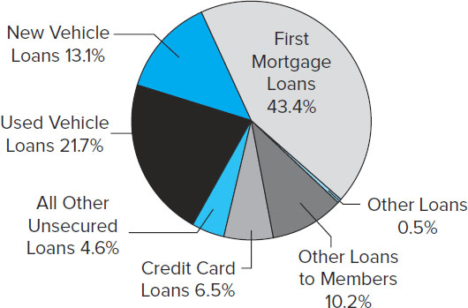
Composition of C U Loan Portfolio
Figure 14-5 Composition of Credit Union Loan Portfolio
Source: National Credit Union Administration, Second Quarter 2016, www.ncua.gov
Access the long description slide.

Slide 18
C U Regulators and Industry Performance
As of 2016, 62.5% of C U s were federally chartered.
  Subject to regulation by the National Credit Union Administration (N C U A).
  Deposit insurance is provided by the National Credit Union Share Insurance Fund (N C U S I F).
    N C U S I F covers 98% of all credit union deposits.
Remaining C U s are regulated at the state level.
Membership increased from 77.5 million to 107.6 million from 1999 to 2016.

Slide 19
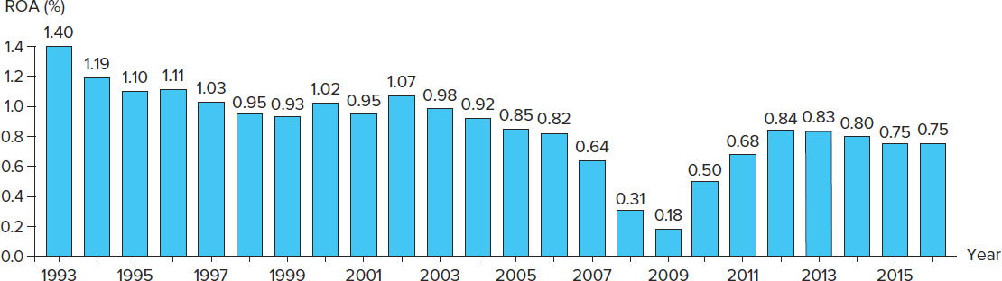
Return on Assets for Credit Unions, 19 93 through 2016
Figure 14-8 Return on Assets for Credit Unions, 1993-2016
Source: National Credit Union Administration, Midyear Statistics and Year End Statistics and Year End Statistics, various years, www.ncua.gov
Access the long description slide.

Slide 20
Finance Companies (F Cs) 1
There are three major types of finance companies (F Cs).
  Sales finance institutions specialize in loans to customers of a particular retailer or manufacturer.
  Personal credit institutions specialize in installment and other loans to consumers.
  Business credit institutions specialize in business loans, especially through equipment leasing and factoring.
    Factoring is the process of purchasing accounts receivable from corporations, usually with no recourse to the seller should the receivables go bad.

Slide 21
Finance Companies (F Cs) 2
Industry assets were $1,820.6 billion in 2016.
FC industry is highly concentrated.
  The 20 largest FCs account for more than 65% of industry assets.
  Many of the largest F Cs tend to wholly owned or captive subsidiaries of major manufacturing companies.
    E.g., Ford Motor Credit is a subsidiary of Ford Motor.

Slide 22
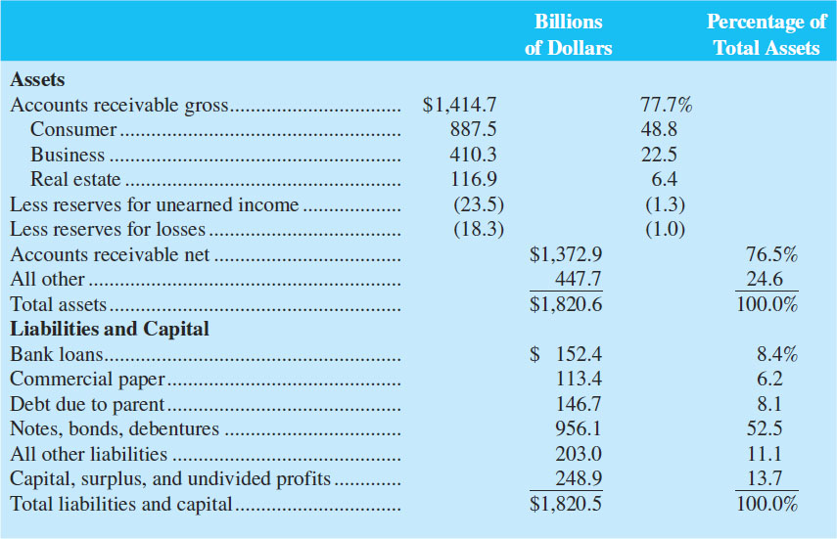
Assets and Liabilities of U.S. Finance Companies, June 2016
Table 14-4 Assets and Liabilities of U.S. Finance Companies (June 30, 2016)
Source: Federal Reserve Bulletin, 2016. www.federalreserve.gov
Access the long description slide.

Slide 23
Balance Sheets of F Cs 1
Some finance companies make loans to riskier customers at higher interest rates than C Bs.
  Subprime lenders are F Cs that lend to high-risk customers.
  Loan sharks are subprime lenders that charge unfairly exorbitant rates to desperate, subprime borrowers.
  Payday lenders provide short-term cash advances that are often due when borrowers receive their next paycheck.
    An estimated 12 million Americans used payday loans in 2016 .

Slide 24
Balance Sheets of F Cs 2
F Cs often have advantages over C Bs with respect to business loans because F Cs:
  Are not subject to regulations that restrict the type of products and services they can offer.
  Do not accept deposits—accordingly, bank-type regulators do not monitor their behavior.
  Often have substantial industry and product expertise.
  Are more willing to accept risky customers.
  Generally have lower overhead than C Bs.

Slide 25
Balance Sheets of F Cs Concluded
Real estate loans.
  Second mortgages are in the form of home equity loans, i.e., loans that let customers borrow on a line of credit secured with a second mortgage on their home.
  Securitized mortgage assets are mortgages purchased and used as assets backing secondary market securities.
  Mortgage servicing is a fee-related activity whereby the flow of mortgage repayments is collected and passed on to investors in whole mortgage loan packages or securitization vehicles.

Slide 26
F C Performance 1
Problems arose in the F C industry in the mid- and late-2000s with the crash of the market for subprime mortgage loans.
  Many F Cs saw sharply lower equity values.
F Cs are subject to state-imposed usury ceilings and additional restrictions have been imposed on payday loans in many states.
Because F Cs do not accept deposits, they are not subject to the extensive oversight common among C Bs, S I s, and C U s .
F C industry improved in the mid-200s and early 2010s.
  In the mid-2010s, industry median R O E rose to 9.33%, up from 6.61% during the height of the crisis, for business credit institutions.
  During the mid-2010s, industry median R O E rose to 13.73%, up from 5.31% during the height of the crisis, for personal credit institutions.

Slide 27
F C Performance 2
Between 2005 and 2007, home prices began to fall and borrowers faced rising interest rates, resulting in more people defaulting on their mortgages.
Mortgage loan delinquencies and small business loan failure rates peaked in 2008 and 2009, hurting overall profitability.
Crash in the subprime mortgage market led to serious problems for the U.S. and worldwide economies as a whole.
  Countrywide Financial failed, G MAC Financial Services was forced to convert to a bank holding company to prevent failure, and C I T Group also failed.
Financial crisis issues remained even into 2016.
  Industry receivables stood at $1.42 trillion in the mid-2010s, down from $1.93 trillion during the crisis, while industry employment was 562,400 in the mid-2010s, down from 715,900 as the crisis began.

Slide 28
Global Issues
Unlike the U.S., S I s in Europe traditionally catered to the commercial industry.
The majority of S I s in Europe are mutual.
S I s worldwide are quite small compared to C Bs.
Nonbank F I lending has increased in both Latin America and in Europe in the last decade, although there were failures, restructurings and consolidations from the financial crisis.
Many foreign S I s operate cooperatively to fund local development rather than focus on profitability.

Slide 29
Real Estate Assets Long Description
39.01% is 1 to 4 family residential. 33.45% is mortgage-backed securities, 13.90 is commercial real estate loans, 10.63% is multifamily residential, 2.73% is construction and land development, and 0.28% is other real estate loans.
Return to slide containing original image.

Slide 30
Composition of C U Loan Portfolio Long Description
43.4% were first mortgage loans, 13.1% were new vehicle loans, 21.7% were used vehicle loans, 4.6% were all other unsecured loans, 6.5% were credit card loans, 10.2% were other loans to members, and 0.5% were other loans.
Return to slide containing original image.

Slide 31
Return on Assets for Credit Unions, 1993 through 2016 Long Description
The R O A declined from 1.4% in 1993 to a low of 0.18 in 2009. In 2010 R O A was 0.5%. 2011 was 0.68%, 2012 was 0.84%, 2013 was 0.83%, 2014 was 0.8%, 2015 was 0.75%, and 2016 was 0.75%.
Return to slide containing original image.

Slide 32
Assets and Liabilities of U.S. Finance Companies, June 2016 Long Description
The assets totaled $1,820.6 billion dollars of which $1,414.7 billion were accounts receivable. Of the $1,820.5 in liabilities, $956.1 were notes, bonds, debentures and $248.9 were capital, surplus, and undivided profits.
Return to slide containing original image.

