Slide 1
Chapter Fifteen
Insurance Companies
©2019 McGraw-Hill Education. All rights reserved. Authorized only for instructor use in the classroom. No reproduction or further distribution permitted without the prior written consent of McGraw-Hill Education.

Slide 2
Insurance Companies (ICs)
The primary function of insurance companies is to compensate policyholders if a prespecified event occurs, in exchange for premiums paid.
  Insurance underwriters assesses and prices risks.
  Insurance brokers sells insurance contracts.
Insurance is broadly classified into two groups.
  Life insurance policies provide protection against untimely death or illness, and/or transfer wealth through time to retirement.
  Property-casualty insurance protects against property damage, personal injury and liability associated with specific events.
Insurance companies also sell a variety of investment products, similar to other FIs.

Slide 3
Life Insurance Companies 1
872 life insurance companies existed in the U.S. in 2015.
  Compares to over 2,300 in 19 88.
  The industry has seen consolidation to take advantage of scale and scope economies.
Aggregate industry assets were $6.47 trillion at the beginning of 2016.
  Compares to $1.12 trillion in 19 88.
The four largest life insurers wrote 30.5% of the industry’s over $681 billion premiums in 2015.
  Many of these policies are sold through commercial banks.
  For example, in 2015 commercial banks sold over 17% of all annuity contracts.

Slide 4
Life Insurance Companies 2
Life insurers pool the risks of individuals to diversify away some of the customer-specific risk.
  Thus, they are able to offer insurance services at a cost lower than any individual could achieve on his/her own.
  This allows the transfer of income related uncertainties from the individual to the group.
Other activities of life insurance companies:
  Sell annuities, which are savings contracts that involve the liquidation of those funds saved over a period of time.
  Manage pension plans (example: tax-deferred savings plans).
  Provide accident and health insurance.

Slide 5
Life Insurance Companies Concluded
Insurance companies accept or underwrite risk that a pre-specified event will occur in return for insurance premiums.
  Underwriting decisions determine which risks are accepted and which are not.
  Underwriting decisions determine how much to charge (in the form of premiums) for accepted risks.
The adverse selection problem is the problem that customers who apply for insurance policies are more likely to be those in need of coverage.

Slide 6
The Role of Actuaries
Actuaries reduce the risks of underwriting and selling insurance.
  With traditional life insurance, actuaries analyze mortality, produce life tables, and apply time-value-of-money tools to price life insurance, annuities, and endowment policies.
  With health insurance, actuaries analyze the rates of disability, morbidity, mortality, fertility, etc.

Slide 7
The Four Types of Life Insurance 1
#1 - Ordinary life insurance is marketed to individuals—policyholders make periodic premium payments in exchange for coverage.
  Term life is the closest to pure life insurance; has no savings element attached.
  Whole life protects the individual over an entire lifetime rather than for a specified coverage period.
  Endowment life combines a pure (term) insurance element with a savings element.
  Variable life invests fixed premium payments in mutual funds of stocks, bonds, and money market instruments.
  Universal life and variable universal life.

Slide 8
The Four Types of Life Insurance 2
#2 - Group life insurance covers a large number of persons under a single policy.
  Contributory—both the employer and the employee cover a share of the premiums.
  Noncontributory—the costs are borne entirely by the employer.
#3 - Credit life insurance protects lenders against borrower death prior to the repayment of a debt contract, such as a mortgage or car loan.

Slide 9
The Four Types of Life Insurance Concluded
#4 – Other activities include the sale of annuities, private pension plans, and accident and health insurance.
  Annuities represent the reverse of life insurance principals.
    Popular among individuals as a mechanism used to save for retirement.
    Annuity sales in 2015 topped $236.7 billion.
  In 2016, life insurance companies were managing over $3.6 trillion in pension fund assets, equal to 41% of all private pension plans.
  More than $171 billion in premiums were written annually by life and health companies in accident-health in 2015.

Slide 10
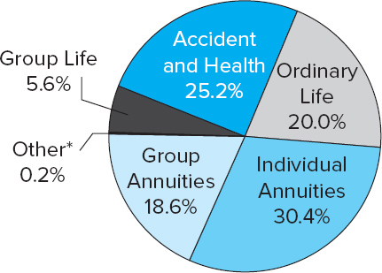
Distribution of Premiums Written on Various Life Insurance Lines
Figure 15-1 Distribution of Premiums Written on Various Life Insurance Lines
*Includes credit life and industrial life.
Source: Insurance Information Institute website, 2016. www.iii.org
Access the long description slide.

Slide 11
Annuities Example 1
You have a policy with a cash value of $250,000 which you wish to annuitize. You are currently 62 years old and your spouse is 58. Interest rates are 5% per year, and you are considering receiving monthly payments under three options.
  In option 1, you will receive 10 years of monthly payments.
  With option 2, you will receive a monthly payment until you die, which is expected to be in 14 years.
  With option 3, you will receive a monthly payment until both you and your spouse die. Your spouse is expected to outlive you by 8 years.
How much will you receive per month with each option (ignoring administrative costs and fees)?

Slide 12


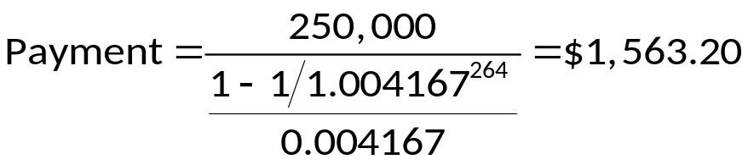
Annuities Example 2
In option 1, you will receive 10 years of monthly payments.
With option 2, you will receive a monthly payment until you die, which is expected to be in 14 years.
With option 3, you will receive a monthly payment until both you and your spouse die. Your spouse is expected to outlive you by 8 years.

Slide 13
Balance Sheets and Recent Trends 1
Assets:
  Life insurers concentrate their asset investments at the longer end of the maturity spectrum.
    Example: corporate bonds, equities, and government securities.
    In 2016, 10.8% of assets were invested in government securities, 67.6% in corporate bonds and stocks, and 6.8% in mortgages.
Liabilities:
  Net policy reserves made up $2.9 trillion, or 44.1% of total liabilities and equity.
  To meet unexpected future losses, life insurers hold a capital and surplus reserve fund with which to meet such losses.
    Reserves for life insurers in 2016 totaled $280.8 billion, or 5.9% of total liabilities and capital.

Slide 14
Balance Sheets and Recent Trends 2
Insurers earn profits by taking in more premium income than they pay out in policy payments.
  Firms can increase their spread between premium income and policy payouts in two ways:
  #1 – Decrease future required payouts for any given level of premium payments.
    Accomplished by reducing the risk of the insured pool.
  #2 – Increase the profitability of interest income on net policy reserves.
Treasury Department extended bailout funds to a number of struggling life insurers in late 2008/early 2009.
  Example: AIG, Hartford Financial Services Group, Prudential Financial, Lincoln Financial, and Allstate.

Slide 15
Regulation 1
McCarren-Ferguson Act of 19 45 confirmed primacy of states over federal regulation of Ics.
  State insurance commissions charter and examine ICs.
  The National Association of Insurance Commissioners (NAIC) has developed a coordinated examination system.
States promote insurance guarantee funds.
  Funds are run by the insurance companies themselves.
  Contributions are paid only when an IC fails (except in NY).
The Financial Services Modernization Act (FSMA) of 19 99 allowed CBs, IBs, and ICs to exist as subsidiaries under one Financial Holding Company (FHC).

Slide 16
Regulation 2
During the financial crisis, Congress considered adding a federal regulator of the insurance industry, but left regulation to the states.
Wall Street Reform and Consumer Protection Act of 2010 created the Federal Insurance Office (F I O) that reports to Congress and the President on the insurance industry.
  The FIO is supposed to identify systemic risks arising from insurers, monitor international insurance events, eliminate state regulatory gaps and encourage the offering of insurance products to underserved segments.
  The Financial Stability Oversight Council (FSOC) is charged with identifying any financial institution (including insurance companies) that presents a systemic risk to the economy and subjecting such institutions to greater regulation.

Slide 17
Property-Casualty (P&C) Insurance Companies
Currently, 2,544 companies sell property-casualty (P&C) insurance, and approximately half of those firms write P&C business in all or more of the U.S.
  Top 10 firms have a 50% market share.
  Top 200 firms have more than a 95% market share.
  In 2016, State Farm was the top firm, writing 11.3% of all P&C insurance premiums.
Property insurance involves coverage related to the loss of real and personal property.
Casualty insurance offers protection against legal liability exposure.

Slide 18
P&C Lines
Fire insurance and allied lines.
  Protects against the perils of fire, lightning, and removal of property damaged in a fire.
Homeowners multiple peril (MP) insurance.
  Protects against multiple perils of damage to a personal dwelling and personal property, as well as liability coverage against the financial consequences of legal liability resulting from the injury to others.
Commercial multiple peril (MP) insurance.
  Protects commercial firms against perils similar to homeowners.
Automobile liability and physical damage (PD) insurance.
  Provides protection against losses resulting from legal liability due to the ownership/use of the vehicle and theft or damage to vehicles.
Liability insurance (other than auto).

Slide 19
Balance Sheets of P&C Companies
Assets:
  P&C companies invest the majority of their assets in long-term securities, but hold a lower proportion in common stock than do life insurance companies.
  Bonds, preferred stock, and common stock made up 71.7% of total assets in 2016.
Liabilities:
  Loss reserves and loss adjustment expenses are a major component (34.4% of total liabilities and capital).
    Loss reserves are funds set aside to meet expected losses from underwriting the P&C lines.
    Loss adjustment expenses are the expected administrative and related costs of settling claims.
Notes:
Unearned premiums, reserves set aside that contain the portion of a premium that has been paid before insurance coverage has been provided, are also a major liability and make up 13.2% of total liabilities and capital.

Slide 20
Underwriting Risk
Underwriting risk is the risk that premiums are insufficient to cover losses and administrative expenses after taking into account investment income.
Underwriting risk may result from:
  Unexpected increases in loss rates.
  Unexpected increases in expenses.
  Unexpected decreases in investment yields.

Slide 21
Loss Risk and Expense Risk
Loss risk is a function of actuarial predictability.
  Property versus liability.
  Severity versus frequency.
  Long tail versus short tail.
  Product inflation versus social inflation.
Loss risk is a measure of pure losses incurred to premiums earned
  Premiums earned are premiums received and earned on insurance contracts because time has passed with no claim filed.
Expense risk occurs from two major sources:
  Loss adjustment expenses (LAE).
  Commissions and other expenses.

Slide 22
Property-Casualty (P&C) Key Ratios
The combined ratio is a measure of overall profitability.
  Equals the loss ratio plus the ratios of loss-adjusted expenses to premium earned as well as commission and other acquisition costs to premiums written plus any dividends paid to policyholders as a proportion of premiums earned.
Investment yield is measured as net interest income divided by premiums earned.
The operating ratio is also a measure of overall profitability.
  Equals the combined ratio minus the investment yield.

Slide 23
P&C Industry Underwriting Ratios 1
Table 15–6 Property–Casualty Industry Underwriting Ratios
Year | Loss Ratio* | Expense Ratio† | Combined Ratio | Dividends to Policyholders‡ | Combined Ratio after Dividends
19 51 | 60.3 | 34.0 | 94.3 | 2.6 | 96.9
19 60 | 63.8 | 32.2 | 96.0 | 2.2 | 98.2
19 70 | 70.8 | 27.6 | 98.4 | 1.7 | 100.1
19 80 | 74.9 | 26.5 | 101.4 | 1.7 | 103.1
19 85 | 88.7 | 25.9 | 114.6 | 1.6 | 116.2
19 95 | 78.8 | 26.2 | 105.0 | 1.4 | 106.4
19 97 | 72.8 | 27.1 | 99.9 | 1.7 | 101.6
2000 | 81.4 | 27.8 | 109.2 | 1.3 | 110.5
2001 | 88.4 | 26.9 | 115.3 | 0.7 | 116.0
2002 | 81.1 | 25.6 | 106.7 | 0.5 | 107.2
2003 | 74.7 | 24.9 | 99.6 | 0.5 | 100.1
2004 | 73.3 | 25.0 | 98.3 | 0.4 | 98.7
2005 | 74.8 | 25.5 | 100.3 | 0.6 | 100.9
2006 | 66.2 | 25.4 | 91.6 | 0.8 | 92.4

Slide 24
P&C Industry Underwriting Ratios 2
Year | Loss Ratio* | Expense Ratio† | Combined Ratio | Dividends to Policyholders‡ | Combined Ratio after Dividends
2007 | 68.0 | 27.1 | 95.1 | 0.5 | 95.6
2008 | 77.4 | 27.2 | 104.6 | 0.5 | 105.1
2009 | 73.2 | 27.3 | 100.5 | 0.5 | 101.0
2010 | 73.5 | 28.4 | 101.9 | 0.5 | 102.4
2011 | 79.4 | 29.8 | 107.8 | 0.4 | 108.2
2012 | 74.5 | 28.2 | 102.7 | 0.5 | 103.2
2013 | 67.4 | 28.3 | 95.7 | 0.6 | 96.3
2014 | 68.6 | 27.9 | 96.5 | 0.5 | 97.0
2015 | 69.8 | 27.8 | 97.6 | 0.7 | 98.3
2016 | 71.9 | 27.6 | 99.5 | 0.5 | 100.0
*Losses and adjustment expenses incurred to premiums earned.
†Expenses incurred (before federal income taxes) to premiums written.
‡Dividends to policyholders to premiums earned.
Sources: Best’s Aggregates & Averages, Property–Casualty (Oldwick, NJ: A.M. Best Company, 19 94), p. 158; and Best’s Review, various issues. Copyrighted by A.M. Best Company. Used with permission. www.ambest.com

Slide 25
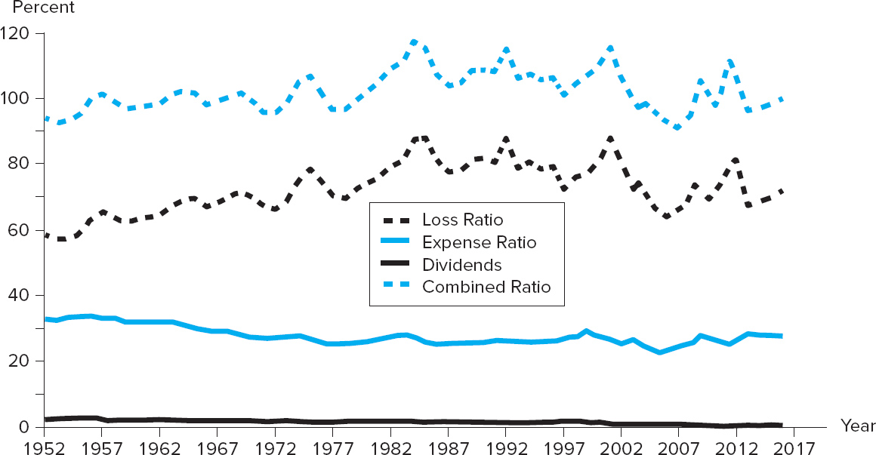
P&C Industry Underwriting Ratios 3
Figure 15–2 Property–Casualty Industry Underwriting Ratios
Access the long description slide.

Slide 26
P&C Recent Trends
Many catastrophes of historically high severity have occurred recently.
  See Figure 15-3 for a list of U.S. catastrophes between 19 49 and 2016.
An underwriting cycle is a pattern that the profits in the P&C industry tend to follow.
The federal government has consistently increased their role of providing compensation and reconstruction assistance following natural disasters.

Slide 27
Property-Casualty (P&C)
Insurance Regulation
P&C insurers are chartered at the state level.
P&C insurers are regulated by state commissioners.
State guarantee funds provide (some) protection to policyholders, similar to the manner described for life insurance companies.
The NAIC provides services to state regulatory commissions such as the Insurance Regulatory Information System (IRIS).
Given the social welfare importance of some lines (example: workers’ compensation and auto insurance), state commissioners often set ceilings on the premiums and premium increases in these lines.

Slide 28
Global Issues
The U.S., Japan, China, the U.K., and France are the world’s five largest countries in terms of insurance premiums written.
Worldwide, 2012 was the third costliest year for the worldwide insurance industry (after 2011 and 2005).
  Natural disasters cost insurers $65 billion in 2012.
  Losses in the U.S. accounted for 90% of the total.
In 2012, total economic costs from natural disasters amounted to $160 billion, compared with $400 billion in 2011.

Slide 29
Distribution of Premiums Written on Various Life Insurance Lines Long Description
25.2% was accident and health, 20% was ordinary life, 30.4% was individual annuities, 18.6% was group annuities, 5.6% was group life, and 0.2% was other.
Return to slide containing original image.

Slide 30
P&C Industry Underwriting Ratios 2 Long Description
Dividends is about 2%, expense ratios were about 30%, loss ratios were about 70%, and the combined ratio is about 100%.
Return to slide containing original image.

