Slide 1
Chapter Seventeen
Investment Companies
©2019 McGraw-Hill Education. All rights reserved. Authorized only for instructor use in the classroom. No reproduction or further distribution permitted without the prior written consent of McGraw-Hill Education.

Slide 2
Investment Companies
Open-end mutual funds sell new shares to investors and redeem outstanding shares on demand at their fair market values.
  The first MF was established in Boston in 19 24.
  By 19 70, 361 MFs held about $50 billion in assets.
Hedge funds (HFs) are a type of investment pool that solicits funds from (wealthy) individuals and other investors (example: commercial banks) and invests these funds on their behalf.
Money market mutual funds (MMMFs) were introduced in 19 72.
Tax-exempt MMMFs were introduced in 19 79.
By 2016, 8,105 MFs held over $16 trillion in assets.

Slide 3
Mutual Fund Industry 1
Cash flows into MFs are highly correlated with the return on stock markets.
Growth has also resulted from the rise in retirement funds under management by MFs.
  MFs manage ~25% of retirement fund assets.
MFs are the second most important group of FIs as measured by asset size; second only to depository institutions.
  Banks’ share of all MF assets was 5% in 2016.
  Insurance companies managed 5% of MF industry assets in 2016.

Slide 4
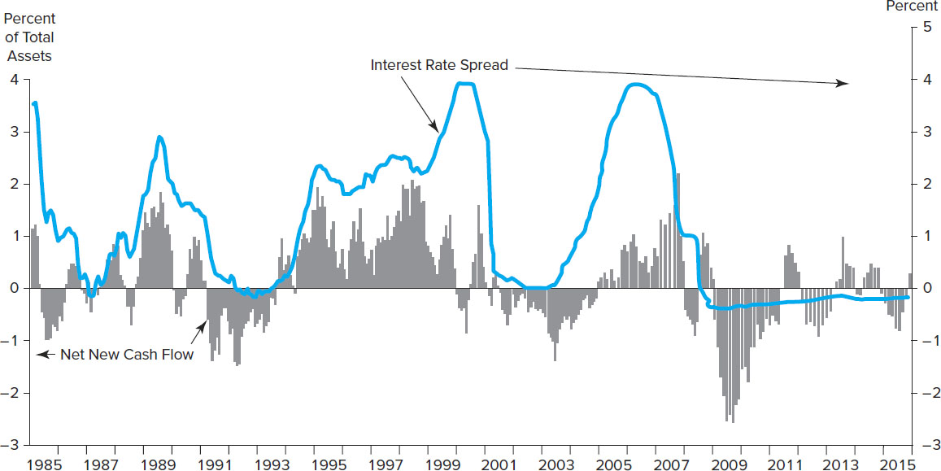
Interest Rate Spread and Net New Cash Flow to Taxable Retail MMFs
Figure 17-2 Interest Rate Spread and Net New Cash Flow to Taxable Retail Money Market Funds, 19 85 to 2016
Source: Investment Company Institute, Investment Company Fact Book, various issues. www.ici.org
Access the long description slide.

Slide 5
Mutual Fund Industry 2
In September 2008, the Primary Reserve Fund - a money market mutual fund - ‘broke the buck’ and had its share value fall below the standard $1 due to losses on $785 million of commercial paper issued by Lehman brothers.
This led to contagion and a run on money funds with over $200 billion outflows over the next few days.
The Treasury guaranteed payments on money funds for one year to stop the runs. The insurance ran out September 19, 2009.
New rules proposed by the SEC mandate money fund shares fluctuate with value of fund holdings to prevent runs.

Slide 6
Mutual Fund Industry Concluded
The barriers to entry in the MF industry are low.
  The largest MF sponsors have not increased their market share recently.
    The largest 25 companies that sponsor mutual funds managed 75% of industry assets in 2016, just slightly larger than 19 95.
  However, the composition of the top 25 fund sponsors in the industry has changed.
    15 of the largest fund companies in 2016 were not among the largest in 19 90.

Slide 7
Types of Mutual Funds
The MF industry has two sectors.
  Short-term funds invest in securities with original maturities of less than one year.
    Money market mutual funds (MMMFs) are funds consisting of various mixtures of money market securities.
    Tax-exempt money market mutual funds contain various mixed of those money market securities with an original maturity of less than one year.
  Long-term funds invest in portfolios of securities with original maturities of more than one year.
    Equity funds consist of common and preferred stock.
    Bond funds consist of fixed-income capital market debt securities.
    Hybrid funds consist of both stock and bond securities.

Slide 8
Types of Mutual Funds Concluded
Money market mutual funds (MMMFs) provide an alternative investment to interest-bearing deposits at commercial banks.
  Bank deposits are relatively less risky, because they are FDIC insured, and generally offer lower returns than MMMFs.
Households own the majority of MFs.
  Owned 57.4% of long-term funds in 2013.
  Owned 38.4% of short-term funds in 2013.
  44.4% of all U.S. households owned MFs in 2016—which represents ~55.9 million households.
  Typical owner has $94,300 invested in four funds.

Slide 9
Number of Mutual Funds, 19 80 through 2016
Table 17-3 Number of Mutual Funds, 19 80 through 2016
Year | Equity | Hybrid | Bond | Taxable money market | Tax-Exempt Money Market | Total
19 80* | 288 | n.a. | 170 | 96 | 10 | 564
19 90 | 1,099 | 193 | 1,046 | 506 | 235 | 3,079
2000 | 4,372 | 519 | 2,225 | 704 | 335 | 8,155
2007 | 4,742 | 478 | 2,001 | 545 | 260 | 8,026
2009 | 4,598 | 473 | 1,888 | 476 | 228 | 7,663
2012 | 4,501 | 560 | 1,941 | 400 | 180 | 7,582
2014 | 4,648 | 666 | 2,196 | 364 | 163 | 7,928
2015 | 4,764 | 717 | 2,154 | 336 | 145 | 8,116
2016 | 4,787 | 720 | 2,182 | 310 | 106 | 8,105
*Data from 19 80 are not comparable to current classification. All funds were reclassified in 19 84.
Source: Investment Company Institute, Trends in Mutual Fund Investing, November 2016. www.ici.org

Slide 10
Equity Valuation 1
Table 17-4 Selected Characteristics of Household Owner of Mutual Funds*
Blank | 19 95 | 2016
Demographic characteristics: | Blank | Blank
Median age | 44 years | 51 years
Median household income | $60,000 | $94,300
Median household financial assets | $50,000 | $200,000
Percentage of households: | Blank | Blank
Married or living with a partner | 71 | 71
Four-year college degree or more | 58 | 50
Employed | 80 | 76
*Characteristics of primary financial decision maker in the household.
†This number is for bond and income funds.
Sources: Investment Company Institute, Investment Company Fact Book, various issues. www.ici.org

Slide 11
Equity Valuation 2
Table 17-4 Selected Characteristics of Household Owner of Mutual Funds*
Blank | 19 95 | 20161
Fund types owned: | Blank | Blank
Equity | 73 | 86
Bond† | 49 | 46
Hybrid | n.a. | 35
Money market | 52 | 55
*Characteristics of primary financial decision maker in the household.
†This number is for bond and income funds.
Sources: Investment company Institute, Investment Company Fact Book, various issues. www.ici.org

Slide 12
Other Types of Investment Company Funds
An open-end MF is a fund for which the supply of shares is not fixed, but can increase or decrease daily with purchases and redemptions of shares.
  In 2016, there were $16,350 billion invested in 8,105 open-end mutual funds.
A closed-end investment company is a specialized investment company that has a fixed supply of outstanding shares, but invests in the securities and assets of other firms.
  In 2016, there were $265 billion invested in 545 closed-end funds.
A unit investment trust, such as a real estate investment trust, is a fund that sells a fixed number of redeemable shares that are redeemed on a set termination date.
  In 2016, there was about $74.25 billion invested in over 5,188 UITs.

Slide 13
Mutual Fund Prospectus and Objectives
MF managers must specify their fund’s investment objectives in a prospectus (a formal summary of a proposed investment), which is made available to potential investors.
  Holds lists of the securities invested in by the funds.
  In 19 98, the Securities and Exchange Commission (S E C) mandated that prospectuses must be written in “plain English” instead of overly legal language.
  No investor should invest in a fund without carefully reading the prospectus.
  The prospectus will contain historical return information, usually for 17-year, 3-year and 5-year periods and perhaps longer.
  The prospectus must also show historical fees and the effect of those fees on a given investment over time.
  Little information on risk is usually provided.

Slide 14
Index Funds and Exchange Traded Funds (ETFs)
In 2016, there were 406 index funds managing $2.2 trillion.
  Index funds are funds in which managers buy securities in proportions similar to those included in a specified major index.
  Index funds involve little research or management, which results in lower management fees and higher returns than actively managed funds.
Exchange traded funds (ETFs) are long-term mutual funds that are also designed to replicate a particular stock market index.
  Traded on exchanges at prices determined by the market.
  Management fees are lower than actively traded funds.
  Unlike index funds, ETFs can be traded during the day, sold short, and purchased on margin.
Notes:
Actively traded funds generally underperformed index funds across nearly all asset classes examined over the period 2004-2014.

Slide 15
Investor Returns from Mutual Fund Ownership
Investor returns from MF ownership reflect three components.
  Income and dividends on portfolio assets.
  Capital gains on assets bought and sold at higher prices.
  Capital appreciation on assets held in the fund.
MF assets are marked to market daily.
  Managers of the fund calculate the current value of each mutual fund share by computing the daily market value of the fund’s total asset portfolio less any liabilities and then dividing this amount by the number of mutual fund shares outstanding.
The net asset value (NAV) of a MF share is equal to the market value of the assets in the MF portfolio divided by the number of shares outstanding.

Slide 16
Mutual Fund Costs
MFs charge investors fees for the services they provide.
  Sales loads (front end or back end).
  12b-1 fees are fees related to the distribution costs of MF shares.
    Marking and distribution expenses cannot exceed 0.75% of a fund’s average net assets per year.
    FINRAvalso imposes an annual cap of 0.25% on shareholder service fees.
  MFs may offer different share classes with different combinations of loads.
A load fund is an MF with an up-front sales or commission charge that the investor must pay.
A no-load fund is an MF that does not charge up-front sales or commission charges on the sale of mutual fund shares to investors.

Slide 17
Largest Mutual Funds in Assets Managed 1
Table 17-6 The Largest Mutual Funds in Assets Managed
Name of Fund | Objective | Total Assets (in millions of dollars) | 12-Month | Total Return 5-Year | 10 year | NAV | Initial Fees
Vanguard 500 Index;Adm | S&P 500 Index | $169,749 | 15.39% | 16.33% | 7.23% | $200.62 | 0.00%
Vanguard Tot Stk Idx;Adm | Growth/Income | 140,730 | 14.98 | 16.33 | 7.53 | 54.19 | 0.00
Vanguard Instl Indx;Inst | S&P 500 Index | 114,076 | 15.41 | 16.35 | 7.24 | 198.50 | 0.00
Vanguard Tot Stk Inx;Inv | Growth/Income | 100,943 | 14.85 | 16.20 | 7.41 | 54.16 | 0.00
Vanguard Instl Index;InsP | S&P 500 Index | 89,057 | 15.43 | 16.37 | 7.26 | 198.51 | 0.00
Vanguard Tot I Stk;Inv | International | 87,057 | 9.53 | 6.71 | 2.15 | 14.69 | 0.00
Fidelity Contrafund | Growth | 75,749 | 10.51 | 15.41 | 8.62 | 100.29 | 0.00
Vanguard T StMk Idx;Inst | Growth/Income | 73,870 | 15.00 | 16.34 | 7.54 | 54.20 | 0.00
American Funds Growth;A | Growth | 73,178 | 8.43 | 15.20 | 6.80 | 43.77 | 5.75
American Funds Inc;A | Income | 72,848 | 7.34 | 9.46 | 5.31 | 21.26 | 5.75

Slide 18
Largest Mutual Funds in Assets Managed 2
Table 17-6 The Largest Mutual Funds in Assets Managed
Name of Fund | Objective | Total Assets (in millions of dollars) | 12-Month | Total Return 5-Year | 10 year | NAV | Initial Fees
Vanguard Wellington;Adm | Balanced | 72,324 | 12.03 | 11.60 | 7.23 | 67.28 | 0.00
American Funds CIB;A | International / Income | 69,166 | 4.67 | 7.64 | 4.34 | 56.90 | 5.75
Vanguard T IntlStIdx;Inst | International | 64,511 | 9.70 | 6.84 | - | 98.27 | 0.00
Fidelity 500 Index:Pr | S&P 500 Index | 56,852 | 15.40 | 16.33 | 7.21 | 76.41 | 0.00
American Funds InvCoA | Growth/Income | 56,519 | 10.95 | 14.38 | 5.98 | 36.64 | 5.75
Dodge & Cox Stock | Growth/Income | 55,832 | 14.53 | 17.10 | 5.52 | 182.21 | 0.00
Dodge & Cox Intl Stock | International | 55,245 | 5.62 | 8.17 | 2.88 | 38.79 | 0.00
American Funds Bal;A | Balanced | 54,031 | 5.64 | 10.80 | 6.18 | 24.94 | 5.75
American Funds CWGI;A | Global | 51,069 | 4.62 | 10.22 | 4.71 | 44.63 | 5.75
American Funds Wash;A | Growth/Income | 50,334 | 8.57 | 13.23 | 5.94 | 41.33 | 5.75
Sources: The Wall Street Journal Online, November 11, 2016. Reprinted by permission of the Wall Street Journal © 2016 Dow Jones & Company, Inc. All Rights Reserved Worldwide www.wsj.com; and authors’ research.

Slide 19
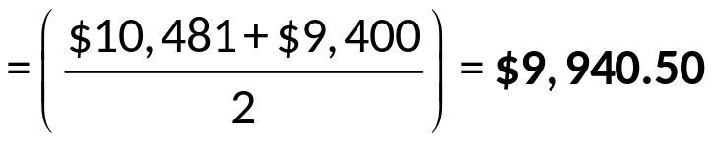
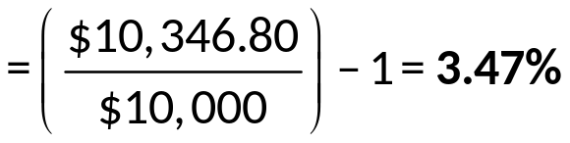
Example
This year an investor placed $10,000 in a mutual fund with a 6% load (one time fee) and estimated annual expenses of 1.35%. Fees are charged against average assets for the year. The fund’s gross return is 11.5%. What was the investor’s first year return net of loads and expenses?
Amount initially invested = $10,000 – (0.06 × $10,000) = $9,400
Amount after gross return = $9,400 × 1.115 = $10,481
Average asset value for year
Fees = $9,940.50 * 0.0135 = $134.20
Ending amount after fees = $10,481 - $134.20 = $10,346.80
Net rate of return (first year)

Slide 20
Mutual Fund Regulation
MFs are heavily regulated because they manage and invest small investor savings.
  The SEC is the primary regulator.
    The Securities Act of 19 33.
    The Securities Exchange Act of 19 34.
  The Investment Advisers Act and Investment Company Act of 19 40.
  The Insider Trading and Securities Fraud Enforcement Act of 19 88.
  The Market Reform Act of 19 90.
  The National Securities Market Improvement Act (NSMIA) of 19 96.

Slide 21
Investor Abuses
Even with heavy regulation, investor abuses still occur.
  Market timing is short-term trading of mutual funds that seeks to take advantage of short-term discrepancies between the price of a mutual fund’s shares and out-of-date values on the securities in the fund’s portfolio.
  Late trading involves buys and sells long after prices have been set at 4:00 pm E.T.
  Directed brokerage occurs when brokers improperly influence investors on their fund recommendations.
  Improperly assessed fees occur when brokers trick customers into thinking they are buying no-load funds or fail to provide discounts properly.

Slide 22
Global Issues
During the 19 90s, mutual funds were the fasting growing financial institution in the United States.
Worldwide investments (other than in the U.S.) in mutual funds have increased over 187%, from $4.916 trillion in 19 99 to $14.130 trillion in 2007.
  This compares to growth of 75% in U.S. funds.
Non-U.S. mutual funds experienced bigger losses in total assets during the financial crisis.
  Worldwide funds fell to 49.316 trillion (34.1%) in 2008, while U.S. funds fell to $9.603 trillion (20%).
  By 2016, worldwide investments in mutual funds increased to $21.16 trillion (an increase of 127% from 2008), while U.S. investments increased to $18.13 trillion (an increase of 88.8%).

Slide 23
Hedge Funds 1
Hedge funds (HFs) are investment pools that solicit funds from wealthy individuals and other investors (example: commercial banks) and invest these funds on their behalf.
  Similar to MFs, but smaller funds under $100 million in assets are not required to register with the SEC.
  Subject to less regulatory oversight than mutual funds and generally can (and do) take significantly more risk than MFs.
  Do not have to publicly disclose their activities to third parties and thus offer a high degree of privacy.
HFs avoid regulation by limiting the number of investors to less than 100 and by requiring investors to be “accredited”.
  Accredited investors have net worth over $1 million or annual income over $200,000 if single (or $300,000 if married).

Slide 24
Hedge Funds 2
HFs use more aggressive trading strategies than MFs, such as short selling, leveraging, program trading, arbitrage, and the use of derivatives.
Because not all HFs are registered, industry and firm data cannot be accurately tracked (that is the data is self-reported).
  ~ 10,000 HFs in the U.S. in 2013.
  ~ $2.98 trillion in assets in 2016.

Slide 25
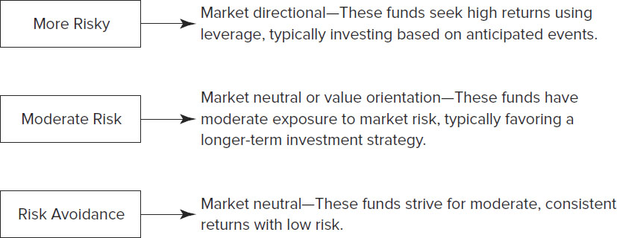
Types of Hedge Funds
Figure 17-4 Classification of Hedge Funds
Access the long description slide.

Slide 26
Fees on Hedge Funds
Management fees on HFs are computed as a percent of total assets under management and run between 1.5% and 2%.
Performance fees give fund managers a share of any positive returns on a hedge fund.
  The average is 20%, but performance fees vary substantially depending on the HF.
  A hurdle rate is a benchmark that must be realized before a performance fee can be assessed.
  A high-water mark is when a manager does not receive a performance fee unless the value of the fund exceeds the highest NAV it has previously achieved.
Offshore HFs are attractive to investors because they provide anonymity and are not subject to U.S. taxes.

Slide 27
Assets and Liabilities of U.S. Finance Companies, June 2016
Table 17-11 Largest Hedge Fund Firms by Assets Managed
Name of Fund | Country | Total Assets (in billions)
Bridgewater Associates | United States | $104.2
Man Group | United Kingdom | 76.4
AQR Capital Management | United States | 47.2
Och-Ziff Capital Management | United States | 44.6
Two Sigma Investments | United States | 35.0
Millennium Management | United States | 34.0
Winton Capital Management | United Kingdom | 34.0
D.E. Shaw & Co. | United States | 33.1
Viking Global Investors | United States | 33.1
B1ackRock Advisors | United States | 31.1
Source: Institutional Investor. www.institutionalinvestor.com

Slide 28
Regulation of Hedge Funds
While mutual funds are very highly regulated, hedge funds have generally been unregulated.
  Mutual funds in the U.S. are required to be registered with the SEC.
Hedge funds operate under two exemptions from registration requirements as set forth in the Investment Company Act of 19 40.
  Funds are exempt if they have less than 100 investors.
  Funds are exempt if the investors are “accredited”.
Hedge funds are only sold via private placements, and may not be offered or advertised to the general investing public.

Slide 29
Top Hedge Funds by Fund Earnings, 2008 to 2009
Table 17-12 Top Hedge Funds by Fund Earnings, 2008 to 2009
Fund, Manager Name(s) | Fund Company | 2009 Return | 2008 Return
Appaloosa Investment I, David Tepper | Appaloosa Management | 117.30% | −26.7%
Redwood Capital Master, Jonathan Kolatch | Redwood Capital Management | 69.1 | −33.0
Glenview Institutional Partners, Larry Robbins | Glenview Capital Management | 67.1 | −49.0
PARS IV, Changhong Zhu | Pacific Investment Management | 61.0 | −17.0
Tennenbaum Opportunities V, TCP Investment Committee | Tennenbaum Capital Partners | 58.5 | −51.2
Kensington Global Strategies, Kenneth Griffin | Citadel Investment Group | 57.0 | −55.0
BlueGold Global, Pierre Andurand, Dennis Crema | BlueGold Capital Management | 54.6 | 209.4
Waterstone Market Neutral Master, Shawn Bergerson | Waterstone Capital Management | 50.3 | 12.0
Canyon Value Realization, Mitchell Julis, Joshua Friedman | Canyon Partners | 49.6 | −29.0
Discovery Global Opportunity, Robert Citrone | Discovery Capital Management | 47.9 | −31.0
Source: Bloomberg, 2009. www.bloomberg.com

Slide 30
High Profile Hedge Funds Problems
The collapse of the two Bear Stearns hedge funds led to investor losses of $1.6 billion and led to the bankruptcy of the company.
Bernard Madoff Investment Securities run by former NASDAQ chairman Bernie Madoff ran a $65 billion Ponzi scheme.
In October 2009, a large hedge fund, Galleon Group LLC, was closed due to an insider trading scandal.
In July 2013, SAC Capital was charged with pervasive violations of inside trading laws.

Slide 31
Interest Rate Spread and Net New Cash Flow to Taxable Retail MMFs Long Description
The vertical axis provided on the left gives the net new cash flow as a percent of total assets. The vertical axis provided on the right gives the interest rate spread (percent). The net new cash flow was sometimes positive and sometimes negative, but tended to fluctuate between negative 1 percent and 1 percent. The interest rate spread was generally positive, but fluctuated from about negative 0.25% to about 3%. In the recent past the interest rate spread was about negative 0.25%.
Return to slide containing original image.

Slide 32
Types of Hedge Funds Long Description
More risky - market directional - these funds seek high returns using leverage, typically investing based on anticipated events. Moderate risk - market neutral or value orientation - these funds have moderate exposure to market risk, typically favoring a longer-term investment strategy. Rick avoidance - market neutral - these funds strive for moderate, consistent returns with low risk.
Return to slide containing original image.

