Slide 1
Chapter Eighteen
Pension Funds
©2019 McGraw-Hill Education. All rights reserved. Authorized only for instructor use in the classroom. No reproduction or further distribution permitted without the prior written consent of McGraw-Hill Education.

Slide 2
Pension Funds 1
Pension funds (PFs) offer savings plans through which fund participants accumulate tax-deferred savings during their working years before withdrawing them in their retirement years.
  Earnings on funds invested are exempt from current taxation (that is during working years).
  Tax payments are not made until funds are withdrawn by the participant (that is during retirement).
PFs were first established in the U.S. in 17 59 to benefit the widows and children of church ministers.
The first corporate PF was established by American Express Co. in 18 75.

Slide 3
Pension Funds 2
By 19 40, approximately 400 PFs existed.
  Most were for employees in the railroad, banking, and public utilities industries.
Currently, over 680,000 PFs exist.
  34% of U.S. households’ financial assets were in PFs in 2016.
  Compares to just over 5% in 19 50.
The financial crisis reduced global pension assets from $25 trillion to $20 trillion.
U.S. retirement accounts fell by $2 trillion, causing many to postpone retirement and reduce spending to save more.

Slide 4
Private versus Public Pension Funds
There are two distinct PF sectors.
  Private PFs are funds administered by private corporations (example: insurance companies or mutual funds).
    Total financial assets in 2016 were $11,803.6 billion.
  Public PFs are funds administered by federal, state, or local governments (example: Social Security).
    Total financial assets in 2016 were $9,929.4 billion.

Slide 5
Pension Funds Concluded
A pension plan governs the operation of a pension fund.
Pension funds are broadly classified into two categories: defined benefit plans and defined contribution plans.
A defined benefit PF is a fund in which the employer agrees to provide the employee with a specific cash benefit upon retirement.
  A flat benefit formula PF pays a flat amount for every year of employment.
  A career average formula PF pays benefits based on the employee’s average salary over the entire period of employment.
  A final pay formula PF pays benefits based on a percentage of the average salary during a specified number of years at the end of the employee’s career times the number of years of service.

Slide 6
Example 1: Defined Benefit Plans
An employee works 20 years for a firm. Her average salary over her entire career with the firm was $65,000, and $75,000 over the last five years. Find the annual retirement benefit for various defined benefit plans.
Assume the employer pays a flat benefit of $2,000 per year worked:
$2,000 × 20 years = $40,000
Assume the employer pays a career average of 4% of the career average salary * number of service years.
$65,000 × 0.04 × 20 years = $52,000
Assume the employer uses final pay, specifically 4% of the last five years of salary times the number of years of service:
$75,000 × 0.04 × 20 years = $60,000

Slide 7
Plan Funding
Defined benefit PFs.
  A fully funded PF has sufficient funds available to meet all future payment obligations.
  An underfunded PF does not have sufficient funds available to meet all future promised payments.
  An overfunded PF has more than enough funds available to meet the required future payouts.

Slide 8
Defined Contribution PFs
A defined contribution PF is a fund in which the employer agrees to make a specified contribution to the pension fund during the employee’s working years.
  Fixed-income funds typically offer a guaranteed minimum rate of return.
  With variable-income funds, all profits and losses on the underlying securities are passed through to the fund participants.

Slide 9
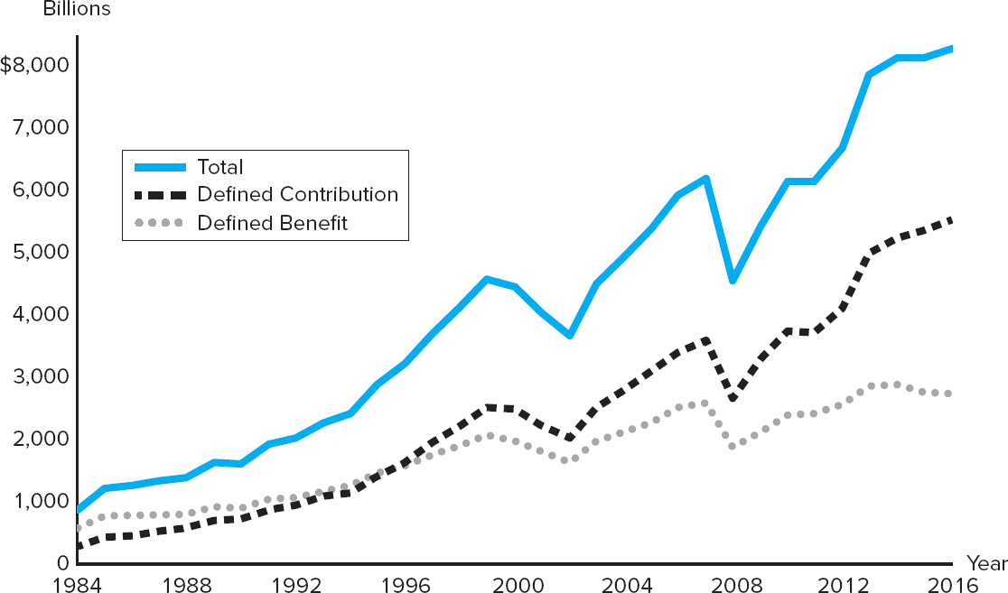
Private Pension Fund Assets, 19 84 to 2016
Figure 18–1 Private Pension Fund Assets, 19 84 to 2016
Sources: Federal Reserve Board, “Flow of Fund Accounts,” various issues. www.federalreserve.gov
Access the long description slide.

Slide 10
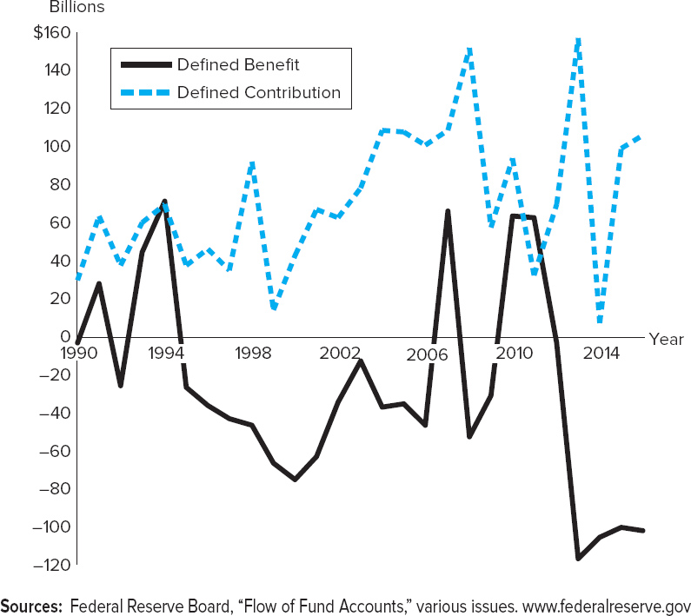
Net Acquisition of Financial Assets, DB and DC Funds
Figure 18–2 Net Acquisition of Financial Assets, Defined Benefit and Defined Contribution Funds
Sources: Federal Reserve Board, “Flow of Fund Accounts,” various issues. www.federalreserve.gov
Access the long description slide.

Slide 11
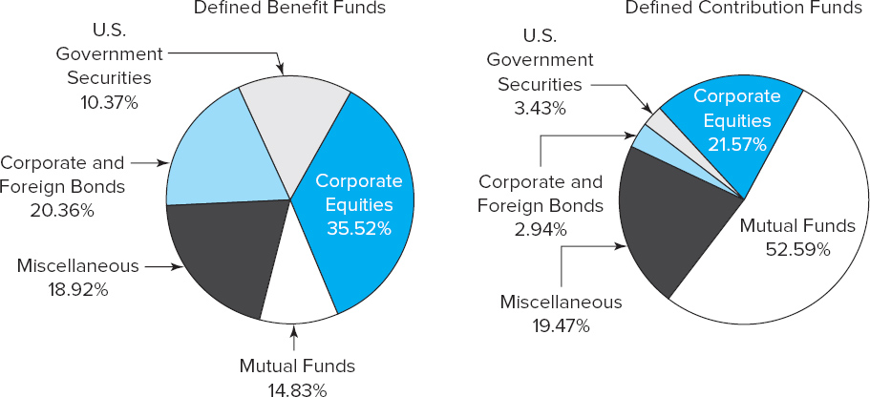
Financial Assets in DB and DC Pension Funds
Figure 18–4 Financial Assets in Defined Benefit and Defined Contribution Pension Funds
Source: Federal Reserve Board, “Flow of Fund Accounts,” November 2016. www.federalreserve.gov
Access the long description slide.

Slide 12
Pension Fund Administration
Pension funds may be either insured or noninsured.
  An insured pension fund is administered by a life insurance company.
  A noninsured pension fund is administered by some other type of financial institution.
Private pension funds are created by private entities and administered by private corporations.
  $11,803.6 billion in total financial assets in 2016.
    Life insurance companies administered $2,928.3 billion.
    Mutual funds administered $3,317.6 billion.
    Other financial institutions (example: banks) administered $5,557.7 billion.

Slide 13
Private Pension Funds
401(k) and 403(b) plans are employer-sponsored plans that supplement a firm’s basic retirement plan.
  Allow for both employer and employee contributions.
  401(k) plans are offered to employees of taxable firms.
  403(b) plans are offered to employees of tax exempt employers.
  Contributions are made on a pretax basis and thus reduce the employee’s taxable salary.
  Most plans are transferable if the employee changes jobs.
  Participants generally make their own choice of the allocation of assets from both employee and employer contributions.
    Younger participants generally invest more in equities while older participants generally invest more in fixed-income securities.

Slide 14
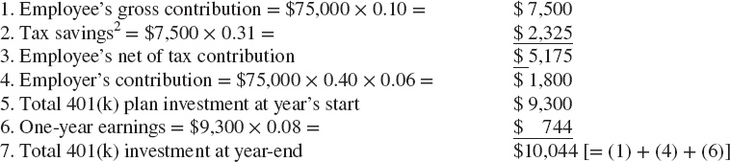

Return on a 401(k)
Example 18-4 Calculating the Return on a 401(k) Plan
An employee contributes 10 percent of his $75,000 salary into the company’s 401(k) plan. The company matches 40 percent of the first 6 percent of the employee’s salary. The employee in the 31 percent tax bracket and the 401(k) plan excepts to yield an 8 percent rate of return. The employee’s own contribution and his plan return for one year are calculated as follows.
Assuming the employee’s salary, tax rate, and 401(k) yield remain constant over a 20-year career, when the employee retires, the 401(k) will be worth:
The employee’s net of tax contributions over the period total $5,175 × 20 = $103,500.
Access the long description slide.
Notes:
You may wish to point out that actual price changes are curvilinear, duration based predicted price changes are linear with r.
Volatility varies along line: prices are a nonlinear function of interest rates, Blue line is actual price change, green line is predicted price change.
Concept: At higher interest rates, volatility is lower: Reason is that discounting far out cash flows more heavily to begin with at higher interest rates, this increases the near term percentage PV weights in relation to the long term weights.
The four variables that affect volatility are coupon and maturity (which are captured by duration), change in ytm or change in r and the starting ytm or the starting r. (r = ytm)

Slide 15
Asset Allocation 1
Example 18–5 Impact of Asset Allocation on a 401(k) Plan Return
An employee contributes $10,000 to a 401(k) plan each year, and the company matches 20 percent of this annually, or $2,000. The employee can allocate the contributions among equities (earning 10 percent annually), bonds (earning 6 percent annually), and money market securities (earning 4 percent annually). The employee expects to work at the company 30 years. The employee can contribute annually along one of the three following patterns:
Notes:
So the only other two variables needed to predict volatility are r and the change in r.

Slide 16
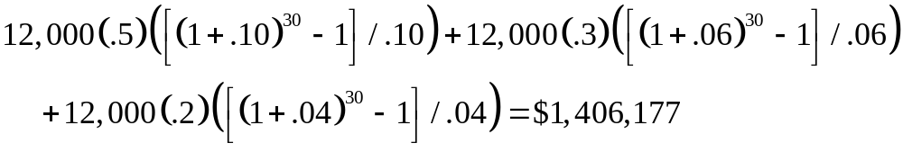
Asset Allocation 2
Blank | Option 1 | Option 2 | Option 3
Equities | 60% | 50% | 40%
Bonds | 40% | 30% | 50%
Money Market Securities | 0% | 20% | 10%
Blank | 100% | 100% | 100%
The terminal value of the 401(k) plan, assuming all returns and contributions remain constant (at $12,000) over the 30 years, will be:
Option 1:
Option 2:

Slide 17
Asset Allocation 3
Example 18–5 Impact of Asset Allocation on a 401(k) Plan Return
An employee contributes $10,000 to a 401(k) plan each year, and the company matches 20 percent of this annually, or $2,000. The employee can allocate the contributions among equities (earning 10 percent annually), bonds (earning 6 percent annually), and money market securities (earning 4 percent annually). The employee expects to work at the company 30 years. The employee can contribute annually along one of the three following patterns:
Notes:
Note that if the security makes semiannual or monthly payments then the cash flow, the interest rate and the number of periods must be adjusted to reflect the payment frequency.

Slide 18
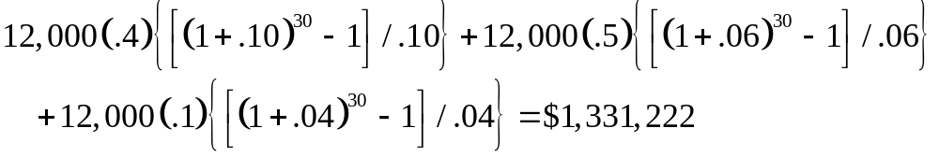
Asset Allocation 4
Blank | Option 1 | Option 2 | Option 3
Equities | 60% | 50% | 40%
Bonds | 40% | 30% | 50%
Money Market Securities | 0% | 20% | 10%
Blank | 100% | 100% | 100%
The terminal value of the 401(k) plan, assuming all returns and contributions remain constant (at $12,000) over the 30 years, will be:
Option 3:
Which option is riskier?

Slide 19
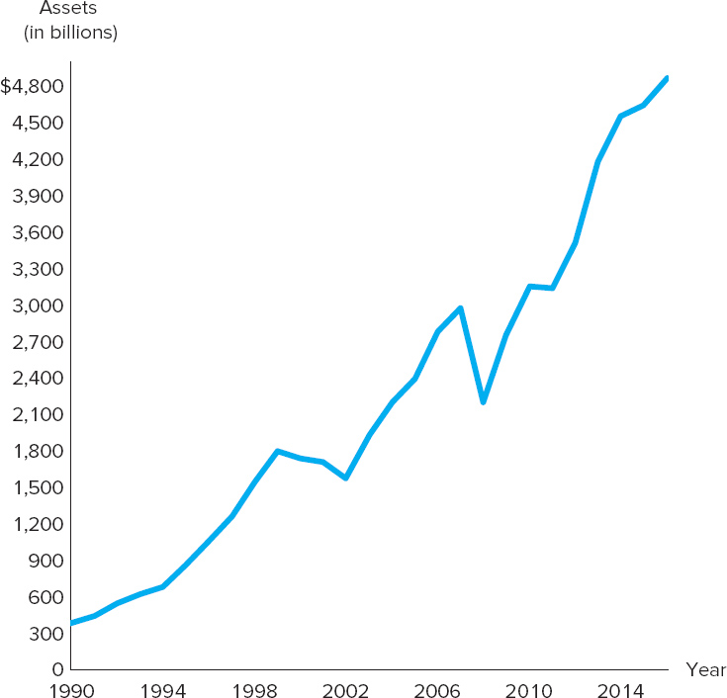
Assets in 401(k) Plans
Figure 18–3 Assets in 401(k) Plans
Sources: Investment Company Institute, Mutual Fund Fact Book, various years. www.ici.orga
Access the long description slide.

Slide 20
I R A s
Individual retirement accounts (IRAs) are self-directed retirement accounts set up by employees who may also be covered by employer-sponsored pension plans as well as self-employed individuals.
  Contributions are made strictly by the employee.
  First introduced in 19 81 to supplement employer-sponsored programs.
  As of 2017, maximum contributions were $5,500 per year.
Roth IRAs were introduced in 19 98.
  In 2016, they allowed a maximum of $5,500 after-tax contribution per individual ($11,000 per household).
  Contributions are taxed in the year of contributions, while withdrawals are tax-free as long as they have been invested at least five years and the account holder is at least 59 ½ years old.
  Income test for availability.
Notes:
This version is in closed form, no summation needed. It is convenient for longer term securities.
If you divide by Price*m you get the duration in years. m= # of compounding or payment periods per year.
I believe the citation is:
Caks, J., Lane, W. R., Greenleaf, R. W., & Joules, R. G. (1985). A SIMPLE FORMULA FOR DURATION. Journal Of Financial Research, 8(3), 245.

Slide 21
Roth IRAs versus Traditional IRAs 1
Table 18–4 Differences between a Roth IRA and a Traditional IRA
Terms | Roth IRA | Traditional IRA
Tax benefits | Tax-free growth Tax-free qualified withdrawals | Tax-deferred growth Contributions may be tax deductible
Eligibility—age | Any age with employment compensation | Under age 70½ with employment compensation
Eligibility—income | 2017 single filers Full contribution: up to $118,000 Partial contribution: $118,000 to $133,000 2017 joint filers Full contribution: up to $186,000 Partial contribution: $186,000 to $196,000 | Full deductibility of a contribution for 2017 is available to active participants whose 2017 modified adjusted gross income (MAGI) is $99,000 or less (joint) and $61,000 or less (single); partial deductibility for MAGI up to $119,000 (joint) and $71,000 (single). In addition, full deductibility of a contribution is available for working or nonworking spouses who are not covered by an employer-sponsored plan whose MAGI is less than $99,000 for 2017; partial deductibility for MAGI up to $119,000.
Maximum contribution | 2016: $5,500 ($6,500 if you are 50 or older) or 100% of employment compensation, whichever is less | Blank

Slide 22
Roth IRAs versus Traditional IRAs 2
Terms | Roth IRA | Traditional IRA
Catch-up contribution | Individuals aged 50 or older (in the calendar year of their contribution) can contribute an additional $1,000 each year | Blank
Contribution deadline | April 15th of the following tax year | April 15th of the following tax year
Taxation at withdrawal | Contributions are always withdrawn tax-free Earnings are federally tax-free after the five-year aging requirement has been satisfied and one of the following conditions has been met: age 59½, death, disability, or qualified first-time home purchase | Withdrawals of pretax contributions and any earnings are taxable when distributed
Notes:
This really doesn’t demonstrate the usage of modified duration (MD). MD is used for non-annual payment securities.

Slide 23
Roth IRAs versus Traditional IRAs 3
Terms | Roth IRA | Traditional IRA
Penalties at withdrawal | A nonqualified distribution is subject to taxation of earnings and a 10 percent additional tax unless an exception applies | Withdrawals before age 59½ may be subject to a 10 percent early withdrawal penalty unless an exception applies
Minimum required distributions (MRDs) | Not subject to minimum required distributions during the lifetime of the original owner | MRDs starting at 70½

Slide 24
Public Pension Funds 1
State or local government pension funds.
  “Pay as you go” in that current employee contributions fund current retiree benefits.
  Because of an increasing number of retirees relative to workers, some funds’ current payments exceed current contributions.
Federal government pension funds.
  Civil service funds cover all federal employees not in the armed forces.
    Such employees are not covered by Social Security.
  A military pension fund covers career military personnel.
    Military personnel are also covered by Social Security.
    Military personnel are eligible after 20 years of military service.
Notes:
Note that the annual change in interest rates is plugged into the prediction model. An example calculation is provided at the end of this file.

Slide 25
Public Pension Funds 2
Social Security, aka Old Age and Survivors Insurance Fund.
  Provides retirement benefits to almost all employees and self-employed individuals in the U.S.
  Established in 19 35 to provide a minimum level of retirement income to all retirees.
  Funded on a “pay as you go” basis.
  Historically, contributions have exceeded disbursements.
    FICA contributions are 7.65% of the first $115,500 earned in 2016 (which is also matched by an employer contribution of 7.65%).
    Self-employed individuals pay the full 15.30%.
  Disbursements exceeded revenues (excluding interest) for the first time in 2010.
  System is expected to be bankrupt by 2034.
Notes:
Duration is an accurate predictor of price changes only for very small interest rate changes. For day to day fluctuations duration works quite well but when interest rates move significantly, such as when the Fed makes an announcement of a rate change, the predicted pricing errors can become significant. The prediction errors arise because bond prices are not linear with respect to interest rates.

Slide 26
Private Pension Fund Investments
Private Pension Funds.
  Financial assets held by private pension funds in 19 75 totaled $244.3 billion and $8.838.6 billion in 2016.
    In 2016, 62.11% of pension fund assets were in corporate equities or equity mutual fund shares. This compares to 44.61% in 19 75.
  In 2016, defined benefit funds had 30.73% of their funds invested in U.S. government securities and corporate and foreign bonds compares to 6.37% for defined contribution funds.
    Defined benefit funds had 35.52% percent of their assets invested in corporate equities compared to 21.57% by defined contribution funds.

Slide 27
Assets Held by Private Pension Funds, 1975 and 2016
Table 18–5 Financial Assets Held by Private Pension Funds, 1975 and 2016 (in billions)
Blank | 19 75 | 19 75 | 2016 | 2016
Total financial assets | $244.30 | 100.00% | $8,838.6 | 100.00%
Checkable deposits and currency | 4.4 | 1.77 | 21.1 | 0.24
Time and savings deposits | 14.5 | 5.84 | 37.6 | 0.43
Money market mutual shares | 0 | 0.00 | 154.8 | 1.75
Security RPs | 4.3 | 1.73 | 2.6 | 0.03
Credit market instruments | 71.3 | 28.70 | 1,267.6 | 14.34
Open market paper | 9.1 | 3.66 | 47.3 | 0.54
Treasury securities | 12.4 | 4.99 | 322.9 | 3.65
Agency- and GSE-backed securities | 5.5 | 2.22 | 152.8 | 1.73
Corporate and foreign bonds | 41.9 | 16.87 | 723.9 | 8.19
Mortgages | 2.4 | 0.96 | 20.7 | 0.23
Corporate equities | 108 | 43.48 | 2,172.1 | 24.57
Mutual fund shares | 2.8 | 1.13 | 3,317.6 | 37.54
Miscellaneous assets | 43.1 | 17.35 | 1,865.2 | 21.10
Sources: Federal Reserve Board, “Flow of Fund Accounts,” various issues.
www.federalreserve.gov
Notes:
Dur Annual = 4.3774 years.

Slide 28
Public Pension Fund Investments
Social Security.
  Contributions are invested in relatively low risk and low-return U.S. Treasury securities.
  Slow population growth and an increasing retirement population challenge the long-term viability of Social Security.
Social Security was restructured in the mid-19 90s.
  Contributions were increased and benefits were decreased.
    Full retirement age is 67 for people born after 19 59.
    Dollar amount of income subject to FICA increases nearly every year.
Future changes to Social Security are slow to occur.
  Increasing contributions and decreasing benefits are unpopular with the public, and are thus unpopular with politicians seeking election or re-election.
  The economic downturn in the U.S. has shifted the spotlight away from Social Security.
Notes:
Dur Annual = 4.3774 years.

Slide 29
Pension Fund Regulation
The Employee Retirement Income Security Act (ERISA) of 19 74 focused on five areas of reform:
  Pension plan funding.
  Vesting of benefits.
  Fiduciary responsibility.
  Pension fund transferability.
  Pension fund insurance.

Slide 30
Regulation - Funding
Funding.
  Prior to ERISA, regulation did not require defined benefit fund administrators to adequately fund their pension funds.
  ERISA established guidelines for funding and set penalties for fund deficiencies.
    Contributions must be sufficient to meet all annual costs and expenses.
    Contributions must be sufficient to fund any unfunded historical liabilities over a 30-year period.
    Any new underfunding must be funded over a 15-year period.
    Has led many defined benefit plans to switch over to a defined contribution structure.

Slide 31
Regulation – Vesting and Fiduciary Responsibilities
Vesting of benefits.
  A vested employee is an employee who is eligible to receive pension benefits because he or she has worked for a stated period of time
  Prior to ERISA, vesting could take up to 25 years.
  ERISA set the maximum vesting period at 10 years.
Fiduciary responsibilities.
  A PF fiduciary is a trustee/investment advisor that manages a PF.
  ERISA requires that PF contributions be invested with the same diligence, skill, and care as a “prudent person” in like circumstances.
  The sole objective of PF management is to provide the promised benefits to the plan participants.

Slide 32
Regulation – Transferability and Insurance
Transferability.
  ERISA allows employees to transfer pension credits from one employer to another when switching jobs.
Insurance.
  ERISA established the Pension Benefit Guarantee Corporation (PBGC), an insurance fund for pension fund participants similar to the FDIC.
  PBGC insures participants of defined benefit pension funds if the proceeds from the fund are unable to meet its promised pension obligations.
  Employers paid $1 in premiums per employee when PBGC was created in 19 74.
    In 2017, the maximum annual coverage for workers who will begin receiving payments from PBGC at age 65 was $64,432.

Slide 33
Regulation – Insurance 1
Insurance.
  Due to chronic deficits, the Retirement Protection Act of 19 94 attempted to strengthen the PBGC.
    The act forced the PBGC to change to a move overtly risk-based premium plan, and underfunded programs were subjected to even higher premiums.
    By 2000, the PBGC operated at a record surplus of $9.7 billion.
  Large bankruptcies in the early 2000s resulted in the agency posting a $23.3 billion deficit and a call for additional reform in 2005.

Slide 34
Regulation – Insurance 2
The Pension Protection Act of 2006.
  Increased annual premiums paid by companies to $30 per worker from $19.
  Imposed automatic increases in premiums each year (which are tied to average wage increases of U.S. workers).
    As of 2018, rates are $74 per participant for single-employer plans and $28 per participant for multi-employer plans.
    Underfunded pension plans pay an addition variable rate change of $38 per $1,000 of unfunded vested benefits.
  The act gives companies 5 years (rather than the previous 20 years) to make up shortfalls in their defined benefit plans.

Slide 35
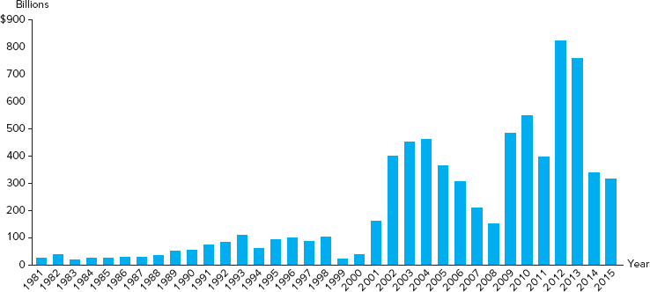
Underfunding of Single-Employer Plans
Figure 18–5 Total Underfunding of Insured Single-Employer Plans
Sources: Pension Benefit Guaranty Corporation website, various dates. www.pbgc.gov
Access the long description slide.

Slide 36
Global Issues
Pension systems vary widely in Europe.
  The U.K., the Netherlands, Ireland, Denmark, and Switzerland all have a tradition of state- (or public-) funded pension schemes.
  Spain, Portugal, and Italy have less developed pension systems.
  France uses a pay-as-you-go system.
One method of distinguishing systems across countries is by the extent to which a person’s contributions are linked to the benefits he/she receives in retirement.
  The link between contributions and benefits is weak in France and Germany, but strong in Sweden, Italy, the U.K., and Chile.
Reform around the globe has included benefit reduction, measures to encourage later retirement, and expansions of private funding for government pensions.

Slide 37
Private Pension Fund Assets, 19 84 to 2016 Long Description
Defined contributions and defined benefits increased over this time period. Defined contributions increased from about 200 billion to about 5000 billion in 2016. Defined benefits rose from about 500 billion to about 2 trillion in 2016.
Return to slide containing original image.

Slide 38
Net Acquisition of Financial Assets, DB and DC Funds Long Description
The net acquisition of defined contribution funds has fluctuated greatly from 19 90 to 2016 between about 10 billion and 150 billion. The net acquisition of defined benefit funds also fluctuated greatly between negative 120 billion and 70 billion.
Return to slide containing original image.

Slide 39
Financial Assets in DB and DC Pension Funds Long Description
For defined benefit funds, 35.52% were corporate equities, 20.36% was corporate and foreign bonds, 10.37% was U.S. government securities, 18.92% was miscellaneous, and 14.83% was mutual funds. For defined contribution funds, 52.59% are mutual funds, 21.57% were corporate equities, 19.47% were miscellaneous, 2.94% were corporate and foreign bonds, and 3.43% were U.S. government securities.
Return to slide containing original image.

Slide 40
Return on a 401(k) Long Description
1. Employee's gross contribution is $7,500.
2. Tax savings is $2,325.
3. Employee's net of tax contribution is $5,175.
4. Employer's contribution is $1,800
5. Total 401K plan investment at year's start is $9,300.
6. One-year earnings is $744.
7. Total 401K investment at year-end is $10,044, which is the sum of the employee's gross contribution, the employer contribution, and the one year earnings.
Return to slide containing original image.

Slide 41
Assets in 401(k) Plans Long Description
The amount of assets in 401K plans has increased steadily from 300 billion to about 4.8 trillion over the years displayed.
Return to slide containing original image.

Slide 42
Underfunding of Single-Employer Plans Long Description
The total underfunding of insured single employer plans increased slowly from 19 81 to 19 98 then peaked to about 450 billion around 2004, decreasing back to about 150 billion around 2008, then increased to a greater peak of 800 billion around 2012.
Return to slide containing original image.

