Slide 1
Chapter Nineteen
Types of Risks Incurred by Financial Institutions
©2019 McGraw-Hill Education. All rights reserved. Authorized only for instructor use in the classroom. No reproduction or further distribution permitted without the prior written consent of McGraw-Hill Education.

Slide 2
Risks at Financial Institutions
One of the major objectives of a financial institution’s (FI’s) managers is to increase the FI’s returns for its owners
Increased returns typically come at the cost of increased risk, which comes in many forms:
  credit risk.
  liquidity risk.
  interest rate risk.
  market risk.
  off-balance-sheet risk.
foreign exchange risk.
country or sovereign risk.
technology risk.
operational risk.
insolvency risk.

Slide 3
Credit Risk at FIs 1
Credit risk is the risk that the promised cash flows from loans and securities held by FIs may not be paid in full.
  FIs make loans or buy bonds backed by a small percentage of capital.
    Thus, banks, thrifts, and insurance companies can be significantly hurt by even minor amounts of loan losses.
  Many financial claims issued by individuals or corporations have:
    Limited upside return (with a high probability).
    Large downside risk (with a low probability).
  A key role of FIs involves screening and monitoring loan applicants to ensure only the creditworthy receive loans.
    FIs also charge interest rates commensurate with the riskiness of the borrower.

Slide 4
Credit Risk at FIs 2
Credit risk (continued).
  The effects of credit risk are evidenced by net charge-offs.
    The Bankruptcy Reform Act of 2005 makes it more difficult for consumers to declare bankruptcy.
  FIs can diversify away some individual firm-specific credit risk, but not systematic credit risk.
    Firm-specific credit risk is the risk of default for the borrowing firm associated with the specific types of project risk taken by that firm.
    Systematic credit risk is the risk of default associated with general economy wide or macroeconomic conditions affecting all borrowers.

Slide 5
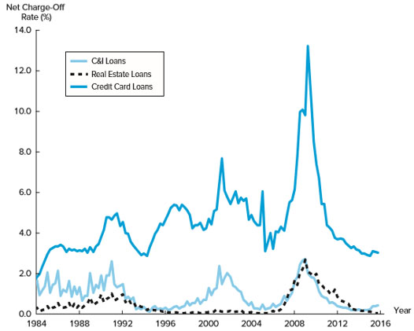
Commercial Bank Charge-off Rates for Lending Activities
Figure 19–1 Charge-Off Rates for Commercial Bank Lending Activities
Sources: FDIC, Quarterly Banking Profile, various issues. www.fdic.gov
Access the long description slide.

Slide 6
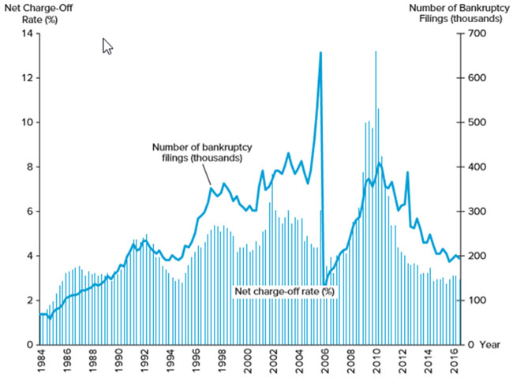
Credit Card Loss Rates and Personal Bankruptcy Filings
Figure 19–2 Credit Card Loss Rates and Personal Bankruptcy Filings
Sources: FDIC, Quarterly Banking Profile, various issues. www.fdic.gov
Access the long description slide.

Slide 7
Impact of Credit Risk on an FI’s Equity Value 1
Example 19–1 Impact of Credit Risk on an FI’s Equity Value.
Consider an FI with the following balance sheet:
Cash | $ 20m | Deposits | $ 90m
Gross loans | 80m | Equity (net worth) | 10m
 | $100m |  | $100m
Suppose that the managers of the FI recognize that $5 million of its $80 million in loans is unlikely to be repaid due to an increase in credit repayment difficulties of its borrowers. Eventually, the FI’s managers must respond by charging off or writing down the value of these loans on the FI’s balance sheet. This means that the value of loans falls from $80 million to $75 million, an economic loss that must be charged off against the stockholder’s equity capital or net worth (that is equity capital falls from $10 million to $5 million). Thus, both sides of the balance sheet shrink by the amount of the loss:
Notes:
Only the unexpected portion of loan losses generates solvency risk per se because banks set aside an allowance for loan loss account against to cover expected loan losses.

Slide 8
Impact of Credit Risk on an FI’s Equity Value 2
Cash | Blank | $20m | Deposits | $90m
Gross loans | 80m | Blank | Equity after charge-off | 5m
Less: Loan loss | – 5m | Blank | Blank | Blank
Loans after charge-off | Blank | 75m | Blank | Blank
Blank | Blank | $95m | Blank | $95m

Slide 9
Liquidity Risk 1
Liquidity risk is the risk that a sudden and unexpected increase in liability withdrawals may require an FI to liquidate assets in a very short period of time and at low prices.
  Day-to-day withdrawals and loan demand are generally predictable.
  To meet the demand for cash by liability holders, FIs must either liquidate assets or borrow additional funds.
    Purchased funds include short-term borrowings, such as federal funds loans and brokered deposits.

Slide 10
Liquidity Risk 2
Liquidity risk (continued).
  Unusually large withdrawals by liability holders can create liquidity problems. In these cases:
    The cost of purchased and/or borrowed funds rises for FIs.
    The supply of purchased or borrowed funds declines.
    FIs may be forced to sell less liquid assets at “fire-sale” prices.

Slide 11
Effect of Unexpected Deposit Withdrawal
Table 19–2 Adjusting to a Deposit Withdrawal Using Asset Sales (in millions)
Before the Withdrawal | Blank | blank | blank | After the Withdrawal | blank | blank | blank
Assets | Blank | Liabilities/Equity | Blank | Assets | Blank | Liabilities/Equity | Blank
Cash assets | $ 10 | Deposits | $ 90 | Cash assets | $ 0 | Deposits | $75
Nonliquid assets | 90 | Equity | 10 | Nonliquid assets | 80 | Equity | 5
Blank | $100 | Blank | $100 | Blank | $80 | Blank | $80
$15 million deposit withdrawal, met with liquidating $10 million cash assets and liquidation of $10 million of nonliquid assets at ‘fire sale’ price of $5 million.
What is the effect on equity? Why?

Slide 12
Interest Rate Risk 1
Interest rate risk is the risk incurred by an FI when the maturities of its assets and liabilities are mismatched and interest rates are volatile.
  Asset transformation involves an FI buying primary securities or assets and issuing secondary securities or liabilities to fund the assets.
  If an FI’s assets are longer-term relative to its liabilities, it faces refinancing risk.
    The risk that the cost of rolling over or reborrowing funds will rise above the returns being earned on asset investments.
  If an FI’s assets are shorter-term relative to its liabilities, it faces reinvestment risk.
    The risk that the returns on funds to be reinvested will fall below the cost of funds.

Slide 13
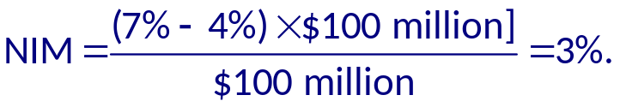

Interest Rate Risk 2
An FI has $100 million of fixed earning assets that mature in 2 years. The assets earn an average of 7%. These are funded by 6 month CD liabilities paying 4%. What is the bank’s net interest margin (NIM)?
How does the NIM change if in 6 months interest rates increase 100 basis points?
  The 2-year assets will still be earning 7%, but the new 6-month CDs will have to pay 5%:
Notes:
This illustrates refinancing risk

Slide 14
Interest Rate Risk Concluded
Interest rate risk (continued).
  All FIs face price risk (or market value uncertainty).
    The risk that the price of the security changes when interest rates change.
  FIs can hedge or protect themselves against interest rate risk by matching the maturity of their assets and liabilities.
    This approach is inconsistent with their asset transformation function.
    They may match the rate sensitivity of their assets and liabilities.
    They may match the duration of their assets and liabilities.

Slide 15
Market Risk 1
Market risk is the risk incurred in trading assets and liabilities due to changes in interest rates, exchange rates, and other asset prices.
  Closely related to interest rate and foreign exchange risk.
  Adds risk of trading activity—that is market risk is the incremental risk incurred by an FI (in addition to interest rate or foreign exchange risk) caused by an active trading strategy.
  FIs’ trading portfolios are differentiated from their investment portfolios on the basis of time horizon and liquidity.
    Trading assets, liabilities, and derivatives are highly liquid.
    Investment portfolios are relatively illiquid and are usually held for longer periods of time.

Slide 16
Banking Book and Trading Book of a Commercial Bank
Table 19–3 The Investment (Banking) Book and Trading Book of a Commercial Bank
Blank | Assets | Liabilities
Banking book | Loans Other illiquid assets | Capital Deposits
Trading book | Bonds (long) Commodities (long) FX (long) Equities (long) Derivatives* (long) | Bonds (short) Commodities (short) FX (short) Equities (short) Derivatives* (short)
*Derivatives are off-balance-sheet (as discussed in Chapter 10).

Slide 17
Market Risk 2
Market risk (continued).
  Declines in underwriting and brokerage income at large investment banks have been offset by increases in trading activity and income.
  Mutual fund managers, who actively manage their asset portfolios, are also exposed to market risk.
  FIs are concerned with fluctuations in trading account assets and liabilities.
    Value at risk (VAR) and daily earnings at risk (DEAR) are measures used to assess market risk exposure.
Notes:
Value at risk (VAR): fluctuation in value
Daily earnings at risk (DEAR): fluctuation in value of trading account assets and liabilities for periods as short as one day

Slide 18
Off-Balance-Sheet Risks 1
Off-balance-sheet (OBS) risk is the risk incurred by an FI as the result of activities related to contingent assets and liabilities.
  In 2016, commercial banks had $15.029 trillion in on-balance-sheet items, while the face or notional value of their off-balance-sheet derivative items was $189.832 trillion.
    OBS activities do not appear on an FI’s current balance sheet since it does not involve holding a currency primary claim (asset) or the issuance of a current secondary claim (liability).
  OBS activities involve the creation of contingent assets and liabilities that give rise to their potential placement in the future on the balance sheet.
Notes:
Contingent asset and liabilities: assets and liabilities off the balance sheet that potentially can produce position or negative future cash flows for an FI

Slide 19
Valuation with vs. without OBS Activities
Table 19–4 Valuation of an FI’s Net Worth with and without Consideration of Off-Balance-Sheet Activities
Panel A: Traditional valuation of an FI’s net worth
Assets | Blank | Liabilities | Blank
Market value of assets (A) | 100 | Market value of liabilities (L) | 90
Blank | Blank | Net worth (E) | 10
Blank | 100 | Blank | 100
Panel B: Valuation of an FI’s net worth with on- and off-balance-sheet activities valued
Assets | Blank | Liabilities | Blank
Market value of assets (A) | 100 | Market value of liabilities (L) | 90
Blank | Blank | Net worth (E) | 5
Market value of contingent assets (CA) | 50 | Market value of contingent liabilities (CL) | 55
Blank | 150 | Blank | 150

Slide 20
Off-Balance-Sheet Risks 2
Off-balance-sheet (OBS) risk (continued).
  Large commercial banks engage in OBS activity.
  The losses on OBS commitments in the financial crisis indicate that banks had excessive risks in their derivatives activities and did not have sufficient capital to back these commitments.
  Very complex derivatives sold by banks.
    In some cases, the securities were so complicated that ratings agencies and regulators had to rely on the bankers’ assessment of the riskiness of the securities.

Slide 21
Off-Balance-Sheet Risks Concluded
OBS activities can affect the future shape of FIs’ balance sheets.
  OBS items become on-balance-sheet items only if some future event occurs.
  A letter of credit (LOC) is a credit guarantee issued by an FI for a fee on which payment is contingent on some future event occurring, most notably default of the agent that purchases the LOC.
  Other examples include:
    Loan commitments by banks.
    Mortgage servicing contracts by savings institutions.
    Positions in forwards, futures, swaps, and other derivatives held by almost all large FIs.

Slide 22
Foreign Exchange Risk 1
Foreign exchange (FX) risk is the risk that exchange rate changes can affect the value of an FI’s assets and liabilities denominated in foreign currencies.
  FIs can reduce risk through domestic-foreign activity/investment diversification.
  FIs expand globally through:
    Acquiring foreign firms or opening new branches in foreign countries.
    Investing in foreign financial assets.
  Returns on domestic and foreign direct investments and portfolio investments are not perfectly correlated.
    Underlying technologies of various economies differ, as do the firms in those economies.
    Exchange rate changes are not perfectly correlated across countries.

Slide 23
Foreign Exchange Risk 2
FX risk (continued).
  A net long position in a foreign currency involves holding more foreign assets than foreign liabilities.
    FI loses when foreign currency falls relative to the U.S. dollar.
    FI gains when foreign currency appreciates relative to the U.S. dollar.
  A net short position in a foreign currency involves holding fewer foreign assets than foreign liabilities.
    FI gains when foreign currency falls relative to the U.S. dollar.
    FI loses when foreign currency appreciates relative to the U.S. dollar.
  An FI is fully hedged if it holds an equal amount of foreign currency denominated assets and liabilities (that have the same maturities).

Slide 24
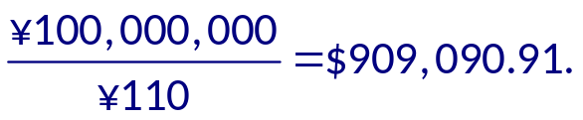
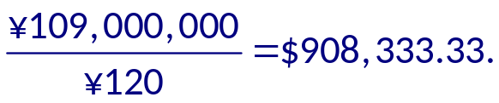
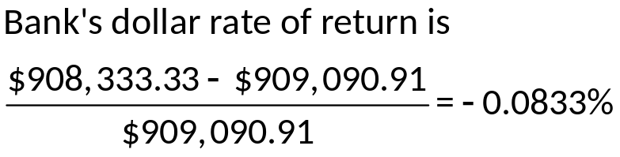
Foreign Exchange Risk Concluded
A U.S. FI lends ¥100 million when the ¥/$ exchange rate is ¥110. The interest rate is fixed at 9% and the loan is for one year. If, in a year, the exchange rate is ¥120 to the dollar, what is the bank’s dollar rate of return on the loan?
The original dollar amount lent by the bank is:
In one year the borrower repays:
  (¥100,000,000 × 1.09) = ¥109,000,000.
In dollar terms this is now worth:
Notes:
Analysis: The dollar depreciated by (¥120/¥110) – 1 = 9.09% and the bank only earned 9% in interest.

Slide 25
Sovereign Risk 1
Country, or sovereign, risk is the risk that repayments from foreign borrowers may be interrupted because of interference from foreign governments.
  Differs from credit risk of FIs’ purchasing domestic assets.
    With domestic assets, FIs usually have some recourse through bankruptcy courts—that is FIs can recoup some of their losses when defaulted firms are liquidated or restructured.
  Foreign corporations may be unable to pay principal and interest even if they desire to do so.
    Foreign governments may limit or prohibit debt repayment due to foreign currency shortages or adverse political events.

Slide 26
Sovereign Risk 2
Country or sovereign risk (continued).
  An FI claimholder may have little or no recourse to local bankruptcy courts or to an international claims court.
  Measuring sovereign risk includes analyzing:
    The trade policy of the foreign government.
    The fiscal stance (deficit or surplus) of the foreign government.
    Government intervention in the economy.
    The foreign government’s monetary policy.
    Capital flows and foreign investment.
    Inflation.
    The structure of the foreign country’s financial system.
Notes:
E.g., In 2001, the government of Argentina, which had pegged its peso to the dollar on a one-to-one basis since the early 1990s, had to default on its government debt largest because of an overvalued peso and the adverse effect this had on its exports and foreign currency earnings.

Slide 27
Technology and Operational Risk
Technology risk and operational risk are closely related.
  Technology risk is the risk incurred by an FI when its technological investments do not produce anticipated cost savings.
    The major objectives of technological expansion are to allow the FI to exploit potential economies of scale and scope by:
      Lowering operating costs.
      Increasing profits.
      Capturing new markets.
  Operational risk is the risk that existing technology or support systems may malfunction or break down.
    indirect costs, and opportunity costs that reduce an FI’s profitability and Operational risk could be the result of technological failure, but other sources of operational risk can result in direct costs, market value.

Slide 28
Insolvency Risk
Insolvency risk is the risk that an FI may not have enough capital to offset a sudden decline in the value of its assets relative to its liabilities.
  Insolvency risk is a consequence or an outcome of one or more of the risks previously described:
    Interest rate, market, credit, OBS, technological, foreign exchange, sovereign, and/or liquidity risk.
  Generally, the more equity capital to borrowed funds an FI has (that is the lower its leverage), the less insolvency risk it is exposed to.
  Both regulators and managers focus on capital adequacy as a measure of an FI’s ability to remain solvent.

Slide 29
Other Risks and Interactions
Other risks and interactions among risks.
  In reality, all of the previously defined risks are interdependent.
    Example: liquidity risk is correlated with interest rate and credit risks.
  When managers take actions to mitigate one type of risk, they must consider effects on other risks.
  Changes in regulatory policy constitute another type of discrete or event-type risk.
  Other event risks.
    Sudden and unexpected changes in financial market conditions due to war, revolutions, and sudden market collapses.
    Theft, malfeasance, and breach of fiduciary trust.
  Macroeconomic risks include increased inflation, inflation volatility, and unemployment.

Slide 30
Commercial Bank Charge-off Rates for Lending Activities Long Description
The net charge-off rate (%) for C&I Loans, Real Estate Loans, and Credit Card loans followed the same general trends over time with the most noticeable spike around the year 2009. The charge-off rates were greatest for credit card loans, which typically varies around 5%, but spiked to about 14% in 2009. The net charge-off rates for C&I Loans and Real Estate Loans both varied around 1% with a spike of about 2% in 2009.
Return to slide containing original image.

Slide 31
Credit Card Loss Rates and Personal Bankruptcy Filings Long Description
The vertical axis on the left side of the graph displays the net charge-off rate (%), and the vertical axis on the right displays the number of bankruptcy filings (in thousands). The net charge-off rate is displayed as a series of thin bars, appearing that the data is presented for each month of the year for the years 19 84 through 2016, but the trend is identical to that described in the previous image. The number of bankruptcy filings (in thousands) increased steadily from about 100 in 19 84 to about 400 in 2004. There was a large spike followed by an even more dramatic drop in the year 2005. The number of bankruptcy filings peaked to about 650 and then dropped by 2006 to about 150. The last noteworthy peak occurred in 2010 with about 400 bankruptcy filings.
Return to slide containing original image.

