Slide 1
Chapter Twenty
Managing Credit Risk on the Balance Sheet
©2019 McGraw-Hill Education. All rights reserved. Authorized only for instructor use in the classroom. No reproduction or further distribution permitted without the prior written consent of McGraw-Hill Education.

Slide 2
Credit Risk Management 1
Financial institutions (F I s) are special because of their ability to transform financial claims of household savers into claims issued to corporations, individuals, and governments.
F I s’ ability to process and evaluate information and control and monitor borrowers allows them to transform these claims at the lowest possible cost to all parties.
Credit allocation is an important type of financial claim transformation.
  F I s transform claims of household savers (in the form of deposits) into loans issued to corporations, individuals, and governments.
  The F I accepts the credit risk on these loans in exchange for a fair return sufficient to cover the cost of funding paid (to household savers, the credit risk involved in lending, and a profit margin reflecting competitive conditions.

Slide 3
Credit Risk Management 2
The default of one major borrower can have a significant impact on the value and reputation of many F I s.
  Example: WorldCom bankruptcy in 2002.
Likewise, a single major economic event can cause losses to many
F I s’ loan portfolios.
  Example: Hurricanes Katrina and Rita in 2005 resulted in over $1.3 billion in bad loans for major banks operating in areas hit by the storm.
  Example: financial crisis of 2008-2009 resulted in the largest ever credit risk-related losses for U.S. financial institutions.
Many F Is were unable to survive the mortgage crisis.
  Example: Countrywide Financial acquired by BofA.
Bank loan portfolios were exposed to losses from the recent European debt crisis.
Notes:
Note: The acquisition of Countrywide proved costly for Bank of America. Even in 2014, BofA paid a record $17 billion settlement to the U.S. Justice Department over questionable mortgages issued by Countrywide before the acquisition. The settlement was the largest ever reached between the U.S. and a single company, and was approximately equal to BofA’s total profit for the previous 3 years.

Slide 4
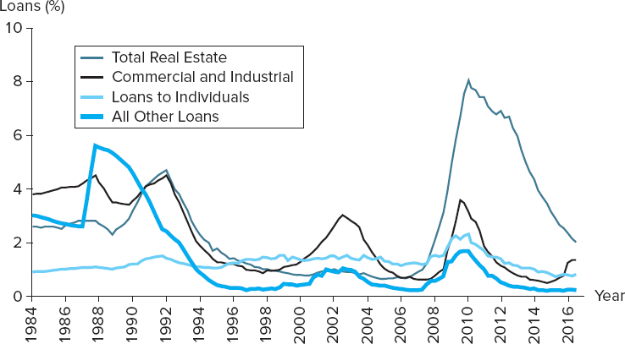
Nonperforming Asset Ratio for U.S. Commercial Banks
Figure 20–1 Nonperforming Asset Ratio for U.S. Commercial Banks.
Note: Noncurrent loan rates represent the percentage of loans that are past due 90 days or more or in nonaccrual status.
Sources: Federal Deposit Insurance Corporation, Quarterly Banking Profile, various issues. www.fdic.gov.
Access the long description slide.

Slide 5
Real Estate Lending 1
Real estate lending.
  Residential mortgage loan applications are among the most standardized of all credit applications.
  Decisions to approve a mortgage application depend on:
    The applicant’s ability and willingness to make timely interest and principal repayments.
    The value of the borrower’s collateral.
  The ability to maintain mortgage payments is measured by the gross debt service (G D S) and total debt service (T D S) ratios.

Slide 6
Real Estate Lending 2
G D S refers to the gross debt service ratio.
  Equal to the total accommodation expenses (mortgage, lease, condominium, management fees, real estate taxes, etc.) divided by gross income.
  Acceptable threshold generally set around maximum of 25% to 30%.
T D S refers to the total debt service ratio.
  Equal to the total accommodation expenses plus all other debt service payments divided by gross income.
  Acceptable threshold generally set around maximum of 35% to 40%.

Slide 7
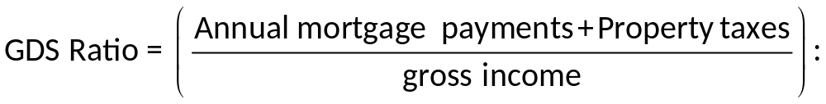
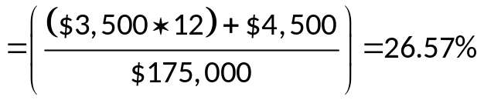
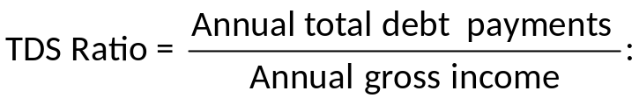
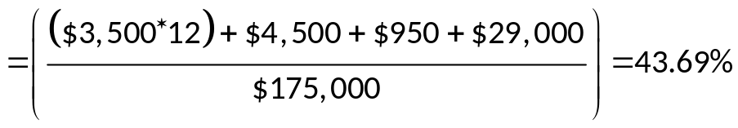
Real Estate Lending Example
A mortgage loan applicant has the following data:
Gross Income | Monthly Mortage P & I Payment | Annual property Taxes | Annual Homeowner’s Insurance | Other Debt Payments/year
$175,000 | $3,500 | $4,500 | $950 | $29,000
Conclusion: Pass
Conclusion: Fail

Slide 8
Credit Scoring Systems
F I s also use credit scoring systems to evaluate potential borrowers.
  Credit scoring systems are mathematical models that use observed loan applicant’s characteristics to calculate a score that represents the applicant’s probability of default.
  Loan officers can often give immediate “yes” or “no” answers —along with justifications for the decision.
Lender may use standard F I C O credit scores.
  F I C O scores run from 300 to 850, with the majority of scores between 600 and 800.
  Scores of 720 or higher are usually sufficient to receive a good mortgage rate.
F I s also verify borrower’s financial statements.
Notes:
Perfecting collateral is the process of ensuring that collateral used to secure a loan is free and clear to the lender should the borrower default on the loan

Slide 9
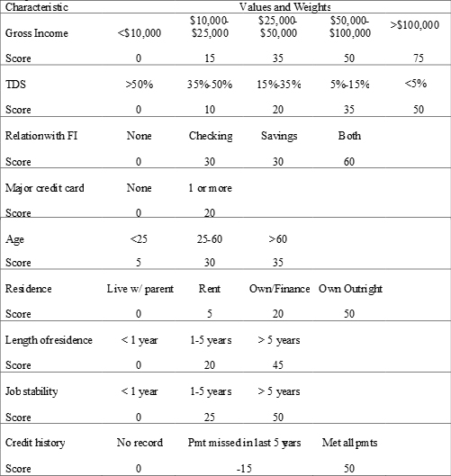
Sample Credit Score Criteria
Sample Credit Score
Characteristics | Value | Score
Gross Income | $95,000 | 50
TDS | 39% | 10
Relation with FI | Checking | 30
Major credit card | 3 | 20
Age | 45 | 30
Residence | Own/Finance | 20
Length of residence | 3 years | 20
Job stability | 2 years | 25
Credit history | Met all payments | 50
 | Total | 255
Real Estate loan is automatically approved
Automatic rejection levelscore 120
Automatic acceptance levelscore 190
Scores between 120 and 190 are reviewed by a loan officer or loan committee
Access the long description slide.

Slide 10
Real Estate Lending Concluded
FIs do not desire to become involved in loans that are likely to go into default.
In the event of default, lenders usually have recourse.
  Foreclosure is the process of taking possession of the mortgaged property in satisfaction of a defaulting borrower’s indebtedness and forgoing claim to any deficiency.
  Power of sale is the process of taking the proceedings of the forced sale of a mortgaged property in satisfaction of the indebtedness and returning to the mortgagor the excess over the indebtedness or claiming any shortfall as an unsecured creditor.

Slide 11
Steps Taken by FI Prior to Accepting a Mortgage
Before an F I accepts a mortgage, it:
  Confirms the title and legal description of the property.
  Obtains a surveyor’s certificate confirming that the house is within the property’s boundaries.
  Checks with the tax office to confirm that no property taxes are unpaid.
  Requests a land title search to determine that there are no other claims against the property.
  Obtains an independent appraisal to confirm that the purchase price is in line with the market value.

Slide 12
Consumer (Individual) and Small-Business Lending
Techniques are very similar to that of mortgage lending.
However, nonmortgage consumer loans focus on the ability to repay rather than on the property.
  Credit models put more emphasis on personal characteristics, such as annual gross income, the T D S score, etc.
Small-business loan decisions often combine computer-based financial analysis of borrower financial statements with behavioral analysis of the business owner.
  Usually, these loans are made to small businesses to help start up the company.

Slide 13
Mid-Market Commercial and Industrial Lending 1
Generally a profitable market for credit-granting F I s.
Typically, mid-market corporates:
  Have sales revenues from $5 million to $100 million per year.
  Have a recognizable corporate structure.
  Do not have ready access to deep and liquid capital markets.
Commercial loans can be for as short as a few weeks to as long as 8 years or more.
  Short-term loans are used to finance working capital needs.
  Long-term loans are used to finance fixed asset purchases.

Slide 14
Mid-Market Commercial and Industrial Lending 2
Generally, at least two loan officers must approve a new loan customer and large credit requests are presented formally to a credit approval officer and/or committee.
Five C’s of credit.
  Character, capacity, collateral, conditions, and capital.
F I s perform cash flow analyses, which provide information regarding an applicant’s expected cash receipts and disbursements.
The statement of cash flows separates cash flows into:
    C F from operating activities, C F from investing activities, and C F from financing activities.
  F Is may also perform ratio analyses.
    Time-series and cross-sectional analyses.

Slide 15
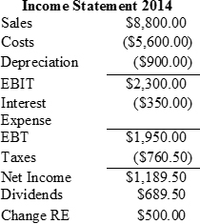
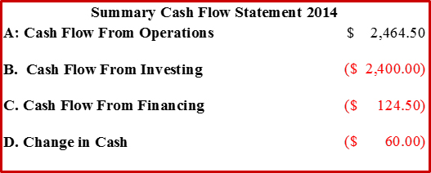
Sample Cash Flow Analysis
Change | Assets | 2013 | 2014 | Liabilities & Equity | 2013 | 2014 | Change
($60) | Cash | $170 | $110 | Accounts payable | $135 | $120 | ($15)
$200 | Accounts rec. | 500 | 700 | Notes payable | 1,200 | 1,400 | $200
($240) | Inventory | 1,240 | 1,000 | Total current liabilities | 1,335 | 1,520
 | Total current | 1,910 | 1,810 | Long-term debt | 2,005 | 2,620 | 615
$1,500 | Fixed assets | 2,000 | 3,500 | Common stock | 100 | 200 | 100
 |  |  |  | Retained earnings | 470 | 970 | 500
 | Total assets | $3,910 | $5,310 | Total liab. & equity | $3,910 | $5,310
Notes:
Notice that although the firm has positive earnings, cash decreased. Ordinarily the loan applicant should have positive operating cash flows. Cash from investing may be positive or negative, depending on the rate of return the firm is earning these investments may generate good growth. In the case above the lender would wish to verify that the borrower will have sufficient return on investment the fixed asset increases to ensure that the firm will have adequate cash balances to repay the loan. A trend of declining operating cash flows financed by cash flow from financing would be a red flag as this is probably not sustainable in the long run. This would imply the firm is borrowing more (possibly from you) to sustain dropping profitability.

Slide 16
Common Ratios
Liquidity ratios.
  Current and quick (that is acid test) ratios.
Asset management ratios.
  # of days in receivables, # of days in inventory, sales to working capital, sales to fixed assets, and sales to total assets (i.e., the asset turnover ratio).
Debt and solvency ratios.
  Debt-to-asset, times interest earned, and cash-flow-to-debt ratios.
Profitability ratios.
  Gross margin, operating profit margin, return on assets (R O A), return on equity (R O E), and dividend payout ratios.

Slide 17
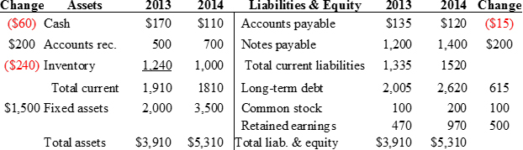


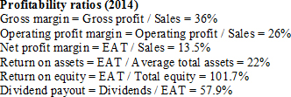

Sample Ratio Analysis
Notes:
Optional slide with ratio example, hide if you do not wish to cover this material

Slide 18
Limitations of Ratio Analysis
Ratio analysis has limitations:
  Diverse firms are difficult to compare versus benchmarks.
  Different accounting methods can distort industry comparisons.
  Applicants can distort financial statements.
Common-size analysis and growth rates:
  Common-size financial statements present values as percentages to facilitate comparison versus competitors.
  Year-to-year growth rates can identify trends.
Loan covenants can be used as part of the loan agreement to mitigate credit risk.
Notes:
In addition to using the ratios discussed previously, an analyst can compute sets of ratios by dividing all income statement amounts by total sales revenue and all balance sheet amounts by total assets. These calculations yield common-size financial statements that can be used to identify changes in corporate performance. Year-to-year growth rates also give useful ratios for identifying trends.

Slide 19
Mid-Market Commercial and Industrial Lending Concluded
Following approval of the loan, the account officer ensures that conditions precedent have been cleared.
  Those conditions specified in the credit agreement that must be fulfilled before drawdowns are permitted.
    Includes title searches, perfecting of collateral, etc.
F Is typically wish to develop permanent, long-term, mutually beneficial relationships with their mid-market commercial and industrial customers.

Slide 20
Large Commercial and Industrial Lending 1
Fees and spreads are smaller relative to small and mid-size corporate loans, but the transactions are often large enough to make them worthwhile.
F Is’ relationships with large clients often center around broker, dealer, and advisor activities with lending playing a lesser role.
  Large corporations often use loan commitments, performance guarantees, and term loans.
Account officers preparing credit reviews often rely on rating agencies and market analysts to aid in their credit analysis, in addition to utilizing sophisticated credit-scoring models based on accounting and/or financial market data.
Notes:
Bargaining strength of FI is severely diminished when it deals with large creditworthy corporate customers because they’re able to issue debt/equity directly in the capital markets, as well as make private placements of securities, among other reasons.

Slide 21
Altman’s Z-Score
Z is an overall measure of the borrower’s default risk classification, where
  X₁ = working capital ÷ total assets.
  X₂ = retained earnings ÷ total assets.
  X₃ = earnings before interest and taxes ÷ total assets.
  X₄ = market value of equity ÷ book value of total liabilities.
  X₅ = sales ÷ total assets.
Notes:
Developed to analyze publicly traded manufacturing firms in the U.S.

Slide 22
Altman’s Z-Score Interpretation
Default classifications (according to Altman):
  Z < 1.81 – high default risk firm.
  1.81 < Z < 2.99 – indeterminate default risk firm.
  Z > 2.99 – low default risk firm.
Problems associated with Z-score model:
  Usually discriminates only among three cases of borrower behavior – high, indeterminate, and low.
  No obvious economic reason to expect the weights in the Z-score model (or, the weights in any credit-scoring model) will be constant over any but very short periods.
  Ignores hard-to-quantify factors that may play a crucial role in the default or no-default decision.
  Accounting variables are updated infrequently.

Slide 23
Altman’s Z-Score Example
Suppose that the ﬁnancial ratios of a potential borrowing firm take the following values:
X₁ = 0.2
X₂ = 0
X₃ = −0.20
X₄ = 0.10
X₅ = 2.0
The ratio X₂ is zero and X₃ is negative, indicating that the ﬁrm has had negative earnings or losses in recents periods. Also. X₄ indicates that the borrower is highly leveraged. However, the working capital ratio (X₁) and the sales/assets ratio (X₅) indicate that the ﬁrm is reasonably liquid and is maintaining its sales volume. The z-score provides an overall score or indicator of the borrower‘s credit risk since it combines and weights these ﬁve factors according to their past importance in explaining (discriminating between) borrower default and borrower repayment. For the borrower in question:
Z = 1.2(0.2) + 1.4(0) + 3.3(−0.20) + 0.6(0.10) + 1.0(2.0)
Z = 0.24 + 0 − 0.66 + 0.06 + 2.0
Z = 1.64
With a Z score less than 1.81 (that is, in the high default risk region). the F l should not make a loan to this borrower until it improves its earnings.

Slide 24
Large Commercial and Industrial Lending 2
Moody’s Analytics (K M V) Credit Monitor Model.
  Uses the option pricing model of Merton, Black, and Scholes to calculate expected default frequencies (E D F) for over 60,000 public companies and many private ones worldwide.
  The E D F predicts the probability of whether the market value of the firm’s assets will fall below required debt repayments in one year.

Slide 25
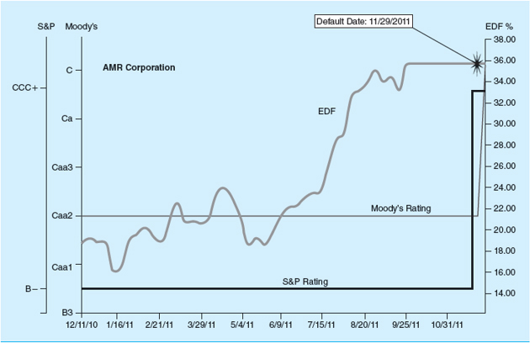
Moody’s Analytics EDF, Moody’s, and S&P Ratings for AMR Corporation
Figure 20–2 Moody’s Analytics E D F, Moody’s, and S&P Ratings for A M R Corporation
Source: Moody’s Analytics. www.moodysanalytics.com
Access the long description slide.

Slide 26
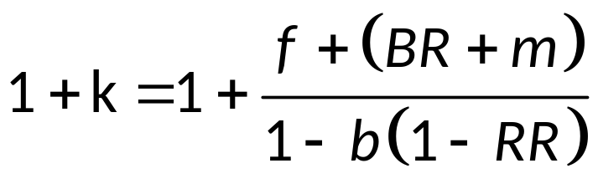
Calculating the Return on a Loan
The return on assets (R O A) approach shows the contractually promised gross return on a loan, k, per dollar lent (or 1 + k) – or R O A per dollar lent – will equal:
    where f = loan origination fee.
    b = compensating balance requirement.
    RR = the reserve requirement charge.
    BR = the base lending rate.
    m = the credit risk premium on the loan.
Notes:
The numerator of this formula is the promised gross cash inflow to the FI per dollar lent, reflecting direct fees (f) plus the loan interest rat (BR +m). In the denominator, for every $1 that the FI lends, it retains b as non-interest-bearing compensating balances. Thus, 1 – b represents the net proceeds of each $1 of loan received by the borrower from the FI, ignoring reserve requirements.

Slide 27
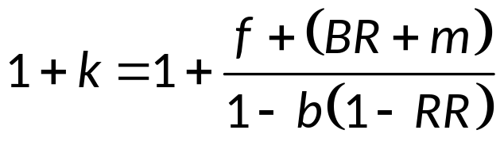
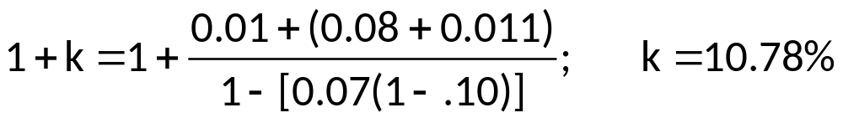
Calculating the Return on a Loan Example
A bank has a base lending rate of 8% (B R), and charges a certain customer a 110 basis point risk premium (m). The bank also charges a 1% origination fee (f). The bank requires the borrower to maintain compensating balances (b) of 7% of the loan amount. The reserve requirement (R R) is 10% and the loan amount is $1 million. Calculate the required gross return on a loan = k.

Slide 28
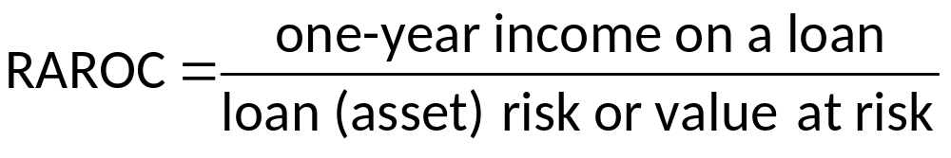
R A R O C Model
The risk-adjusted return on assets (R A R O C) model balances a loan’s expected income against its expected risk.
The R A R O C is compared vis-à-vis the lender’s tax-adjusted return on equity (R O E).
  If R A R O C > R O E, make the loan.
  If R A R O C < R O E, either adjust the loan such that R A R O C > R O E or decline to make the loan.

Slide 29

R A R O C Example
Suppose a borrower of $100,000 has risk characteristics that put the firm in a risk class that has experienced an average historical default rate of 0.2 percent. However, one year in every 100 (or 1 percent of the time), such as in a major recession, the bank expects 4 percent of these types of loans to default. This 4 percent can be viewed as the unexpected or 1 in 100 years default rate. Moreover, upon default, the F I has historically recovered only 20 percent of the defaulted loans. As a result, the loss given default is 80 percent. Accordingly, for this borrower, the loan loss risk per dollar lent is 0.032×(0.04 × 0.80), or the value (or capital) at risk to the F I (the denominator of the R A R O C equation) is $100,000×(0.04 × 0.80) = $3,200.
Suppose the cost of funds for the F I is 9.80 percent and the loan rate is 10 percent on the $100,000 loan. After adjusting for fees of 0.1 percent, the expected one-year income on the loan, or the numerator of the RAROC equation, is $100,000 times 0.3 cents per dollar lent (10% – 9.80% + 0.10%), or 0.003. The extreme case loss rate for borrowers of this type is 4 percent (i.e., the default that has or is projected to occur once in every 100 years), and the dollar proportion of loans of this type that cannot be recaptured on default (loss given default) has historically been 80 percent. Then:
If the F I’s R O E is less than 9.375 percent (e.g., it is 9 percent), the loan can be viewed as being profitable. If the R O E is higher than 9.375 percent (e.g., 9.5 percent), it should be rejected and/or the loan officer should seek higher spreads and fees on the loan.

Slide 30
Nonperforming Asset Ratio for U.S. Commercial Banks Long Description
All four categories tended to move together, although there is a large spike in the total real estate loan % in 2010 of approximately 8%.
Return to slide containing original image.

Slide 31
Sample Credit Score Criteria Long Description
The characteristics were the gross income, TDS, Relation with financial institution, number of major credit cards held, age, residence, length of residence, job stability, and credit history.
Return to slide containing original image.

Slide 32
Moody’s Analytics E D F, Moody’s, and S&P Ratings for A M R Corporation Long Description
The horizontal axis has the time, from December 11, 2010 to October 31, 2011. There are 3 vertical scales: S&P, Moody's, and E D F %. The S&P Rating was a B minus for this entire period. The Moody's Rating was a Caa2 for this entire period and the E D F percent fluctuated around 20% until June 9, 2011. Beyond that it steadily rose to about 35% until about 8/20/11 and then it was flat at about 36% from then until the end of October 2011.
Return to slide containing original image.

