Slide 1
Chapter Twenty-Two
Managing Interest Rate Risk and Insolvency Risk on the Balance Sheet
©2019 McGraw-Hill Education. All rights reserved. Authorized only for instructor use in the classroom. No reproduction or further distribution permitted without the prior written consent of McGraw-Hill Education.

Slide 2
Interest Rate Risk
The asset-transformation function performed by financial institutions (FIs) often exposes them to interest rate risk via the mismatching of asset and liability maturities.
FIs use two main methods to measure interest rate exposure:
  The repricing model (a.k.a. the funding gap model) examines the impact of interest rate changes on net interest income (NII).
  The duration model examines the impact of interest rate changes on the overall market value of an FI, and thus on net worth.

Slide 3
Interest Rate Risk Measurement and Management
The Federal Reserve’s monetary policy strategy is the most direct influence on the level and movement of interest rates.
  If the Fed wants to slow down the economy, it will tighten monetary policy by taking actions that raise interest rates.
  If the Fed wants to stimulate the economy (that is expansionary monetary policy), it allows interest rates to fall.

Slide 4
Repricing Model 1
The repricing or funding gap is the difference between those assets whose interest rates will be repriced or changed over some future period (RSAs) and liabilities whose interest rates will be repriced or changed over some future period (RSLs).
  Simple model used by small FIs in the U.S.
  Using this approach, DIs report quarterly on their Call Reports, interest-rate sensitivity reports which show the repricing gaps for assets and liabilities with various maturities.

Slide 5
Repricing Model 2
Example of maturity bucks (or bins):
  One day.
  More than 1 day to 3 months.
  More than 3 months to 6 months.
  More than 6 months to 12 months.
  More than 1 year to 5 years.
  More than 5 years.

Slide 6
Repricing Model Concluded
The gap in each bucket (or bin) is measured as the difference between the rate-sensitive assets (RSAs) and the rate-sensitive liabilities (RSLs).
  Rate sensitivity is the time to repricing of an asset or liability.
A negative gap (where RSA < RSL) exposes the FI to refinancing risk, which is the risk that the cost of rolling over or reborrowing funds will rise about the returns being earned on asset investments.
A positive gap (where RSA > RSL) exposes the FI to reinvestment risk, which is the risk that the returns on funds to be reinvested will fall below the cost of the funds.
Notes:
Note that repricing could be the result of a rollover of an asset or liability, or it can occur if the asset of liability is a variable-rate instrument.

Slide 7
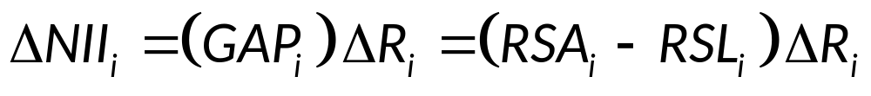
Change in Net Interest Income
The change in net interest income for any given bucket i (ΔNII_{i}) is measured as:
  Where GAP_{i} = the dollar size of the gap between the book value of rate-sensitive assets and rate-sensitive liabilities in maturity bucket i
  ΔR_{i} = the change in the level of interest rates impacting assets and liabilities in the ith maturity bucket

Slide 8
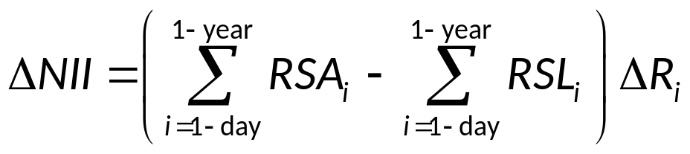
C G A P
Cumulative gaps (C G A P) over various repricing categories may also be estimated, with a common interest being the one-year repricing gap.
The cumulative effect on the bank’s net interest income may be estimated using:
where ΔNII is the cumulative change in net interest income from all rate-sensitive assets and liabilities that are repriced within a year given a change in interest rates, ΔR_{i.}
Notes:
Note that the cumulative change in net interest income is equivalent to CGAP times the change in interest rates.

Slide 9
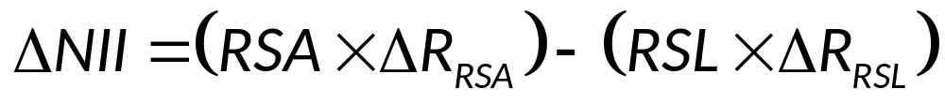
Spread Effect
The spread effect is the effect that a change in the spread between rates on RSAs and RSLs has on net interest income (NII) as interest rates change.
In general, the spread effect is such that, regardless of the direction of the change in interest rates, a positive relation exists between changes in the spread (between rates on RSAs and RSLs) and changes in NII.
When the spread increases (decreases), NII increases (decreases).

Slide 10
Repricing Gap
Dollar GAP | Spread Effect | ∆R | Direction of ∆NII
Positive | Positive | Increase | Increase
RSA > RSL | Negative | Increase | Ambiguous
Blank | Positive | Decrease | Ambiguous
Blank | Negative | Decrease | Decrease
Dollar GAP | Spread Effect | ∆R | Direction of ∆NII
Positive | Positive | Increase | Ambiguous
RSA < RSL | Negative | Increase | Decrease
Blank | Positive | Decrease | Increase
Blank | Negative | Decrease | Ambiguous
Ignoring the spread effect for simplicity (highlighted rows):
For a positive repricing gap, interest rates and profitability move in the same direction.
For a negative repricing gap, interest rates and profitability move in the opposite direction.
Notes:
The four highlighted rows ignore the spread effect. In each of these cases, the effect of the spread effect is the same as the effect of the interest rate change.

Slide 11
Limitations of the Repricing Model
The repricing model has some major weaknesses.
  It ignores market value effects of interest rate changes.
  It ignores cash flow patterns within a maturity bucket.
  It fails to deal with the problem of rate-insensitive asset and liability cash flow runoffs and prepayments.
  It ignores cash flows from off-balance-sheet (O B S) activities.

Slide 12
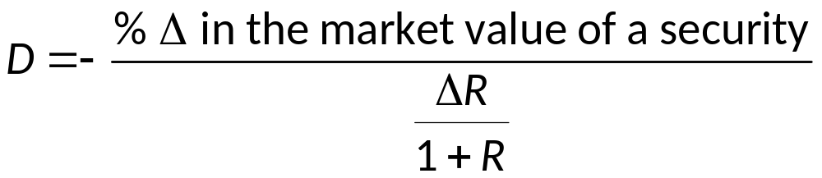
The Duration Model 1
Duration measures the interest rate sensitivity of an asset or liability’s value to small changes in interest rates.
The duration gap is a measure of overall interest rate risk exposure for an F I.
To find the duration of the total portfolio of assets (D_{A}) (or liabilities, (D_{L})) for an F I:
  First, determine the duration of each asset (or liability) in the portfolio.
  Then, calculate the market value weighted average of the duration of the assets (or liabilities) in the portfolio.

Slide 13
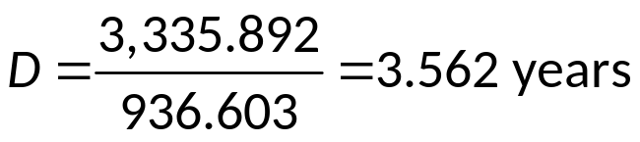
Duration Example
Table 22–8 Duration of a Four-Year Bond with an 8 Percent Coupon Paid Annually and a 10 Percent Yield
t | CF_{t} | PV of CF | PV of C × t
1 | 80 | 72.727 | 72.727
2 | 80 | 66.116 | 132.231
3 | 80 | 60.105 | 180.316
4 | 1,080 | 737.655 | 2,950.618
Blank | Blank | $936.603 | $3,335.892

Slide 14
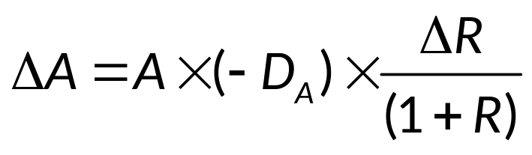
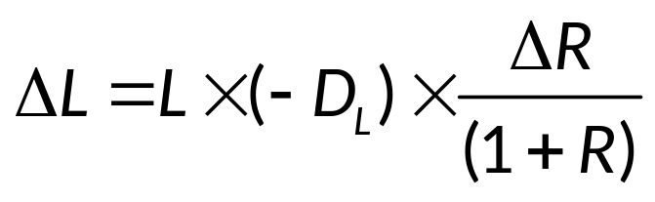
The Duration Model 2
The dollar change in the market value of the asset portfolio for a change in interest rates is:
Similarly, the dollar change in the market value of the liability portfolio for a change in interest rates is:

Slide 15

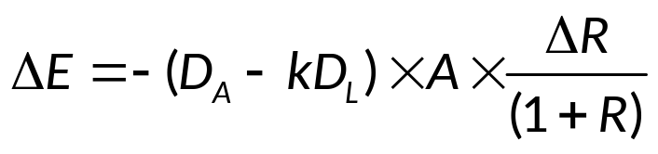
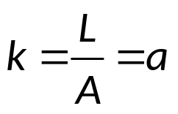
The Duration Model Concluded
Finally, the change in the market value of equity of an FI given a change in interest rates is determined from the basic balance sheet equation:
By substituting and rearranging, the change in net worth is given as:
where
measure of the FI’s leverage.
Notes:
In other words, k is the amount of borrowed funds or liabilities rather than owners’ equity used to fund its asset portfolio.

Slide 16
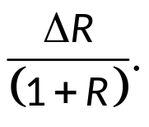
Effects of Interest Rate Changes on Net Worth
The effect of interest rate changes on the market value of equity or net worth of an FI breaks down to three effects:
  The leverage adjusted duration gap = (D_{A} – kD_{L}).
    Measured in years.
    Reflects the degree of duration mismatch on an FI’s balance sheet.
    The larger the gap (in absolute terms), the more exposed the FI to interest rate risk.
  The size of the FI = A = the size of the FI’s assets.
  The size of the interest rate shock =

Slide 17
Fannie Mae Duration Gap 1
Table 22–6 Fannie Mae Duration Gap
For the Three Months Ended September 30, 2016
Blank | Duration Gap (in months) | Rate Slope Shock 25 Bps Exposure (dollars in billions) | Rate Level Shock 50 Bps Exposure (dollars in billions)
Average................................ | 0.3 | $0.0 | $ 0.0
Minimum.............................. | (0.3) | 0.0 | 0.0
Maximum............................. | 0.9 | 0.1 | 0.1
Standard deviation.............................. | 0.3 | 0.0 | 0.0

Slide 18
Fannie Mae Duration Gap 2
For the Three Months Ended September 30, 2015
Blank | Duration Gap (in months) | Rate Slope Shock 25 Bps Exposure (dollars in billions) | Rate Level Shock 50 Bps Exposure (dollars in billions)
Average................................ | (0.2) | $0.0 | $ 0.0
Minimum.............................. | (0.8) | 0.0 | 0.0
Maximum............................. | 0.7 | 0.1 | 0.1
Standard deviation.............................. | 0.3 | 0.0 | 0.0

Slide 19
Limitations of the Duration Model
Duration matching can be costly.
  Critics claim that restructuring the balance sheet can be time-consuming and costly.
  Note that this argument isn’t as true today as is has been in the past, given the growth of purchased funds, asset securitization and loan sales markets have eased the speed and lowered the transaction costs of major balance sheet restructurings.
Immunization is a dynamic problem.
  The duration of assets and liabilities changes as they approach maturity, and the rate at which their durations change through time may not be the same on the asset and liability sides of the balance sheet.
Large interest rate changes and convexity.
  Convexity is the degree of curvature of the price-yield curve around some interest rate level.

Slide 20
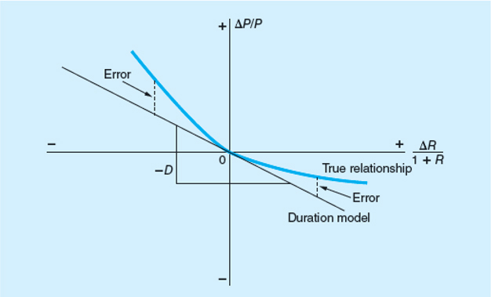
Duration Estimated versus True Bond Price
Figure 22–2 Duration Estimated versus True Bond Price
Access the long description slide.

Slide 21
Insolvency Risk Management 1
To ensure survival, an FI manager must protect against the risk of insolvency.
The primary protection against the risk of insolvency is equity capital.
  Capital is also a source of funds.
  Capital is a necessary requirement for growth under existing minimum capital-to-asset ratios set by regulators.
FI managers often prefer low levels of capital in order to generate a higher return on equity (ROE).
  The moral hazard problem of deposit insurance exacerbates this tendency.
  Strategy results in an increased likelihood of insolvency.

Slide 22
Insolvency Risk Management 2
The Capital Purchase Program (CPP) was part of the TARP funding in 2008 to 2009.
  The Treasury purchased over $205 billion in senior preferred stock under the program.
The CPP was designed to help U.S. FIs increase their capital with the aim of increasing lending to the general public.
  Through December 2016, $245 billion of TARP capital injections had been allocated to DIs, of which $239.6 billion had been paid back, along with a return of $35.7 billion in dividends and assessments.

Slide 23
Capital
The economic meaning of capital is net worth.
  Net worth is equal to the difference between the market value (MV) of an FI’s assets and the market value of its’ liabilities.
  The market value or mark-to-market value basis uses balance sheet values that reflect current rather than historical prices.
Regulatory and accounting-defined capital is based in whole or in part on historical or book values (BV), which means the value of assets and liabilities are based on their historical costs.

Slide 24
Market Value of Capital
The market value of capital and credit risk.
  Decreases in current and expected future cash flows on loans lowers the MV of an FI’s assets.
  Decreases in the MVs of assets are directly charged against the equity owners’ capital or net worth.
  Liability holders are only hurt when asset losses exceed equity capital levels.
  Thus, equity capital acts as “insurance” protecting liability holders (and guarantors, such as the FDIC) against insolvency risk.
The market value of capital and interest rate risk.
  Rising interest rates decrease the value of an FI’s assets more than the value of the FI’s liabilities when the duration gap of the FI’s balance sheet is positive.
  Losses are first charged against equity capital.
Notes:
Note that the market value of equity is more relevant than book value because, in the event of bankruptcy, the liquidation (market) value determines the FI’s ability to pay various claims.

Slide 25
Interest Rate Changes and Equity Value
Duration Gap | Interest Rate Change | Biggest Value Change | Equity Value
Positive | Increase | Assets | Decreases
Positive | Decrease | Assets | Increases
blank | blank | blank | blank
Negative | Increase | Liabilities | Increases
Negative | Decrease | Liabilities | Decreases
If interest rates are projected to increase, how should the FI position its’ duration gap?
If interest rates are projected to decrease, how should the FI position its’ duration gap?

Slide 26
The Book Value of Capital
The book value of capital is the difference between the BV of assets and the BV of liabilities.
  BV of capital is usually composed of the par value of shares, the surplus value of shares, and retained earnings.
  BV of equity does not equal the market value of equity.
  Managers can manipulate the BV of equity by:
    Using discretion when timing the recognition of loan losses.
    Selectively selling assets to inflate reported earnings (and, thus, capital).
Notes:
Selectively selling assets to inflate reported earnings (and thus capital) is called ‘gains trading.’

Slide 27
Discrepancy between MV and BV
Interest rate changes have no impact on book values of assets and liabilities.
  FIs can be solvent from a BV perspective, but massively insolvent from an economic perspective.
The degree to which the BV of capital deviates from the MV of capital depends on:
  Interest rate volatility.
  Examination and enforcement.
  Asset trading.
The discrepancy between the MV and BV of equity capital is measured by the market-to-book ratio.

Slide 28
Market Value versus Book Value 1
Table 22–13 An FI’s Book Value Balance Sheet (in millions of dollars)
Assets | Blank | Liabilities | Blank
Long-term securities | $ 80 | Short-term liabilities | $ 90
Long-term loans | 20 | Equity | 10
Blank | $100 | Blank | $100
Table 22–9 An FI’s Market Value Balance Sheet (in millions of dollars)
Assets | Blank | Liabilities | Blank
Long-term securities | $ 80 | Liabilities (short-term floating-rate deposits) | $ 90
Long-term loans | 20 | Net worth | 10
Blank | $100 | Blank | $100

Slide 29
Market Value versus Book Value 2
Table 22–10 An FI’s Market Value Balance Sheet after a Decline in the Value of Loans (in millions of dollars)
Assets | Blank | Liabilities | Blank
Long-term securities | $ 80 | Liabilities | $ 90
Long-term loans | 12 | Net worth | 2
Blank | $92 | Blank | $92
Scenario 1, credit problems
Table 22–12 An FI’s Market Value Balance Sheet after a Rise in Interest Rates (in millions of dollars)
Assets | Blank | Liabilities | Blank
Long-term securities | $ 75 | Liabilities | $ 90
Long-term loans | 17 | Net worth | 2
Blank | $92 | Blank | $92
Scenario 2, interest rate increase

Slide 30
Market-to-Book Value Ratios for U.S. Dis
Table 22–14 Market-to-Book Value Ratios for U.S. Depository Institutions
Bank Name | Market-to-Book Ratio
Bank of America | 0.955×
Bank of New York Mellon | 1.412
BB&T | 1.544
Citigroup | 0.826
Comerica | 1.552
Deutsche Bank | 0.341
J.P. Morgan Chase | 1.394
KeyCorp | 1.888
Northern Trust | 2.424
PNC Financial | 1.379
Regions Financial | 1.103
State Street Corp. | 1.629
SunTrust Banks | 1.231
U.S. Bancorp | 2.149
Wells Fargo | 1.608
Source: Authors’ research.
Notes:
1. Interest Rate Volatility —the higher the interest rate volatility, the greater the discrepancy between market and book value.
2. Examination and Enforcement —the more frequent are on-site and off-site examinations and the stiffer the examiner/regulator standards regarding charging off problem loans, the smaller the discrepancy.
3. Asset Trading —the more assets that are traded, the easier it is to assess the true market value of the asset portfolio.

Slide 31
Arguments Against MV Accounting 1
Arguments include:
  It is difficult to implement.
    Especially for small FIs that are not publicly traded, because when market prices cannot be determined accurately, marking to market may be done only with error.
  It introduces an unnecessary degree of variability into reported earnings.
  FIs are less willing to accept longer-term asset exposures if these assets must be continually marked-to-market to reflect changing credit quality and interest rates.

Slide 32
Arguments Against MV Accounting 2
The industry argues the lack of liquidity in the recent crisis led to unrealistically low market values of assets and marking to market imposed excessive losses on institutions.
  Consequently, the Financial Accounting Standards Board (FASB) allows management to rely on internal estimates of cash flows to estimate fair value.
As of April 2009, FASB allows DIs to not recognize losses in earnings and regulatory capital on accounts that are a) designated as held for investment rather than sale and b) temporarily impaired in value due to market conditions rather than underlying credit deterioration.

Slide 33
Duration Estimated versus True Bond Price Long Description
The true relationship is vertically greater than the duration model, but the duration model lies tangent to this curve. The vertical distance between the duration model and the true relationship is labeled error.
Return to slide containing original image.

