Slide 1
Chapter Twenty-Three
Managing Risk off the Balance Sheet with Derivative Securities
©2019 McGraw-Hill Education. All rights reserved. Authorized only for instructor use in the classroom. No reproduction or further distribution permitted without the prior written consent of McGraw-Hill Education.

Slide 2
Derivative Securities Used to Manage Risk
Managers are increasingly turning to off-balance-sheet (O B S) instruments such as forwards, futures, options, and swaps to hedge the risks their financial institutions (FIs) face.
  Interest rate risk.
  Foreign exchange risk.
  Credit risk.
FIs also generate fee income from derivative securities transactions.

Slide 3
Forward and Futures Contracts 1
A spot contract is an agreement to transact involving the immediate exchange of assets and funds.
A forward contract is a contractual agreement between a buyer and a seller, at time 0, to exchange a prespecified asset for cash at some later date at a price set at time 0.
  Often involve underlying assets that are nonstandardized (example: six-month pure discount bonds).
  Buyer and seller must locate and deal directly with each other to set terms of contract.
  Once a party has agreed to a forward position, canceling the deal prior to expiration is generally difficult.

Slide 4
Forward and Futures Contracts 2
A futures contract is an exchange-traded agreement to transact involving the future exchange of a set amount of assets for a price that is settled daily.
  Futures are liquid, most traders close their position before the delivery date so the underlying transaction may never take place.
  Futures contracts are marked to market daily—that is the traders’ gains and losses on outstanding futures contracts are realized each day as futures prices change.
  Exchange clearinghouse stands behind all contracts so there is no counterparty default risk and trading is anonymous.

Slide 5
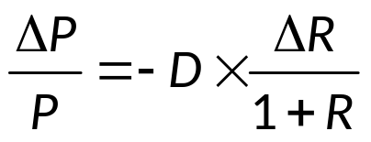
Hedging with Forward Contracts
A naïve hedge is a hedge of a cash asset on a direct dollar-for-dollar basis with a forward (or futures) contract.
Managers can predict capital loss (ΔP) using the duration formula:
where ΔP = capital loss on portfolio = ?
P = the initial value of portfolio
D = the duration of the portfolio
R = the interest rate (and thus ΔR is the change in interest)
FIs can immunize assets against risk by using hedging to fully protect against adverse movements in interest rates.

Slide 6
Hedging with Futures Contracts
Microhedging is using a derivative securities contract to hedge a specific asset or liability.
  Basis risk is a residual risk that occurs in a hedged position because the movement in an asset’s spot price is not perfectly correlated with the movement in the price of the asset delivered under a futures (or forwards) contract.
  Firms use short positions in futures contracts to hedge an asset that declines in value as interest rates rise.
Macrohedging is hedging the entire (leverage-adjusted) duration gap of an FI.

Slide 7
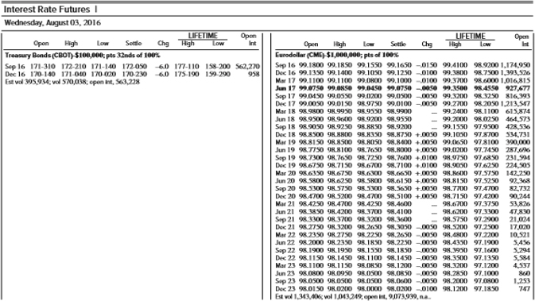
Futures Contracts on Interest Rates, August 3, 2016
Table 23.1 Future Contracts on Interest Rates, August 3, 2016
Source: The Wall Street Journal Online, August 4 2016. www.wsj.com

Slide 8
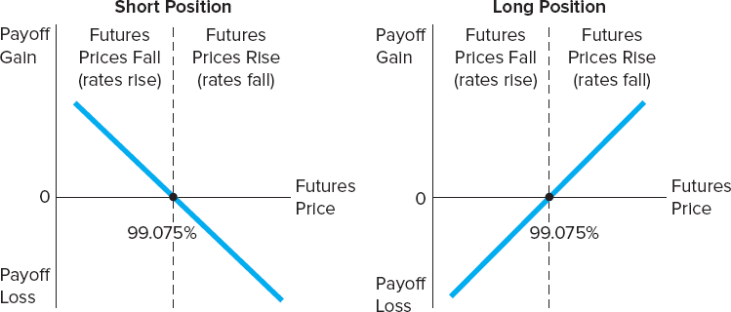
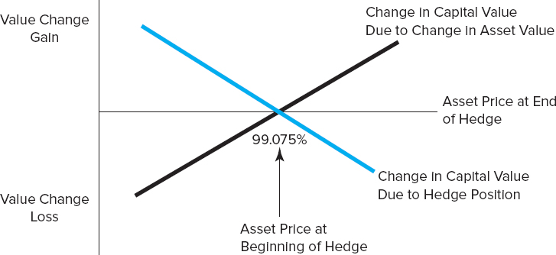
Futures Gain and Loss and Hedging with Futures
Figure 23–1 Profit or Loss on a Futures Position in Eurodollar Futures, Taken on August 3, 2016
Figure 23–2 FI Value Change On and Off the Balance Sheet from a Perfect Short Hedge
We assume that the balance sheet has no liability of equal size and maturity (or duration) as the CD. If the FI has such a liability, any loss in value from the CD could be offset with an equivalent decrease in value from the liability. In this case, there is no interest rate risk exposure and thus there is no need to hedge.
Notice that if rates move in an opposite direction from that expected, losses are incurred on the futures position—that is, if rates rise and futures prices drop, the long hedger loses. Similarly, if rates fall and futures prices rise, the short hedger loses.
This might be the case when the FI is financing itself with long-term, fixed-rate certificates of deposit.
Access the long description slide.

Slide 9
Options
Many types of options are used by FIs to hedge.
  Exchange-traded options.
  Over-the-counter (O T C) options.
  Options embedded in securities.
  Caps, collars, and floors.
Four basic option strategies that FIs might employ to hedge interest rate risk.
  Consider options in which the underlying the futures contracts are bonds whose payoff values are inversely linked to interest rate movements in a manner similar to bond prices and interest rates in general.

Slide 10
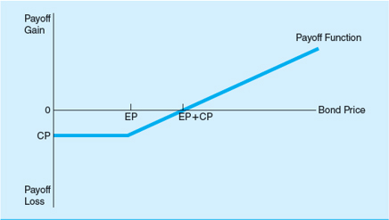
#1 - Buying a Call Option
Buying a call option on a bond.
  As interest rates fall, bond prices rise, and the call option buyer has a large profit potential.
  As interest rates rise, bond prices fall, and the potential for a negative payoff (loss) for the buyer of the call increases.
Figure 23–3 Payoff Function for the Buyer of a Call Option on a Bond
Access the long description slide.
Notes:
Note: buying a call is a good strategy if interest rates are expected to fall.

Slide 11
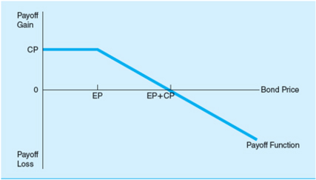
#2 - Writing a Call Option
Writing a call option on a bond.
  When interest rates fall, bond prices rise, and the call option writer will take a loss increase.
  When interest rates rise, bond prices fall, and the potential for the writer of the call to receive a positive payoff or profit increases.
Figure 23–4 Payoff Function for the Writer of a Call Option on a Bond
Access the long description slide.
Notes:
Note: writing a call option if a good strategy if interest rates are expected to rise.

Slide 12
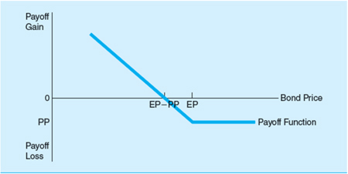
#3 - Buying a Put Option
Buying a put option on a bond
  When interest rates rise, bond prices fall, and the buyer of the put will make a profit.
  When interest rates fall, bond prices rise, and the probability the buyer of a put has a loss increases.
Figure 23–5 Payoff Function for the Buyer of a Put Option on a Bond
Access the long description slide.
Notes:
Note: buying a put option is a strategy to take when interest rates are expected to rise.

Slide 13
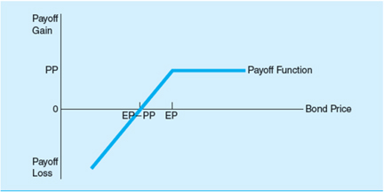
#4 - Writing a Put Option
Writing a put option on a bond.
  When interest rates rise, bond prices fall, and the put option writer has large potential losses.
  As interest rates fall, bond prices rise, the writer has an enhanced probability of making a profit.
Figure 23–6 Payoff Function for the Writer of a Put Option on a Bond
Access the long description slide.
Notes:
Note: writing a put option is a strategy to take when interest rates are expected to fall.

Slide 14
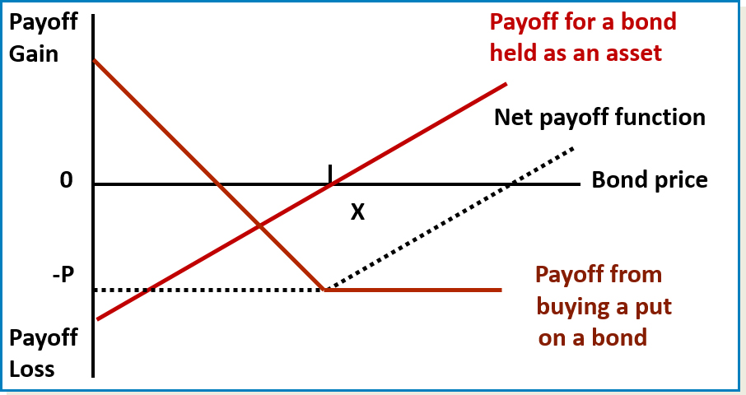
Hedging with Put Options

Slide 15
Caps, Floors, and Collars
Buying a cap means buying a call option, or a succession of call options, on interest rates rather than on bond prices.
  Like buying insurance against an (excessive) increase in interest rates.
Buying a floor is akin to buying a put option on interest rates.
  Seller compensates the buyer should interest rates fall below the floor rate.
  Like caps, floors can have one or a succession of exercise dates.
A collar amounts to a simultaneous position in a cap and a floor.
  Usually involves buying a cap and selling a floor to offset cost of cap.

Slide 16
Risks Associated with Futures, Forwards, and Options
Contingent credit risk is likely to be present when FIs expand their positions in forward, futures, and option contracts.
Contingent credit risk is the risk that the counterparty defaults on payment obligations, leaving the FI unhedged and having to replace the contract at today’s interest rates, prices, or exchange rates.
  Forward contracts and all O T C derivatives are exposed to counterparty default risk, as they are nonstandard contracts entered into bilaterally.

Slide 17
Interest Rate and Currency Swaps
Swap agreements are contracts where two parties agree to exchange a series of payments over time.
There are several types of swaps:
  Interest rate swaps.
    Parties agree to swap interest payments on a stated notional principal amount for a set period of time (some more than 5 years), and no principal is usually exchanged.
  Currency swaps.
    Used to hedge against foreign exchange rate risk from mismatched currencies on assets and liabilities.

Slide 18
Currency Swap Example
Consider a U.S. FI with fixed-rate $ denominated assets and fixed-rate £ denominated liabilities.
Also, consider a U.K. FI with fixed-rate £ denominated assets and fixed-rate $ denominated liabilities.
The FIs can engage in a currency swap to hedge their foreign exchange exposure.
  That is, the FIs agree on a fixed exchange rate at the inception of the swap agreement for the exchange of cash flows at some point in the future.
  Both FIs have effectively hedged their foreign exchange exposure by matching the denominations of their cash flows.

Slide 19
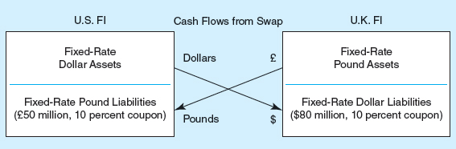
Currency Swap Hedging Example Illustrated
Figure 23–10 Fixed–Fixed Pound/Dollar Currency Swap
Table 23–7 Financing Costs Resulting from the Fixed–Fixed Currency Swap Agreement (in millions of dollars)
Blank | U.S. FI | UK FI
Cash outflows from balance sheet financing | –10% × £50 | –10% × $80
Cash inflows from swap | 10% × £50 | 10% × $80
Cash outflows from swap | –10% × $80 | –10% × £50
Net cash flows | –10% × $80 | –10% × £50
Rate available on | Blank | Blank
Dollar-denominated notes | 10.5% | Blank
Pound-denominated notes | Blank | 10.5%
Access the long description slide.

Slide 20
Credit Default Swaps (C D Ss) 1
Total Return Swap (T R S):
  Swap involving an obligation to pay interest at a specified fixed or floating rate for payments representing the total return on a specified amount.
  Can be designed to cover any change in value of the principal as well as just the interest.
    Often used when there is exposure to a change in the credit risk of the counterparty.
Pure Credit Swap (P C S):
  Swap in which an FI receives the par value of the loan on default in return for paying a periodic swap fee.

Slide 21
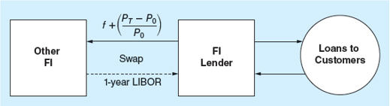
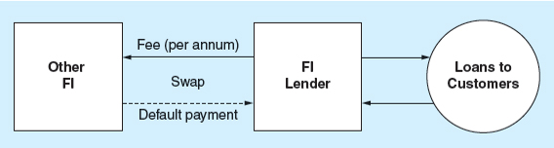
Credit Default Swaps (C D Ss) 2
Total Return Swap
Figure 23–11 Cash Flows on a Total Return Swap
Pure Credit Swap
Figure 23–12 A Pure Credit Swap
Access the long description slide.

Slide 22
Swaps and the Financial Crisis
Lehman Brothers and A I G sold credit default swaps worth billions of dollars in payments insuring mortgage-backed securities (M B S).
When mortgage security values collapsed, required outflows at these firms far exceeded capital.
Other institutions invested more heavily in M B S because they were insured; exposure to mortgage markets was more widespread than it would have been otherwise.
Credit swaps may cause lenders to make loans they would not otherwise make and earn fee income on other services offered to borrowers.

Slide 23
Plain Vanilla Swap
A plain vanilla swap is:
  A standard agreement where one participant pays a fixed rate of interest and the other party pays a variable rate of interest on a stated notional principal; no principal is exchanged.
The SB sends fixed-rate interest payments to the M C B.
  Thus, the M C B’s fixed-rate inflows are now matched to its fixed-rate payments.
The M C B sends variable-rate interest payments to the S B.
  Thus, the S B’s variable-rate inflows are now matched to its variable-rate payments.

Slide 24
Credit Risk Concerns with Swaps
The growth of the over-the-counter swap market was a major factor underlying the imposition of the BIS risk-based capital requirements.
  The fear was that out-of-the-money counterparties would have incentives to default.
  BIS now requires capital to be held against interest rate, currency, and other swaps.
Credit risk concerns with swaps.
  Netting: only the difference between the fixed and the floating payment is exchanged between swap parties.
  Payment flows are often interest, not principal.
  Standby letters of credit are required of poor-quality swap participants.

Slide 25
Comparison of Hedging Methods
Writing versus buying options.
  Writing options limits upside profits, but not downside losses.
  Buying options limits downside losses, but not upside profits.
  CBs are prohibited from writing options in some areas.
Futures versus options hedging.
  Futures produce symmetric gains and losses.
  Options protect against losses, but do not fully reduce gains.
Swaps versus forwards, futures, and options.
  Swaps and forwards are O T C contracts, unlike options and futures.
  Futures are marked to market daily.
  Swaps can be written for longer-time horizons.

Slide 26
Regulation
Regulators specify “permissible activities” that FIs may engage in
  Institutions engaging in permissible activities are subject to regulatory oversight.
  Regulators judge the overall integrity of FIs engaging in derivatives activity based on capital adequacy regulation.
The Securities and Exchange Commission (S E C) and the Commodity Futures Trading Commission (C F T C) are the functional regulators of derivatives securities markets.
The Dodd-Frank Act of 2010 requires most O T C derivatives to be exchange-traded to ensure performance by all parties.
Notes:
The Dodd-Frank Act also requires OTC derivatives be regulated by the SEC and/or the CFTC

Slide 27
Futures Gain and Loss and Hedging with Futures Long Description
The first graph is labeled short position and shows a blue line with a negative slope. This graph shows that as interest rates rise (Futures prices fall), there is a payoff gain and as interest rates fall (futures prices rise) there is a payoff loss. The second graph is labeled long position and shows a blue line with a positive slope. This graph shows that as interest rates rise (futures prices fall), there is a payoff loss and as interest rates fall (futures prices rise) there is a payoff gain.
This graph displays the asset price at the end of the hedge on the horizontal axis and the value change gain or loss on the vertical axis. A blue line with a negative slope is labeled change in capital value due to hedge position. A black line with a positive slope is labeled change in capital value due to change in asset value. The intersection of these two lines and the horizontal axis is labeled the asset price at beginning of hedge and equals 99.075%.
Return to slide containing original image.

Slide 28
#1 - Buying a Call Option Long Description
A blue piecewise function describes the payoff function as bond price increases. When the bond price is 0, the call premium is below the horizontal axis (payoff loss). The payoff equals the call premium until the bond price increases to the exercise price. Beyond that point the payoff rises linearly. The payoff is zero when the bond price equals the exercise price plus the call premium and a payoff gain is realized beyond that price.
Return to slide containing original image.

Slide 29
#2 - Writing a Call Option Long Description
A blue piecewise function describes the payoff function as bond price increases. When the bond price is 0, the call premium is above the horizontal axis (payoff loss). The payoff equals the call premium until the bond price decreases to the exercise price. Beyond that point the payoff decreases linearly. The payoff is zero when the bond price equals the exercise price plus the call premium and a payoff loss is realized beyond that price.
Return to slide containing original image.

Slide 30
#3 - Buying a Put Option Long Description
A blue piecewise function described the payoff function as bond price increases. When the bond price is between 0 and the exercise price, the payoff decreases linearly passing through the horizontal axis when the bond price equals the exercise price minus the up front put premium and is negative when the bond price is between this point and the exercise price. When the bond price is greater than the exercise price, the payoff is a loss and equals the up-front put premium.
Return to slide containing original image.

Slide 31
#4 - Writing a Put Option Long Description
A blue piecewise function described the payoff function as bond price increases. When the bond price is between 0 and the exercise price, the payoff increases linearly passing through the horizontal axis when the bond price equals the exercise price minus the up front put premium and is positive when the bond price is between this point and the exercise price. When the bond price is greater than the exercise price, the payoff is a gain and equals the up-front put premium.
Return to slide containing original image.

Slide 32
Currency Swap Hedging Example Illustrated Long Description
A blue piecewise function described the payoff function as bond price increases. When the bond price is between 0 and the exercise price, the payoff increases linearly passing through the horizontal axis when the bond price equals the exercise price minus the up front put premium and is positive when the bond price is between this point and the exercise price. When the bond price is greater than the exercise price, the payoff is a gain and equals the up-front put premium.
Return to slide containing original image.

Slide 33
Credit Default Swaps (C D Ss) Long Description
A blue piecewise function described the payoff function as bond price increases. When the bond price is between 0 and the exercise price, the payoff increases linearly passing through the horizontal axis when the bond price equals the exercise price minus the up front put premium and is positive when the bond price is between this point and the exercise price. When the bond price is greater than the exercise price, the payoff is a gain and equals the up-front put premium.
The other financial institution swaps the default payment for a fee per annum with the financial lender who loans to customers.
Return to slide containing original image.

