Slide 1
Chapter Twenty-Four
Managing Risk off the Balance Sheet with Loan Sales and Securitization
©2019 McGraw-Hill Education. All rights reserved. Authorized only for instructor use in the classroom. No reproduction or further distribution permitted without the prior written consent of McGraw-Hill Education.

Slide 2
Loan Sales and Securitization
FIs use loan sales and securitization to hedge credit, interest rate, and liquidity risk exposure.
A loan sale occurs when an FI originates a loan and then subsequently sells it.
Loan securitization is the packaging and selling of loans and other assets backed by securities issued by an F I.
Mortgage securitization generally takes one of three forms:
  Pass-through securities.
  Collateralized mortgage obligations (C M Os).
  Mortgage-backed bonds (M B Bs).

Slide 3
Loan Sales 1
A large part of correspondent banking involves small FIs making large loans and selling (or syndicating) parts of the loans to large banks.
  Correspondent banking is a relationship between a small bank and a large bank in which the large bank provides a number of deposit, lending, and other services.
Large banks also sell parts of their loans, called participations, to smaller F Is.
The syndicated loan market is the buying and selling of loans once they have been originated.

Slide 4
Loan Sales 2
Syndicated loan market participants.
  Market makers.
    Generally large commercial banks (C Bs).
  Active traders.
    Mainly I Bs, C Bs, and vulture funds.
  Occasional sellers and investors.
The syndicated loan market grew rapidly in the early 19 80s due to the expansion of H L T loans.
  Highly leveraged transaction (H L T) loans are loans that finance a merger and acquisition; a leveraged buyout results in a high leverage ratio for the borrower.

Slide 5
Loan Sales Concluded
A loan sale is the sale of a loan originated by a bank with or without recourse.
  Recourse is the ability of a loan buyer to sell the loan back to the originator should it go bad.
Two basic types of loan sale contracts.
  A participation in a loan is the act of buying a share in a loan syndication with limited contractual control and rights over the borrower.
  An assignment is the purchase of a share in a loan syndication with some contractual control and rights over the borrower.

Slide 6
The Loan Sales Market
Traditional short-term segment.
  Loans are secured by assets of the borrower.
  Borrowers are investment-grade.
  Original maturities of 90 days or less.
  Sold in units of $1 million and up.
  Loan rates are closely tied to commercial paper rates.
Highly leveraged transactions (H L Ts) loan sales.
  Secured by assets of borrower.
  Long maturity - often 3 to 6 years.
  Interest rates are floating.
  Have strong covenant protection.
  May be distressed or nondistressed.
Less developed country (L D C) loan sales.
  L D C loans are loans made to less developed countries.
Notes:
The U.S. loan sales market has three segments – two involve sales and trading of domestic loans, and the third involves sales of LDC (less developed country) loans.

Slide 7
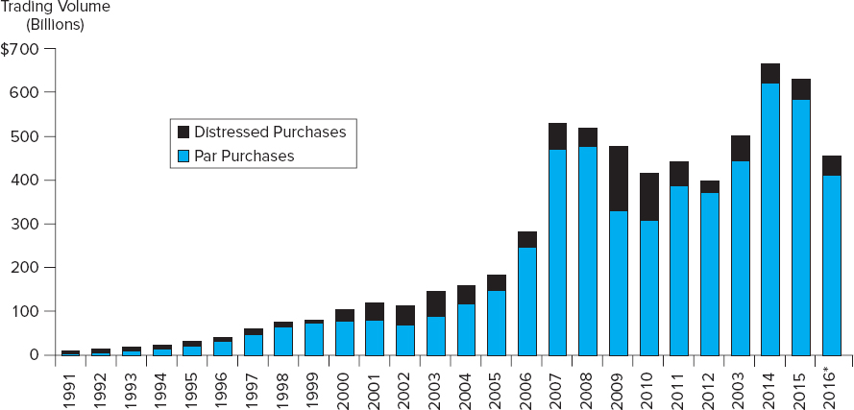
Recent Trends in the Loan Sales Market
Figure 24.1 Recent Trends in the Loan Sales Market
*Through three quarters
Sources: Thompson Reuters L P C website, 2016, thompsonreuters.com
Access the long description slide.

Slide 8
The Buyers
Investment banks are the predominant buyers of H L T loans.
  Adept at the analysis required to value these types of loans.
  Often are closely associated with the H L T borrower.
Vulture funds are specialized funds that invest in distressed loans.
Other domestic banks.
  Traditional correspondent relationships are breaking down as markets get more competitive.
  Counterparty risk and moral hazard have increased.
  Barriers to nationwide banking have eroded and fewer smaller banks exist now than in the past.

Slide 9
The Buyers and Sellers
Loan buyers (continued).
  Foreign banks are the dominant buyer of U.S. bank loans.
  Insurance companies and pension funds buy long-term loans.
  Closed-end bank loan mutual funds buy U.S. bank loans.
  Nonfinancial corporations: predominantly financial service arms of the very largest companies.
Loan Sellers.
  Major money center banks dominate loan sales.
  Small regional or community banks sell loans to diversify credit risk.
  Foreign banks.
  Investment banks act as loan sellers.
  U.S. government and agencies.

Slide 10
Less Developed Country (L D C) Debt
In recent years, three market segments of sovereign debt have emerged
Sovereign bonds (that is government-issued debt).
Performing loans are original or restructured outstanding sovereign loans on which the sovereign country is currently maintaining promised payments.
Nonperforming loans reflect the secondary market prices for the sovereign loans of countries where there are no interest or principal payments currently being made.

Slide 11
Future Loan Sales Growth
Factors encouraging future loan sales growth.
  Fee income – originating and quickly selling loans can boost an FI’s reported income.
  Liquidity risk - secondary market for loans reduces their illiquidity.
  Capital costs: regulatory capital ratios can be increased by reducing the overall size of the balance sheet.
  Reserve requirements: represents a form of tax that adds to the cost of funding the loan portfolio.
Factors discouraging future loan sales growth.
  Access to the commercial paper (C P) market: many firms now rely on C P rather than bank loans.
  Customer relationship effects: loan sales can harm revenues generated by the F I as current and potential future customers take their business elsewhere.
  Legal concerns such as fraudulent conveyance.
Notes:
Fraudulent conveyance means that a loan sale was conducted improperly or illegally according to the terms of the original loan agreement. In particular, fraudulent conveyance is the transfer of assets at less than fair value made while a firm is insolvent. This activity is prohibited to protect the interests of creditors.

Slide 12
Loan Securitization
Securitization is the process of transforming loans (or other debt instruments) into marketable securities.
Pass-through mortgage securities “pass-through” promised payments by households of principal and interest on pools of mortgages created by FIs to secondary market investors holding an interest in these pools.
Each pass-through security represents a fractional ownership share in a mortgage pool.
Pass-through securitization was originally developed by government-sponsored programs to enhance the liquidity of residential mortgages.
  Ginnie Mae (G N M A), Fannie Mae (F N M A), and Freddie Mac (F H L M C).

Slide 13
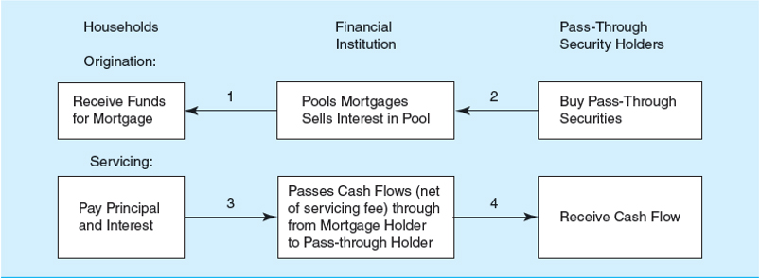
Pass-Through Mortgage Security
Figure 24.2 Pass-Through Mortgage Security
Access the long description slide.

Slide 14
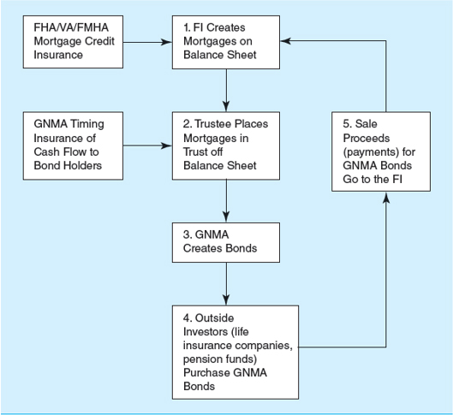
Summary of a G N M A Pass-Through
Figure 24.3 Summary of a G N M A Pass-Through
Access the long description slide.

Slide 15
Prepayment Risk on GNMA Pass-Throughs
Most fixed-rate mortgages are fully amortized.
  Full amortization is the equal, periodic repayment on a loan that reflects part interest and part principal over the life of the loan.
Most mortgages are paid off prior to maturity because borrowers move or refinance their mortgages.
  To prepay is to pay back a loan before its maturity.
Thus, realized cash flows can deviate from expected cash flows.

Slide 16
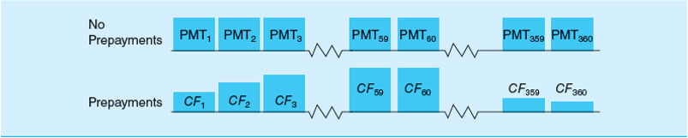
Effects of Prepayments on Pass-Through Bond Holders’ Cash Flows
Figure 24.5 The Effects of Prepayments on Pass-Through Bond Holders’ Cash Flows
Access the long description slide.

Slide 17
Collateralized Mortgage Obligations (C M Os) 1
Collateralized mortgage obligations (C M Os) are mortgage-backed securities issued in multiple classes, or tranches, to provide prepayment protection.
  In a sequential pay C M O, tranches are differentiated by the order in which each class is paid off.
  Each class has a guaranteed coupon payment, but prepayment of principal occurs sequentially to only one class of bondholder at a time.
  Thus, some classes of bondholders are more protected against prepayment risk than others.

Slide 18
Creation of C M Os
C M Os are usually created by placing existing pass-through securities in a trust off-the-balance-sheet
The trust issues three different classes, each with a different level of prepayment risk.
  Class A C M O holders have the least prepayment protection, and are of great interest to investors seeking short-duration mortgage-backed assets to reduce the duration of their mortgage-related asset portfolios.
  After all Class A C M Os have been retired, Class B C M O holders receive principal prepayment cash flows.
  Finally, Class C has the most prepayment protection, and are attractive to insurance companies and pension funds.
Notes:
CMOs may also be creating by packaging and securitizing whole mortgage loans.
Note: each class also receives regular coupon (interest) payments

Slide 19
Initial Payments on a Three-Class Agency C M O
Month 1 | Amount paid into pool in Month 1 | Amount paid into pool in Month 1 | $2 million | Blank
Class | Beginning Balance | Interest Due & Paid | Actual Principal reduction | End Balance
A | $50,000,000 | $375,000 | $2 mill − $1,125,000 =$875,000 | $49,125,000
B | $50,000,000 | $375,000 | Blank | $50,000,000
C | $50,000,000 | $375,000 | Blank | $50,000,000
Blank | Total | $1,125,000 | Blank | Blank
Month 2 | Amount paid into pool in Month 2 | Amount paid into pool in Month 2 | $3 million | Blank
Class | Beginning Balance | Interest Due& Paid | Actual Principal reduction | End Balance
A | $49,125,000 | $368,437 | $3 mill − $1,118,437 = $1,881,563 | $47,243,437
B | $50,000,000 | $375,000 | Blank | $50,000,000
C | $50,000,000 | $375,000 | Blank | $50,000,000
Blank | Total | $1,118,437 | Blank | Blank

Slide 20
Collateralized Mortgage Obligations (C M Os) 2
The sum of the prices at which C M O classes can be sold normally exceeds that of the original pass-through.
  The C M O’s restructured prepayment risk makes each class more attractive to specific classes of investors.
  C M Os with up to 17 different classes have been created.
C M Os often contain a Z class that accrues, but does not pay, interest (or principal) until all other classes have been fully retired.
Another special C M O class is a planned amortization class (P A C).
  Produces a constant cash flow within a band of prepayment rates.
  Offers greater predictability of cash flows.
  Has priority in receiving principal payments.

Slide 21
Mortgage-Backed Bond
Mortgage- (asset-) backed bonds (M B Bs) are bonds collateralized by a pool of assets
M B Bs differ from pass-throughs and C M Os.
  Mortgages remain on the balance sheet.
  Mortgages collateralize M B Bs, but are not directly related to the associated cash flows.
FIs usually back M B Bs with excess collateral, which results in a higher investment rating for the M B B than for the issuing F I
M B B costs.
  M B Bs tie up mortgages on the balance sheet for long periods of time.
  The F I is subject to prepayment risk on the underlying mortgages.
  The F I continues to face capital adequacy and reserve requirement taxes as the mortgages remain on the balance sheet.

Slide 22
Securitization of Other Assets
The same securitization techniques applied to mortgages have been used to securitize other assets:
  Automobile loans.
  Credit card receivables (C A R Ds).
  Small-business loans guaranteed by the Small Business Administration.
  Commercial and industrial loans.
  Student loans.
  Equipment loans.
  Junk bonds.
  Adjustable-rate mortgages.

Slide 23
Can All Assets be Securitized?
Can all assets and loans eventually be securitized?
  In theory – yes, so long as doing so is profitable or the benefits to the F I from securitization outweigh its costs.
With heterogeneous loans, the salient features should be standardized, default risks should be reduced via diversification, and expected maturities should be reasonably similar.

Slide 24
Benefits versus Costs of Securitization
Table 24.6 Benefits versus Costs of Securitization
Benefits | Costs
New funding source (bonds versus deposits). Increased liquidity of bank loans. Enhanced ability to manage the duration gap and thus interest rate risk. A savings to the issuer (if off balance sheet) on reserve requirements, deposit insurance premiums, and capital adequacy requirements. | Public/private credit risk insurance and guarantees. Overcollateralization. Valuation and packaging (the cost of asset heterogeneity).

Slide 25
Recent Trends in the Loan Sales Market Long Description
The bar graph gives the trading volume in billions for each of these years broken down by the volume of distressed purchases and par purchases. The volume rose steadily from about 10 billion in 19 91 to a peak of about 600 billion in 2014. The majority of each bar is par purchases, and approximately an average of 5% of each bar is distressed purchases.
Return to slide containing original image.

Slide 26
Pass-Through Mortgage Security Long Description
Households receive funds for mortgage.
Financial institution pools mortgages sells interest in pool.
Servicing: pay principal and interest.
Passes cash flows net of servicing fee) through from mortgage holder to pass-through holder and cash flows are received.
Return to slide containing original image.

Slide 27
Summary of a GNMA Pass-Through Long Description
FHA / VA / FMHA mortgage credit insurance creates mortgages on the balance sheet. GNMA timing insurance of cash flow to bond holders trustee places mortgages in trust off balance sheet. Then the GNMA creates bonds. Next the outside investors (life insurance companies, pension funds) purchase GNMA bonds. Finally sale proceeds (payments) for GNMA bonds go to the financial institution.
Return to slide containing original image.

Slide 28
Effects of Prepayments on Pass-Through Bond Holders’ Cash Flows Long Description
When there are no prepayments, the 360 payments are of the same size. When there are prepayments, the cash flows vary in size, increasing steadily until the end of the term.
Return to slide containing original image.

